Slide 1
MENTOR CONNECT Manchester School District Edition 2016 Plan April 12th, 2016 Nischal Chandra, Technology Chair nchandra@nccbl.org

Slide 2
Outline
Introduction
Proposed Architecture
Current Implementation
Common/Main Starting Page
Public Search Results
Public Specific Search Result
Mentor Login
Mentor View/Edit Profile
Google Android Mobile App (In Progress)
Next Steps

Slide 3
Introduction
Mentor Connect will be a big-data / analytics based website, tablet app, mobile app, and smart watch app platform and system which will enable mentors to engage with students.
This presentation contains the screen shots of the demo for the Mentor Connect – MSD Edition that was delivered to Dr. Debra Livingston, Superintendent for the Manchester School District on February 18, 2016.
MSD Edition is still being evolved and redesigned based upon feedback from stakeholders.
The active URL for the system is: http://nccbl.org/mentors

Slide 4
Proposed Architecture
Mentor Connect
aims to attract / engage the busiest of mentors through its web, mobile, and smart watch platforms …
Mentor Connect:
Big-data and analytics based website, tablet
app, mobile app, and smart watch app platform and system which will enable
mentors to engage
with students
Web & Mobile Web
Apple & Google Mobile Apps
Apple & Google Smart Watch Apps
Primary
Compute / Data / AI Server
Secondary
Compute / Data / AI Server
Client 1
Laptop
Client 2
Laptop
Client 3
Laptop

Slide 5
Current Implementation
Current implementation of Mentor Connect is via N. Chandra’s personal system / services, i.e., “Client 1 Laptop”, “Web & Mobile Web”, and “Google Mobile App - in progress” …
Mentor Connect:
Big-data and analytics based website, tablet
app, mobile app, and smart watch app platform and system which will enable
mentors to engage
with students
Web & Mobile Web
Apple & Google Mobile Apps
Apple & Google Smart Watch Apps
Primary Compute / Data / AI Server
Secondary Compute / Data
/ AI Server
Client 1
Laptop
Client 2
Laptop
Client 3
Laptop

Slide 6
Common / Main Starting Page
Links To
Mentors (functional)
Parents
Students
Educators
Searching Mentors
By
Career Paths
Competencies

Slide 7
Public Search Results
Example of publicly
viewable search results

Slide 8
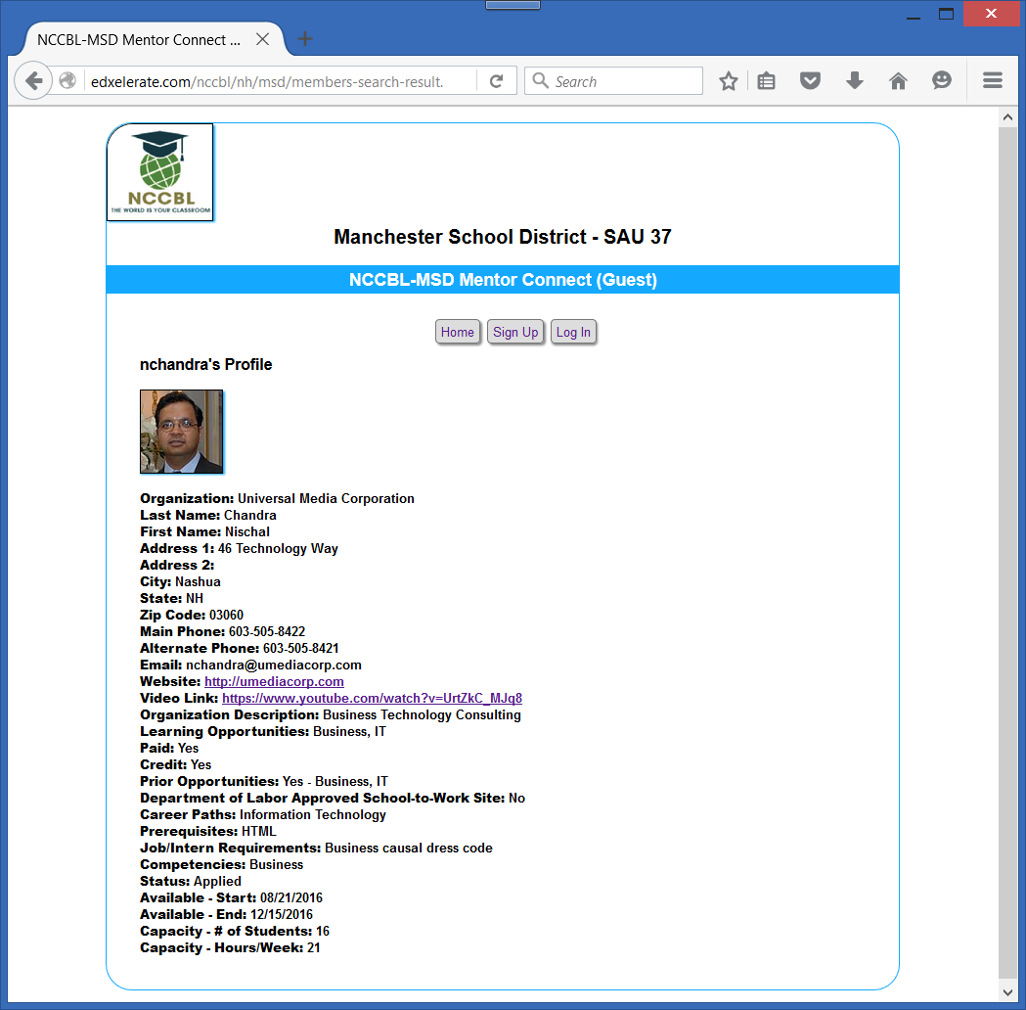
Public Specific Search Result
Example of a publicly
viewable search result

Slide 9
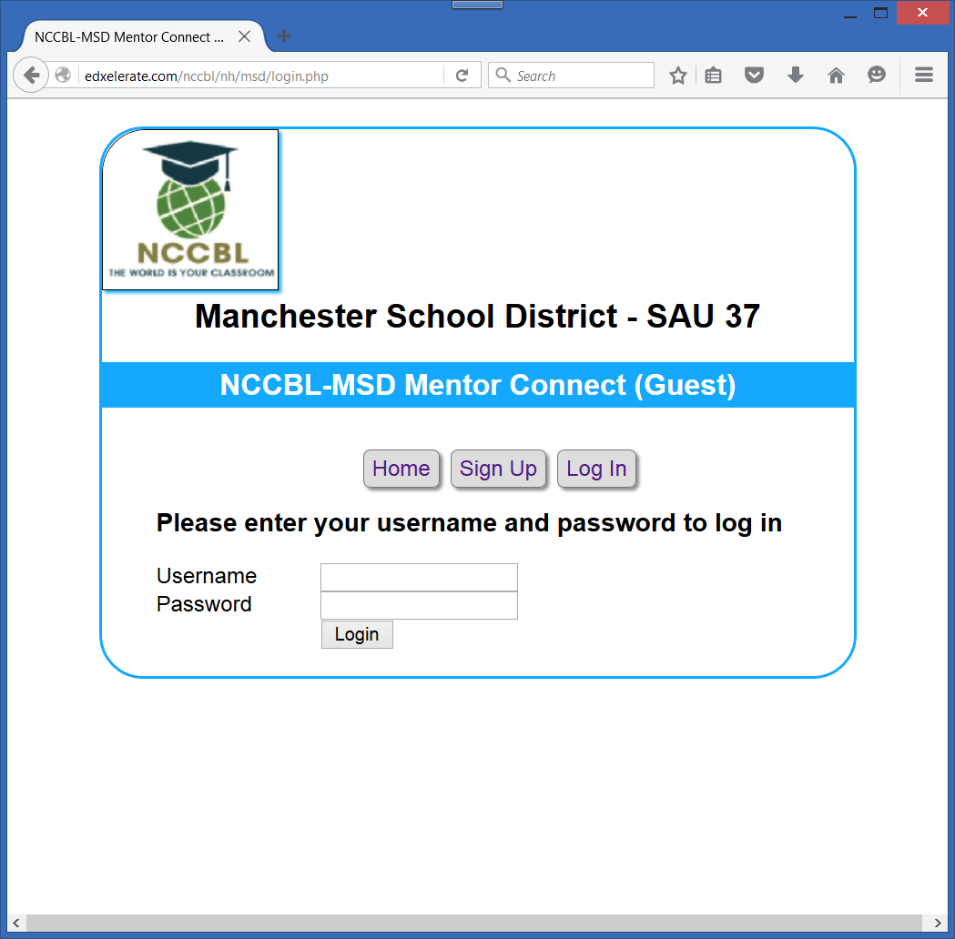
Mentor Login
Where a Mentor would
log in

Slide 10
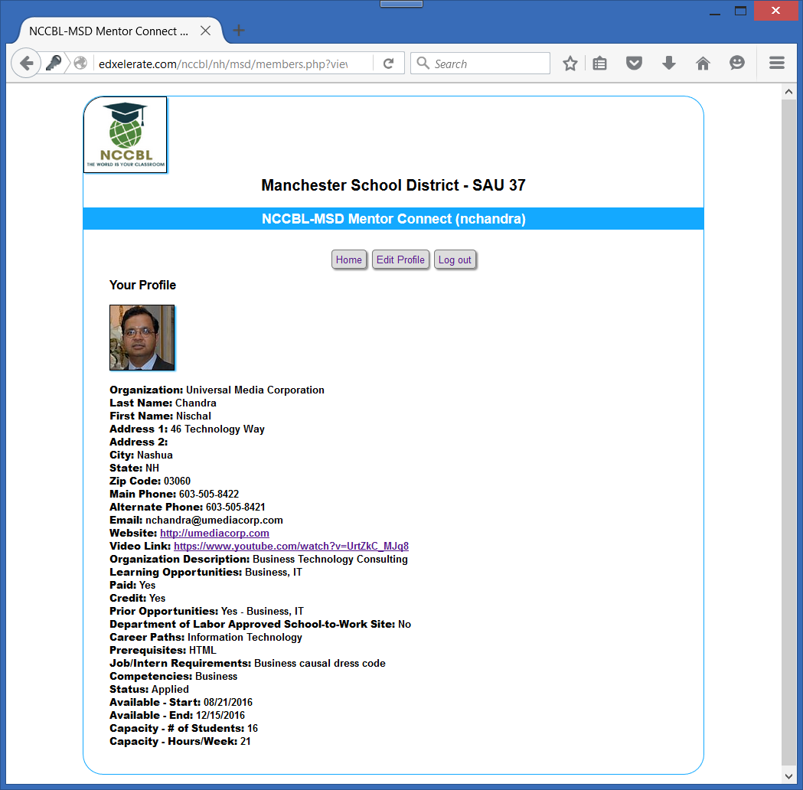
Mentor View / Edit Profile
Once a Mentor logs in, s/he can
view and/or edit her/his profile

Slide 11
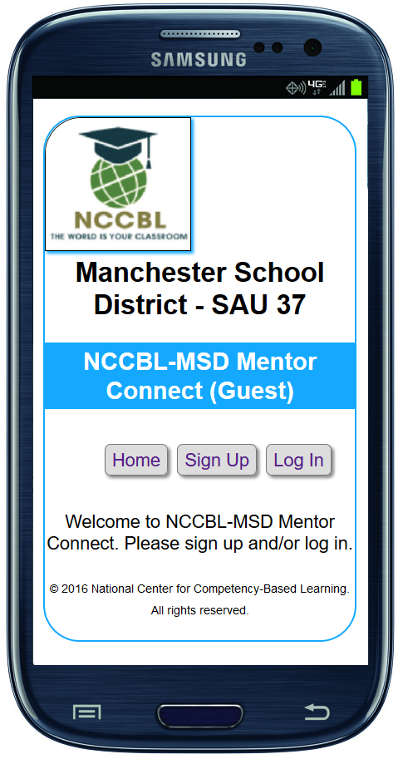
Google Android Mobile App (In Progress)
The design and development of a Google Android mobile app is in progress. Full capability for Mentors to manage their information in real-time is currently available. During the demo, this app successfully made changes to a mentor’s information and it was reflected both in the app and the website.

Slide 12
Next Steps
This project resonated with Dr. Livingston and she suggested that NCCBL move forward with a pilot program with a small group of community partners.
The pilot program was officially launched on February 18th, 2016 and is currently in progress, with its next checkpoint on August 18th, 2016.
In order to execute the project plan, NCCBL is actively seeking financial support for the pending information technology development, support, infrastructure, software, and services.

