Slide 1
Underserved Youth on the greater seacoast
Chase Home serves youth in crisis.
New Heights serves at-risk youth.
www.chasehome.org
www.newheightsonline.org

Slide 2
Data from NH 2015 Youth Risk Behavior Survey of 57,326 students
1. 10.8% drank alcohol before age 13, 2. 29.9% currently drink alcohol, 3. 22.2% currently use marijuana, 4. 6.8% currently use prescriptions without a doctor’s Rx, and 5. 15.3% considered attempting suicide.

Slide 3
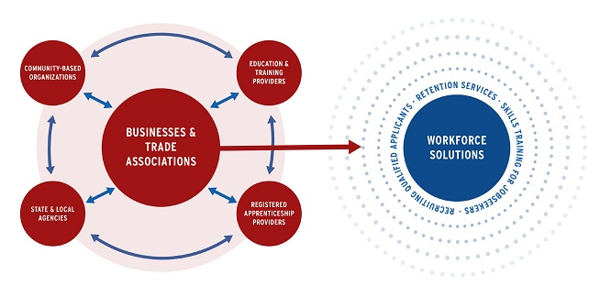
The above graph represents an image from the sector partnerships initiative. Chase Home and New Heights intersect with three of these concentric circles on the left.

Slide 4
PROPOSED PILOT PROGRAM ON THE SEACOAST The Opportunity, part 1
New Heights has developed STEAM programs with industry leaders, but requires targeted resources to expand, including mentors.
Chase Home works with youth in crisis through the age of 18, but does not have an embedded career pathway for graduates.

Slide 5
The Opportunity, part 2
Collectively, Chase Home and New Heights work with underserved youth who require extra supports, which we both provide.
We need assistance, however, creating more concrete career pathways for New Heights and Chase Home youth.

Slide 6
The Opportunity, part 3
Collectively, we possess established relationships with area schools, police departments, local courts, the Office of Juvenile Justice and Delinquency Prevention (OJJDP), community health centers and other agencies.
These relationships can be leveraged to advance the mission of NHCBE

Slide 7
CONTACT US
Rob Levey CHASE HOME BOARD PRESIDENT and CEO, Exponential Squared
rob@exponentialsquared.com
Meme Wheeler, Chase Home Executive Director
mwheeler@chasehome.org

