Slide 1


Strategic Executive Board
Region 17

Slide 2
Oversight of CTE
NH DoE
Carl Perkins Career & Technical Education Act
Local/District Oversight
Region 17
Strategic Executive Board
Management Committee
Center/Program Specific Advisory Committees

Slide 3
Region 17

Slide 4
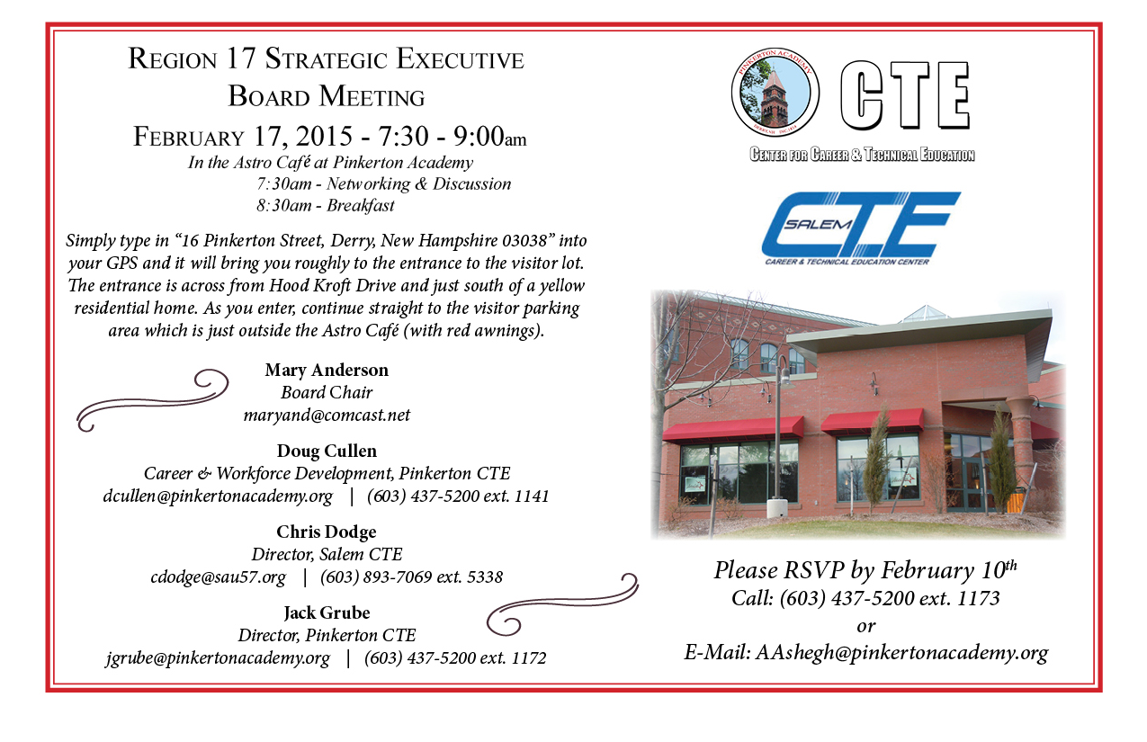
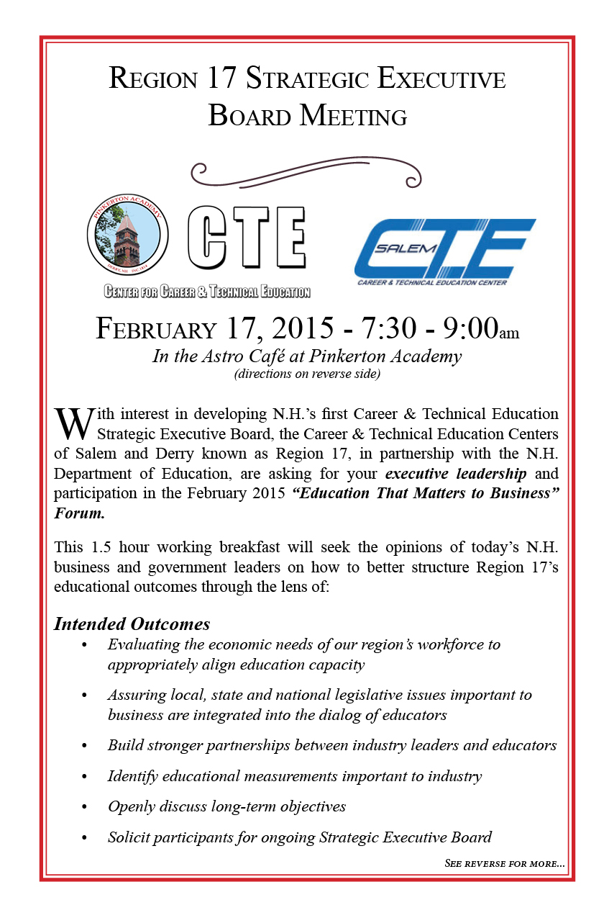

Slide 5
The purpose of the Region 17 Strategic Executive Board is to provide high altitude oversight by a diverse set of stakeholders. Initial charges include:
Examine our operations from an outside perspective
Build capacity and help us to connect with our larger communities
Evaluate the strategic fit between the current and future needs of the region’s within the workforce and the economy with our Centers
Develop opportunities for students and staff they could never realize otherwise
Improve advocacy and communication
Provide oversight with the evaluation of our Centers

