Slide 1

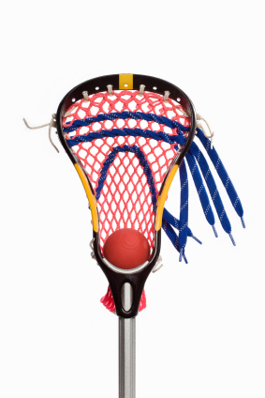
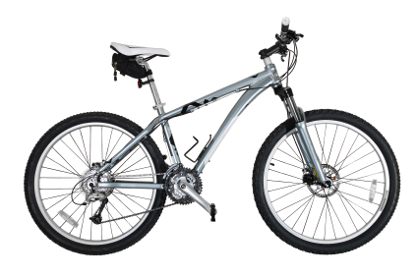





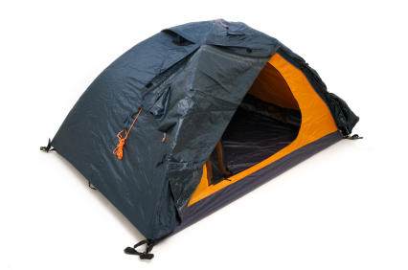


Slide 2


NHInternships.com

Slide 3

Employers 470 → 940 (562 current)
Students 150 → 300 (246 current)
Increase number of internships in NH

Slide 4


Slide 5
Come Stay Work Play NH

Slide 6


Claremont Concord Keene Lebanon Manchester Nashua
May 3, 2017
stayworkplay.org/stayworkplaygive

Slide 7

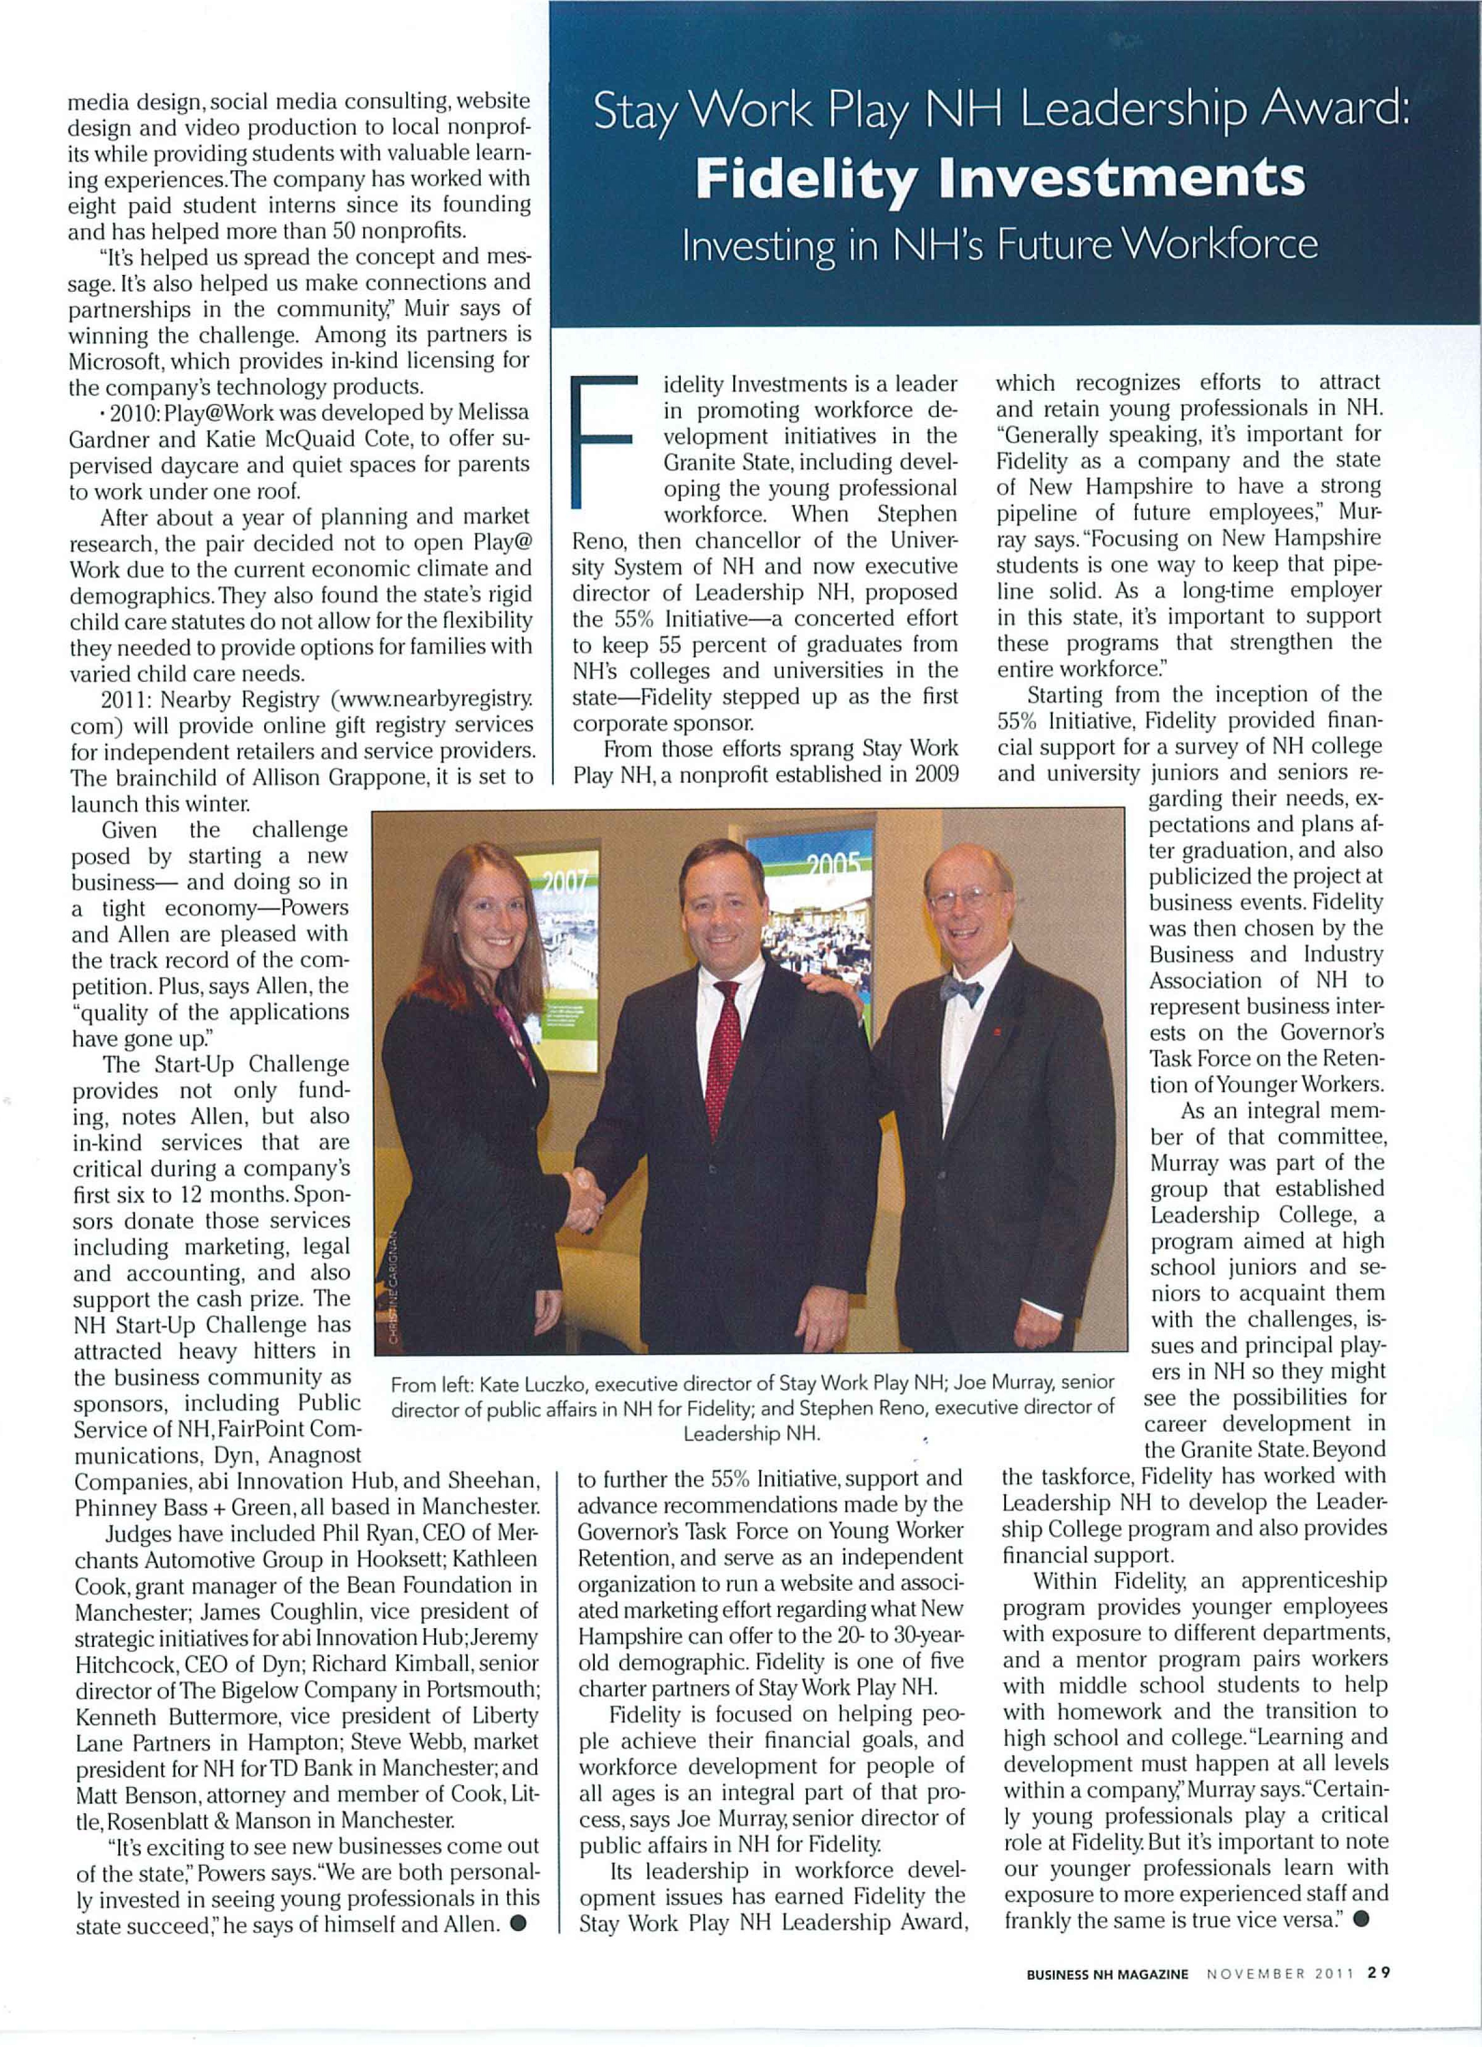

Nominations open until July 21st!
stayworkplay.org/risingstarsawards

