Slide 1
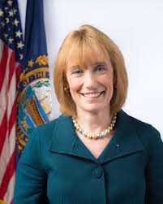
THE CHARGE
Governor Hassan’s Charge to the Task Force:
“[t]o help young people develop the skills and innovative thinking needed for jobs that growing businesses are creating here in New Hampshire
. . . to ask tough questions about how we can best educate our young people, especially in the STEM fields of science, technology, engineering and math.”
Organized: May 2014
Reported recommendations: January 2015
Reconstituted: July 2015

Slide 2
Task Force Representation
Colleges
&
Universities
NH Teachers of Mathematics Association
(NHTM)
Business
&
Industry
Girls in STEM
NH Superintendent’s Association
NH Science Teachers’ Association
Early Childhood Education
NH Principals’ Association
12 participating entities
Parents
NH School Boards
NH Department of Education
CTEs

Slide 3
FOUR AREAS OF CONCENTRATION
Inspiring Students
Foundations
in STEM
Empowering
Teachers
Communication
&
Engagement

Slide 4



FOUNDATIONS IN STEM
Traditional approaches are not preparing students for 21st century STEM careers. Strong STEM foundation and integration of STEM is critical for a wide range of careers from biology, to health care, to IT, to engineering.
RECOMMENDATIONS:
Create alternative (to pre-calculus/calculus) math pathways --- statistics/quantitative reasoning, linear algebra
Integrate Coding in the curriculum
Support Next Generation Science Standards

Slide 5

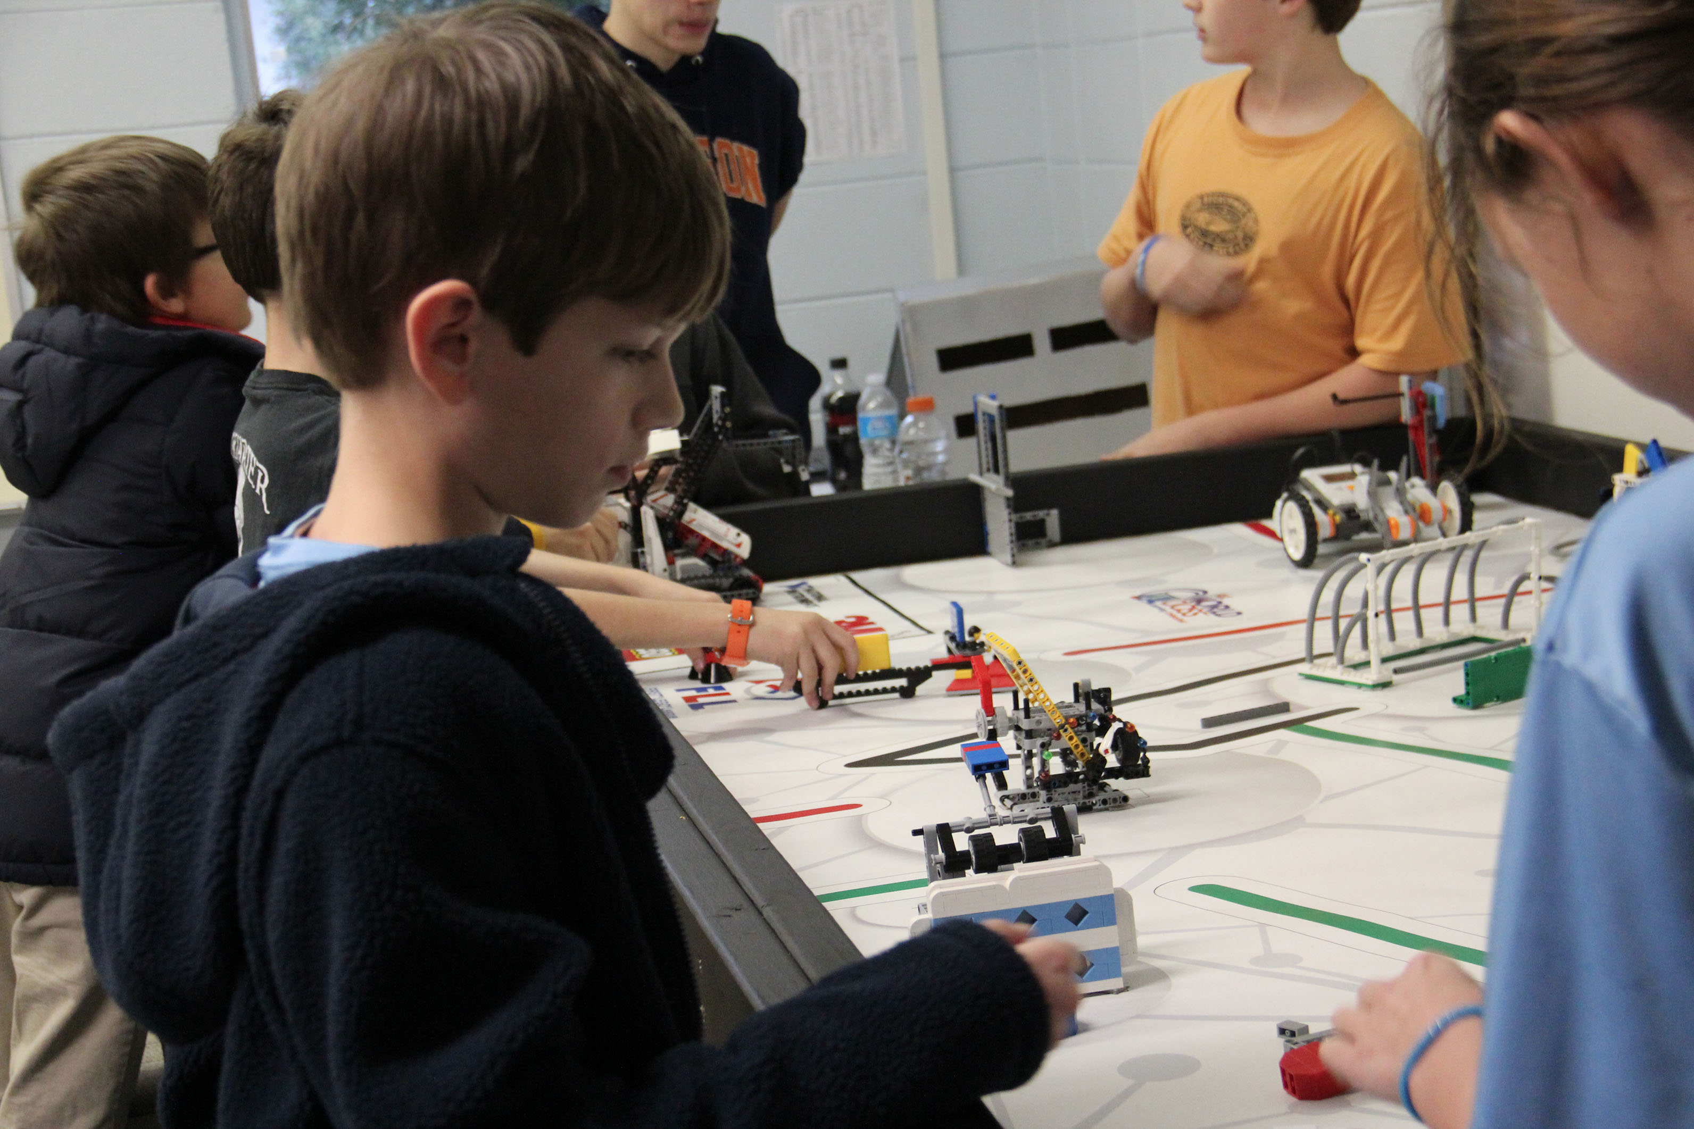

INSPIRING STUDENTS
Students have natural curiosity and interest in STEM at an early stage but too often that interest goes away with STEM teaching by rote or by textbook

Slide 6
INSPIRING STUDENTS
RECOMMENDATIONS:
STEM Challenges, Competitions and Capstones.
STEM Early College Academy for Math and Science Excellence
STEM foundations in CTE programs, including in early college opportunities
Expose middle schoolers to career options and Personal Learning Plans
Support girls in STEM careers

Slide 7
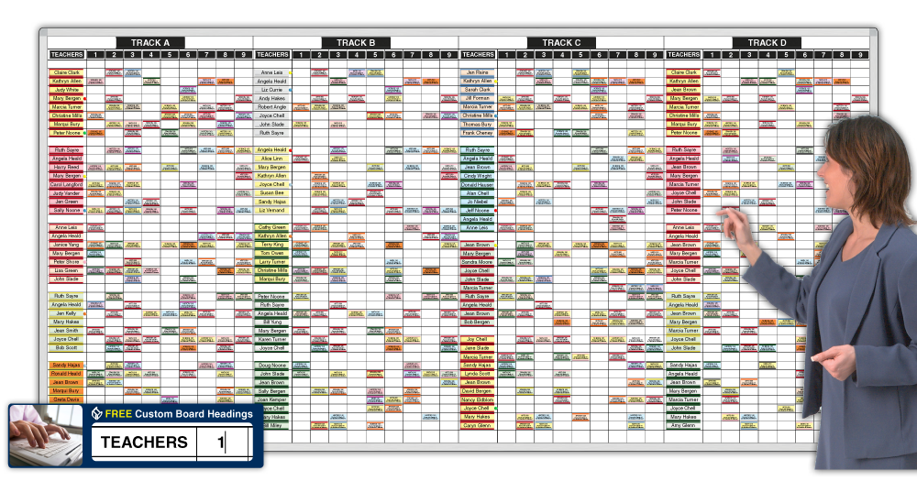



EMPOWERING TEACHERS
Key Barriers:
Tightly packed teaching schedules
Use of existing pedagogy
Lack of hands-on-experience
Limited applied science expertise (K-8)
RECOMMENDATIONS:
Pioneer new STEM teacher preparation and development programs
Support of teacher efforts to incorporate STEM learning “every day in different ways”
Notes:
Key barriers to STEM education are tightly packed K-12 teaching schedules, use of existing pedagogy, lack of hands-on learning opportunities and limited applied science expertise among K-8 teachers.
The Task Force is working with the NH DoE to reformulate STEM teacher preparation programs and enhanced professional development including micro-credentialing

Slide 8






COMMUNICATIONS & ENGAGEMENTS
Despite many strong STEM programs throughout the state, information about these activities is limited. The Task Force will create a communications hub website to organize and centralize information in an easy-to-access format.
STEM career professionals are volunteering for school visits and organizing STEM career days.

Slide 9
Gratitude Dyn Hypertherm NH Ball Bearings Northeast Delta Dental NH Charitable Foundation as our fiscal agent Others? Thank you!

