Slide 1

Initiative Updates: STEM from the Start
NHCBE Meeting • 09.28.2017

Slide 2
Program Updates
STEM from the Start lessons are being used in NH classrooms, homeschools and aftercare programs. Feedback has been highly positive.
Since January, the SFTS website has been getting a steady flow of new & returning users, with over 14,500 page views. Average stays for this month ≈ approx. 19 min/session.
SFTS is being recommended as a resource by a growing # of national forums:
The Cooney Center (Sesame Street's Research Arm)
Common Sense Education
National Conference of State Legislators
Notes:
Slide 1: lessons are being used in 1, 2, 3 .. highly posititve
Website

Slide 3
Inititatives
4 more episodes are in development with a projected delivery of March 2018. (This will complete our coverage of the NGSS Physical Science Standards!)
A quantitative assessment of SFTS' effectiveness in 25 NH classrooms across the state. This effort will be lead by Dr. Lauren Provost.
Our partner, NH PBS, is creating a sponsorship program that maximizes the amount of TV & Internet exposure a company gets for sponsoring a SFTS lesson.

Slide 4
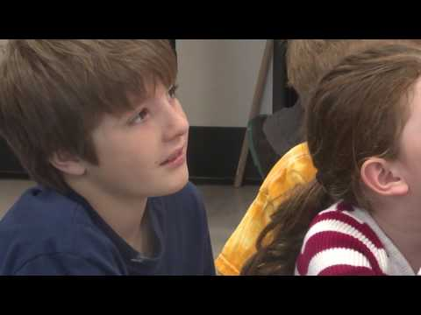
Notes:
https://youtu.be/g2Rf5ar-s9c

Slide 5
Get Involved!
We need your help!
Get in touch to become a SFTS sponsor.
Funding will go towards…
Developing a first-of-its-kind STEM curriculum for early learners
Supplying free & accessible resources to K-2 educators/parents in NH
Providing free educator workshops across state (in partnership w/ NHDOE)
Sponsors of SFTS get...
TV & internet exposure New Hampshire’s PBS station
PR & marketing campaigns based around org’s participation in community initiatives, like DOE workshops (incl. NH PBS’ mailing list of 35,000 subscribers!)
...& much more!
www.STEMfromtheSTART.org
Georgia Maguire // georgia@stemfromthestart.org

