Slide 1
NH’s College and Career Readiness Research
Fall 2019
Preliminary Findings
Notes:
About the New Hampshire Alliance for College and Career Readiness
The New Hampshire Alliance for College and Career Readiness is a coalition of organizations representing K-12, post-secondary education, nonprofit, and business and industry sectors, with the shared goal of college and career readiness for all students. It is unique in its vision of harnessing community-level insights, experiences, and innovations to work in concert with system-wide strategy, research, analysis, and implementation
Guiding Research Questions
How does college and career-readiness look across NH?
Are there differences across and within counties?
Do different students experience CCR differently?
Do all students have access to rigorous coursework offerings?
This project collected data from:
The U.S. Department of Education’s Office of Civil Rights 2015-16 Data Collection on high school Science, Technology, Engineering, and Mathematics (STEM) courses, Advanced Placement (AP) courses and exams, and dual enrollment, including student participation by group.
New Hampshire Department of Education on SAT test scores compared with the college-readiness benchmark, Career and Technical Education (CTE) program offerings, and high school graduation.
Federal data on Career and Technical Education Participation and Performance through the Perkins Data Explorer.
The New England Secondary Schools Consortium data on high school graduation, college enrollment, college persistence, and college completion.
Integrated Postsecondary Education Data Set (IPEDS) data from the National Center for Education Statistics on college enrollment by institution in New Hampshire.

Slide 2
Executive Summary of Key Findings
New Hampshire’s high school graduation rates exceed New England and national rates, but the percent of graduates going to college dropped 4% between 2014-16 and is well below the national average.
Due to demographic shifts, between the 2008-09 and 2018-19 academic years, high school enrollment dropped 14% statewide, with some rural communities seeing declines of 20% or more.
The decline in the number of students continues at younger ages. Between the 2008-09 and 2018-19 academic years, middle school (Grades 5-8) enrollment dropped 11% statewide and elementary school (Grades 1-4) dropped 12%.

Slide 3
Executive Summary of Key Findings
The non-white school-age population has grown from 8% of the total 10 years ago to 15% today. There has been a similar percentage growth in children with disabilities.
On average, New Hampshire students outperform other New England states with mandatory SAT requirements, but less than half of the test takers are meeting the math benchmark.
The vast majority of high schools offer calculus, physics and dual enrollment courses, 5% of students take calculus, 13% take physics in New Hampshire and 5% enroll in dual enrollment classes.

Slide 4
NH Enrollment Data

Slide 5
2018-2019 School Year | # of students | % of students
Student Enrollment: Pre-K - 12 | 177,369
Student Enrollment: K - 12 | 173,138
Student Enrollment: 1 - 12 | 158,229
Free/Reduced Lunch Eligible (1 – 12) | 42,981 | 27.2%
Students with Disabilities (K - 12) | 27,645 | 16.0%
Limited English Proficiency (Pre-K- 12) | 4,938 | 2.8%
American Indian or Alaskan Native (Pre-K - 12) | 440 | 0.2%
Asian or Pacific Islander (Pre-K - 12) | 6,022 | 3.4%
Hispanic (Pre-K - 12) | 11,567 | 6.5%
Black (Pre-K - 12) | 3,695 | 2.1%
White (Pre-K - 12) | 150,666 | 84.9%
Multi-Race (Pre-K - 12) | 4,976 | 2.8%
Notes:
1. So let’s start with who our students are, and this table has three rows with total student enrollment of sorts. The Department of Ed collects data that is sometimes pre-K- 12, K-12, or 1st through 12. And we’ve left this in for you, so that you know when we’re sharing percentages or data, we’re using the appropriate student count.
a. There were about 173,000 students enrolled in public school this past year. 27.2% were eligible for Free or Reduced Price Lunch.
b. In 2017, children in a family of four with income at or below $45,510 qualified for Free or Reduced Lunch.
c. 16% of our public school students have been identified as having special needs – and there is a wide range: specific learning disabilities, developmental delay, visual impairments, speech or language impairments…it’s a very wide category.
d. There are almost 5,000 students who are classified as “Limited English Proficient,” which means they are emerging dual or multi-lingual English learners.
e. And then we have our race and ethnicity break down in the state.

Slide 6
NH High School Enrollment
New Hampshire’s public and charter schools enroll 55,757 students in grades 9 to 12, down 14% from 64,939 students in 2008-09.

Slide 7
County | High School Enrollment |  | % change, 2008-09 to 2018-19
 | 2008-09 | 2018-19
Belknap | 3,308 | 2,642 | -20%
Carroll | 1,979 | 1,651 | -17%
Cheshire | 3,109 | 2,448 | -21%
Coos | 1,627 | 1,174 | -28%
Grafton | 4,142 | 3,472 | -16%
Hillsborough | 22,231 | 18,660 | -16%
Merrimack | 6,049 | 5,227 | -14%
Rockingham | 15,404 | 14,514 | -6%
Strafford | 5,231 | 4,477 | -14%
Sullivan | 1,859 | 1,492 | -20%
Total | 64,939 | 55,757 | -14%

Slide 8
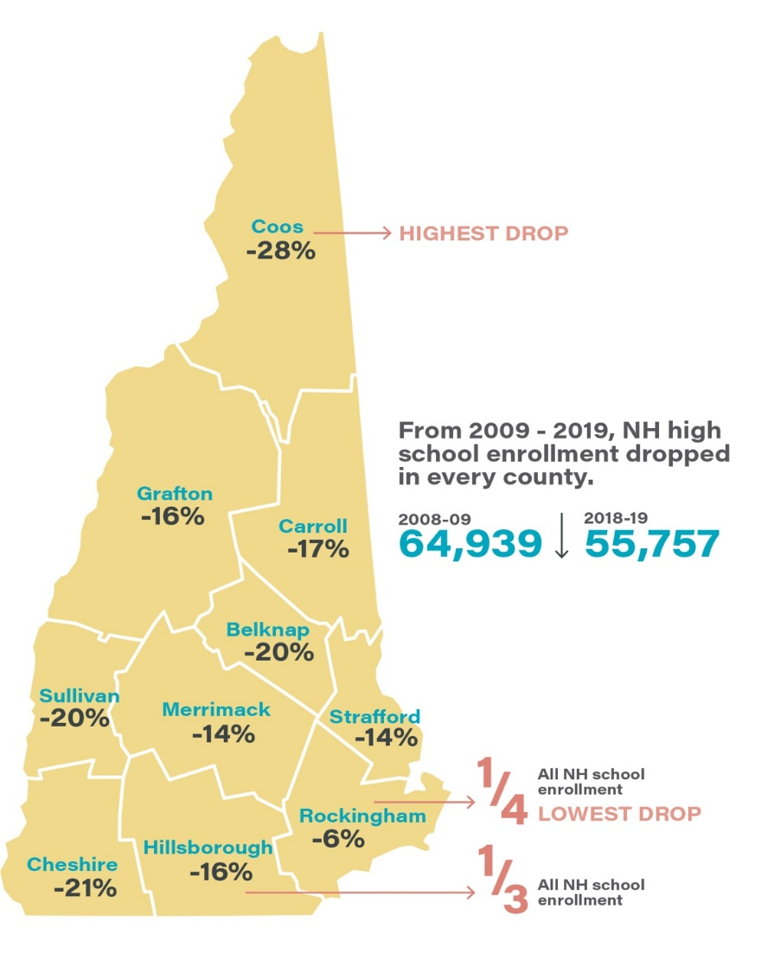
NH High School Enrollment

Slide 9
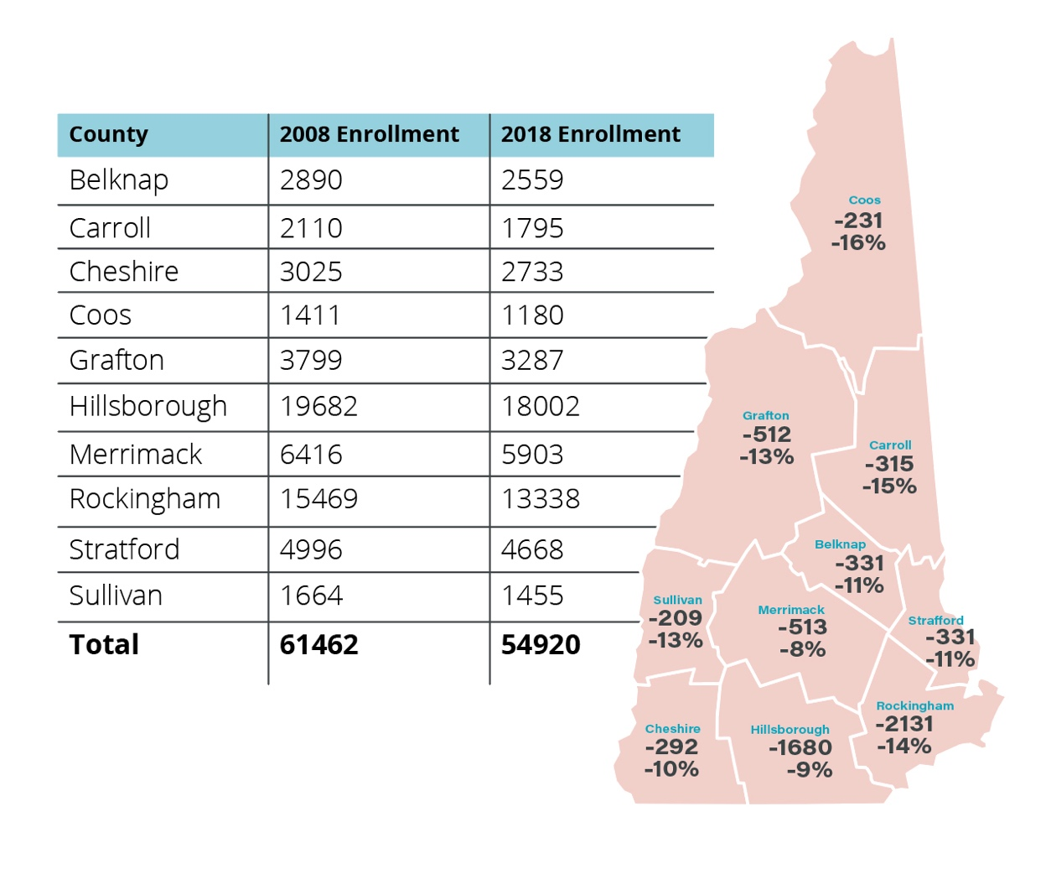
NH Middle School Enrollment (Grades 5-8)
Notes:
NH Middle School (Grades 5-8) Enrollment
New Hampshire’s public and charter schools enrolled 54,920 students in Grades 5-8 for the 2018-19 school year. This is a reduction of 11% from 61,462 students in 2008-09. The largest losses are not primarily in rural counties as they were in the high school numbers presented earlier in this report. Like the high school enrollments, no county saw growth. In fact, the county with the lowest loss of high school students was Rockingham County – with a 6% drop – is showing the second highest drop of middle school students at 14%.
Like the high school numbers, Rockingham and Hillsborough counties include New Hampshire’s largest urban areas and have the highest population density. When combined, 57% of the state's middle school students live in Hillsborough and Rockingham counties in 2018-19.
We are tracking similar trends at the elem level. With a 12% decline in the same 10 year period.

Slide 10
NH Graduation Rates

Slide 11
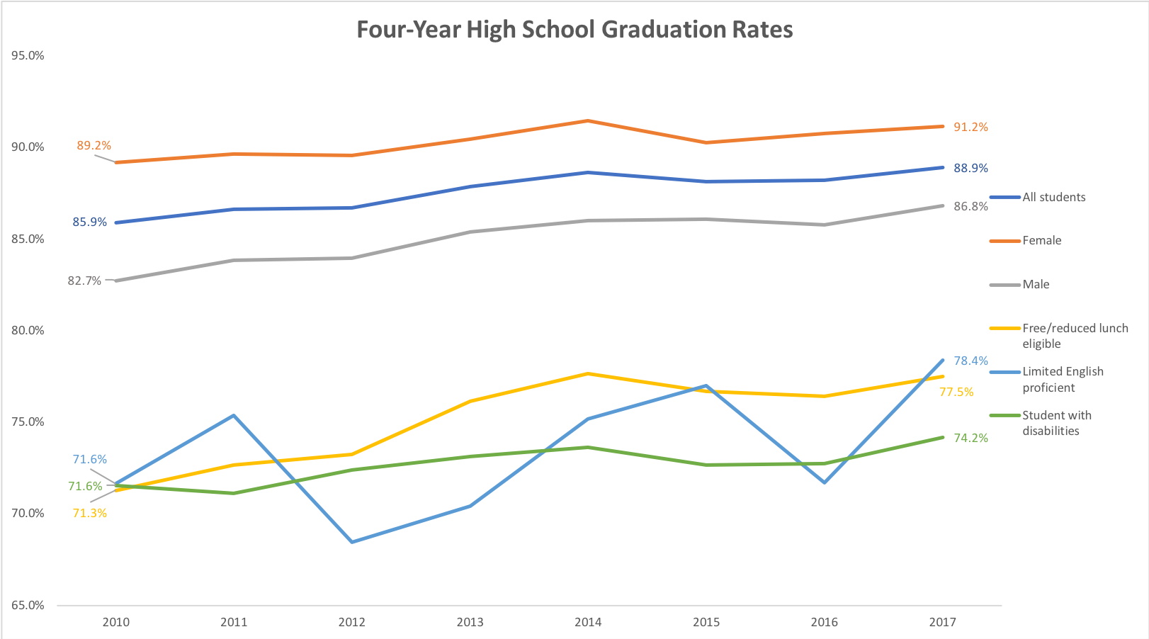
Notes:
By Cohort
There are a few data points on here - let’s zoom in on the dark blue line. In NH, our average graduation rate is 88.9% within four years -- the national average is 85%. Our trend line is going up, as well - but a word of caution, and I know you’ve talked about this in other contexts (**maybe during Phil’s**), which is that our class sizes, each year, are getting smaller. This will be important again in a moment…
Our female students outperform the average, at 91.2%. But let’s look at the yellow line: Our free/reduced lunch eligible students are trending up, but are still only at 77.5%. Our Limited English Proficient students are slightly higher at 78.4% - and students with disabilities...again, a wide range...is the lowest, at 74.2%.

Slide 12
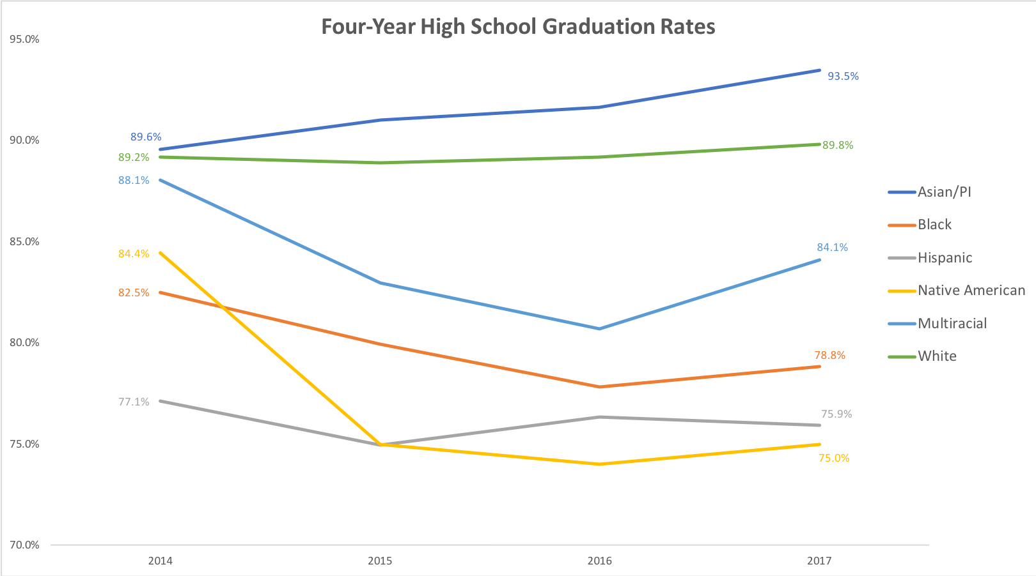
Notes:
By Race and Ethnicity
We are exceeding the national average in overall student graduation rates - our white students perform at the same rate as the national level. Our Hispanic students, however, are at 75.9% here in NH, whereas the national average is 80%. So - there are some cohorts who are graduating at the same rate as what we see nationally, and some who are graduating at lower rates here in NH.
We have limited time today, so I want to zoom in on some college data, since I know you’ve heard about and are closely connected to 65x25 - and beyond that, data regarding students who leave high school and do not enroll in college is extremely limited in New Hampshire.

Slide 13
College Enrollment, Persistence, & Completion

Slide 14
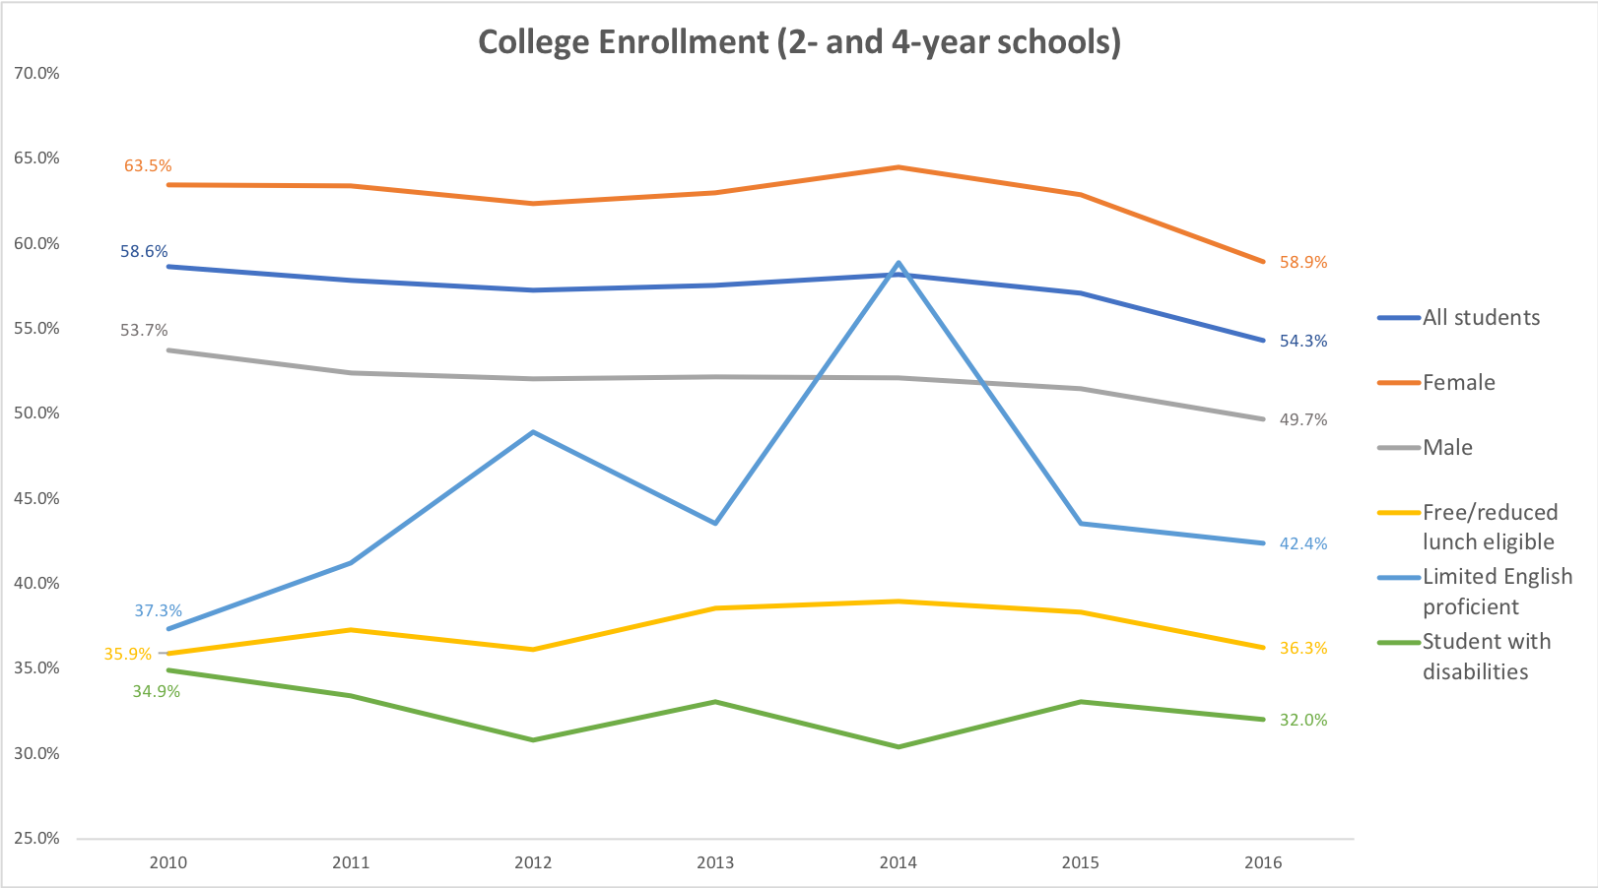
Notes:
This graph shows us college enrollment for students entering 2-year or 4-year schools. Let’s look again at the dark blue line to start - this is trending down since 2010. Remember earlier when I said that our cohorts are getting smaller each year? That means this is even more drastic - 2016 is the smallest graduating class AND the lowest rate of college enrollment. The national average for college enrollment? 67%. So NH is well below the national average.
Free/reduced lunch and students with disabilities? They are at 36% and 32%.
[So let’s pause for a moment. Let’s say 1000 students graduated from all of our NH public schools. 540 enroll in college.]
Let’s take a quick moment to see how students do when they get to college.

Slide 15
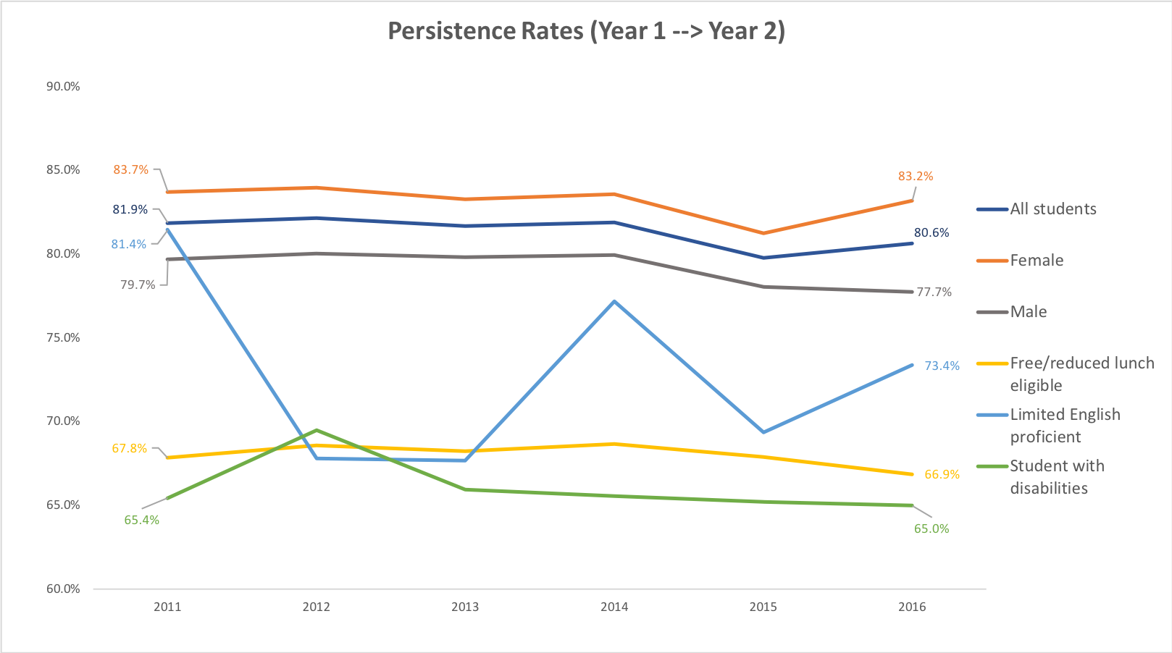
Notes:
The college persistence rate measures students who enrolled their first year, and then reenrolled their second year. Starting with the dark blue line again for consistency - 80.6% of the students who enrolled the first year, returned their third semester. You’ll also see that, for the most part, everyone is remaining flat, maybe even trending slightly down.

Slide 16
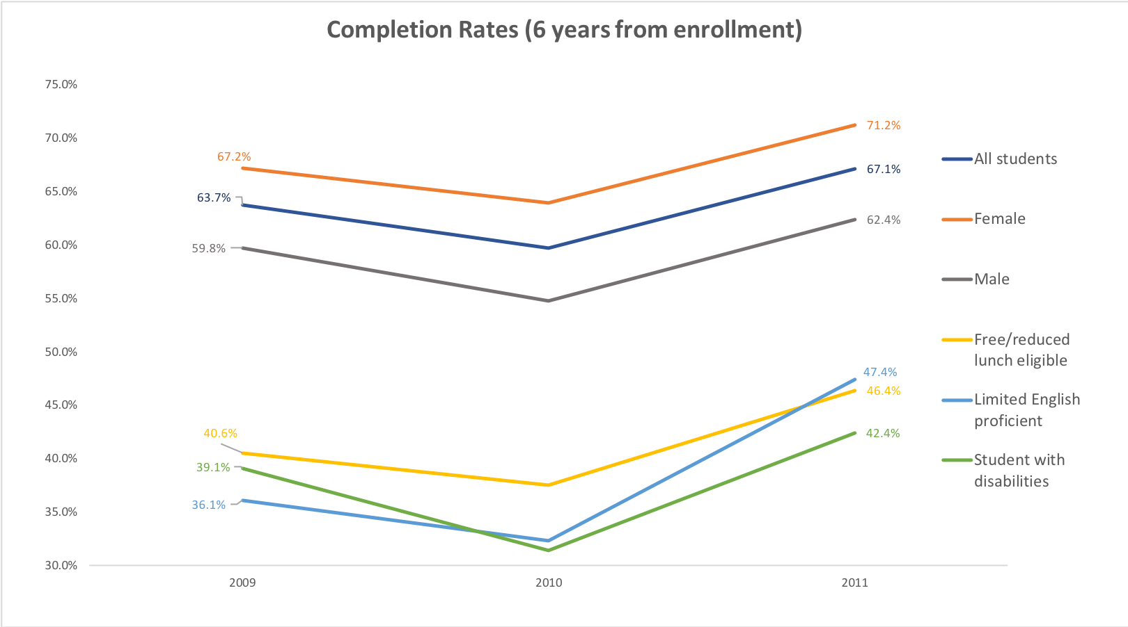
Notes:
And our last college-data point is completion - how many of the students who enrolled completed their degree within six years - the years at the bottom are the years of initial college enrollment. So 2011, for example, measures students who enrolled in college for the first time in 2011, and completed by 2017.
Dark blue line -- 67.1% of students who enrolled in college completed a degree within 6 years.
It also behooves us to look at FRL, LEP, and students with disabilities - and their rates of college completion fall under 50%. That’s a big deal.

Slide 17
2018 SAT Data
Junior Test day

Slide 18
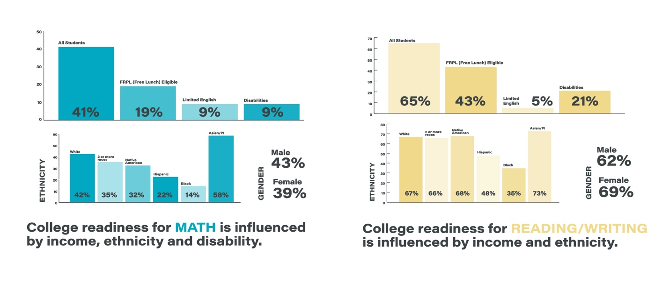
NH SAT Data
Sub-Group Reporting

Slide 19
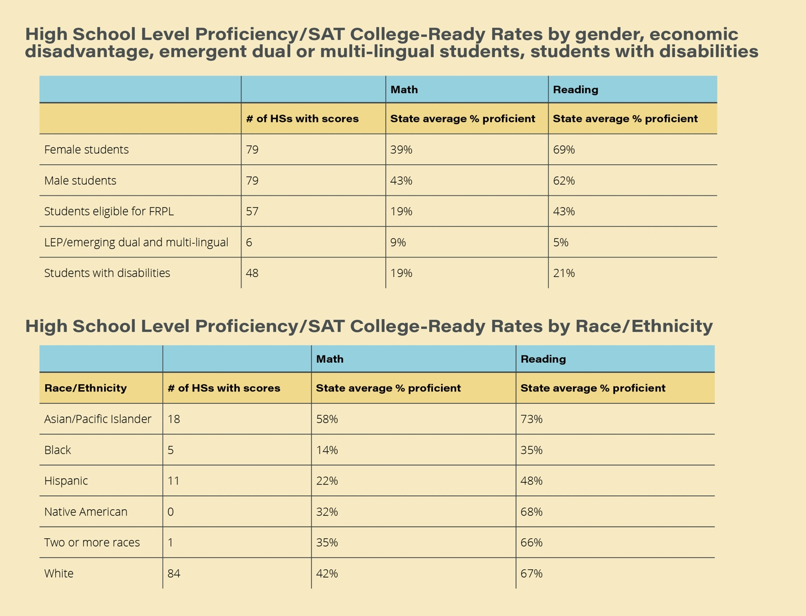

Slide 20
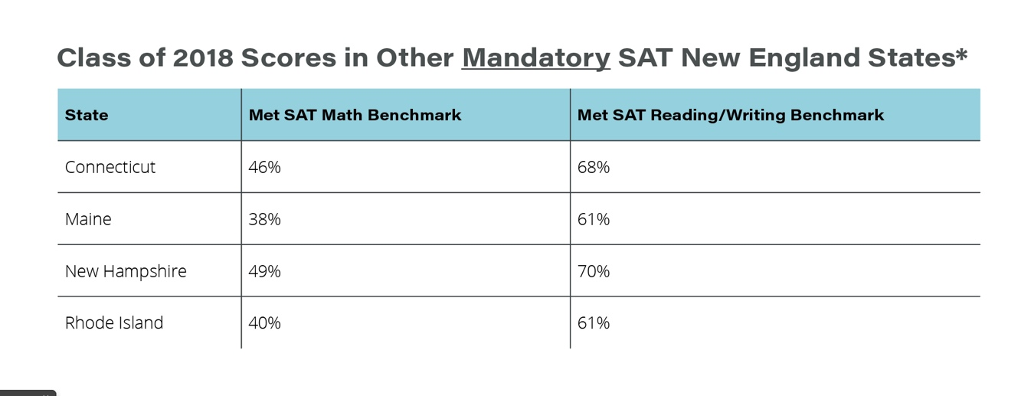

Slide 21
Access to Rigorous Coursework

Slide 22
Advanced Placement in New Hampshire
74 of 92 high schools (80%) had students enrolled in Advanced Placement courses.
Notes:
AP courses are pretty well-known, even outside of the wonky education policy conversations - and here in NH, 80% of high schools have students enrolled in them. And that sounds pretty great - that’s a high percentage! Let’s look more closely.

Slide 23
Advanced Placement in New Hampshire
2015-2016 | Total Students | % of students enrolled in AP | % of total high school students | % of specific cohort in state
Total High School Students | 57,435
Students enrolled in AP courses | 7,762 |  | 13.5%
Limited English Proficient Students | 41 | 0.5% | 0.07%
Students with disabilities | 106 | 1.4% | 0.02% | 0.9%
Notes:
A lot of things are happening here - don’t panic! So in 2015-2016, there were 57,435.
7,762 students enrolled in AP courses. 41 of those students were emerging dual or multi lingual English language learners. 106 students received special education services.
13.5% of high school students in 2015-2016 were enrolled in AP courses. Which is…different than that 80% figure one slide earlier.

Slide 24
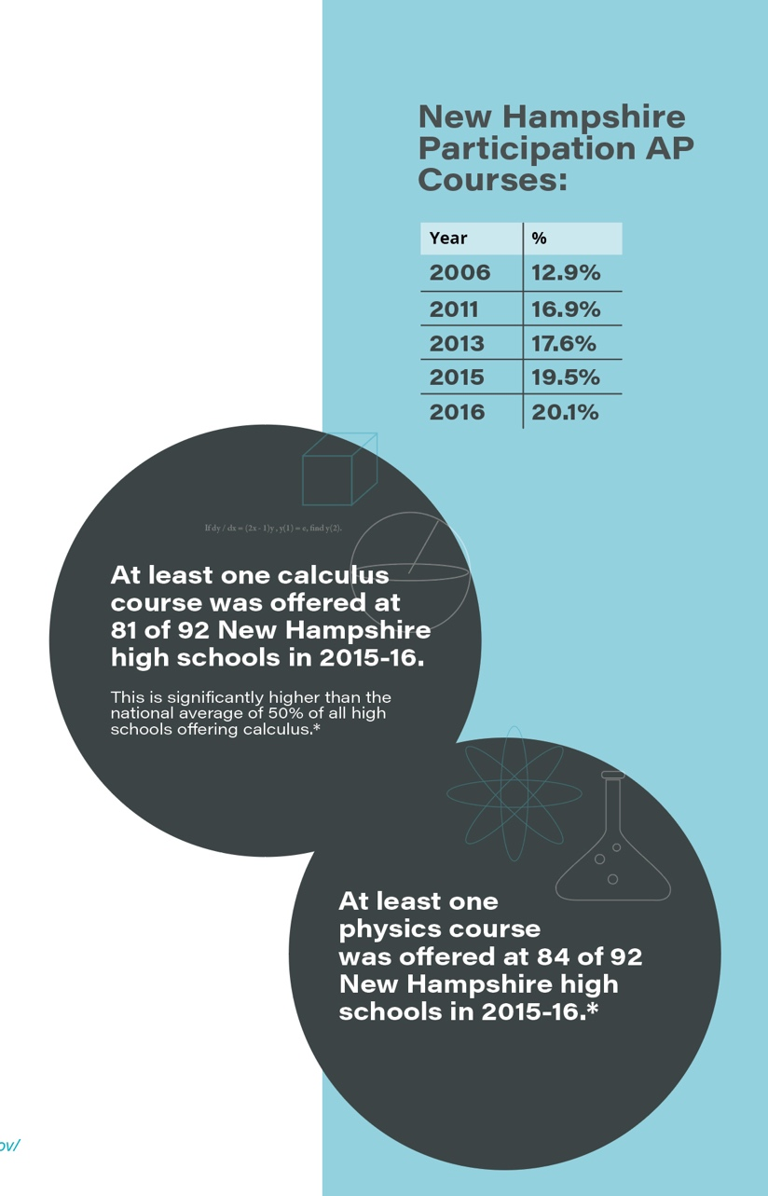

Slide 25
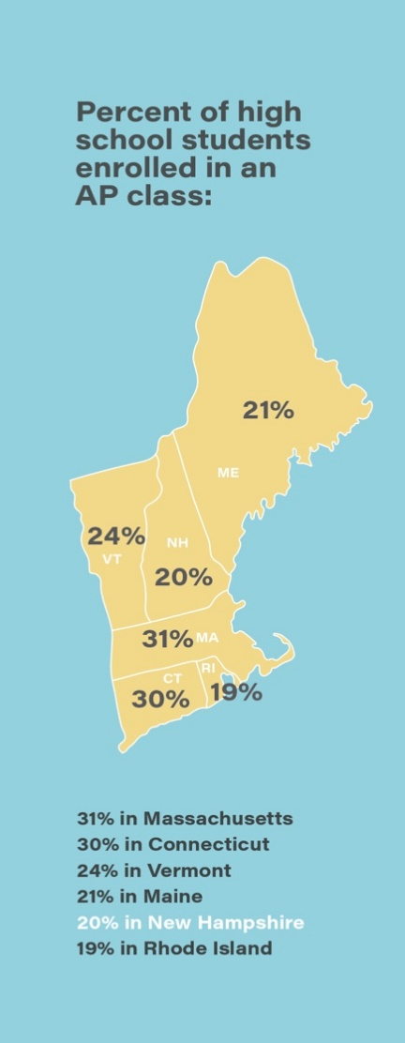

Slide 26
Dual Enrollment
56 schools, or about 60% of New Hampshire’s high schools, reported that they offered dual enrollment courses in 2015-16.
5% of high school students statewide participated in dual enrollment.
2% of students with disabilities (IDEA) participated in dual enrollment, less than half of the state average rate.
No schools reported Limited English proficient (LEP) students participating in dual enrollment courses.

Slide 27
High School Calculus
81 of 92 New Hampshire high schools (88%) surveyed by the Office of Civil Rights reported that they offer at least one Calculus course. This is much higher than the national average of 50% of all high schools offering Calculus.
A reported 2,881 students were enrolled in Calculus courses in 2015-16, about 5% of all high school students. Nationwide, 4% of all students were enrolled in Calculus.
Twelve Limited English Proficient students statewide (1%) were enrolled in Calculus in 2015-16.
Schools reported 66 students with disabilities statewide (1%) enrolled in Calculus.

Slide 28
Middle School Algebra
88 of 146 New Hampshire middle schools (60%) reported that they offered at least one algebra course in 2015-2016.
3,374 8th graders (23.8% of all 8th graders) were enrolled in Algebra in 2015-2016.
81% of 8th graders enrolled in algebra in 8th grade passed the course.
Notes:
And so I want to take one more step back – to middle school algebra. There’s plenty of research on the importance of algebra in 8th grade, and there are schools that even offer it earlier in seventh.
In NH, 60% of middle schools offer at least one algebra course.
23.8% of eighth graders were enrolled in algebra- and of those, 81% passed.

Slide 29
Student Group | Number enrolled in Algebra in 8th grade | % of all 8th graders enrolled in Algebra | N/% Passing Algebra of those enrolled | % of all 8th graders passing Algebra
Female | 1,784 | 12.5% | 1,450 81% | 10.2%
Male | 1,590 | 11.2% | 1,285 81% | 9.0%
Limited English Proficient | 8 | 0.1% | not reported | not reported
Students with Disabilities | 75 | 0.5% | 46 61% | 0.3%
TOTAL | 3,374 | 23.7% | 2,735 81% | 19.2%

Slide 30
Student Group | Number enrolled in Algebra in 8th grade | % of all 8th graders enrolled in Algebra
Asian/Pacific Islander | 127 | 0.9%
Black | 34 | 0.2%
Hispanic | 76 | 0.5%
Native American | 16 | 0.1%
Two or More Races | 61 | 0.4%
White | 3,060 | 21.5%
TOTAL | 3,374 | 23.7%

Slide 31
Questions to Consider
What intersections do we see between education and other public policy areas?
What other data and information would be helpful to know?

Slide 32
Sources, References, and Thanks
New England Secondary School Consortium, Common Data Project, https://www.newenglandssc.org/resources/common-data-project/
NH Department of Education, Attendance and Enrollment Reports, https://www.education.nh.gov/data/attendance.htm#district
U.S. Department of Education’s Office of Civil Rights Data Collection for 2015-16, https://www2.ed.gov/about/offices/list/ocr/docs/crdc-2015-16.html
Plimpton Research

