Slide 1
July 26, 2018 Presentation NHCBE
Executive Director, Ellen Hume-Howard
Program Director, Jonathan Vander Els
Program Director, Mariane Gfroerer

Slide 2
NHLI Board Members
Current 2018-19 NH Learning Initiative Board
Val Zanchuk, Board President, President of Graphicast, Inc.
Christine Rath (Founding board member), Former Superintendent of Schools Concord NH
Mark Joyce (Founding board member), Past Executive Director NHSAA
Irv Richardson, Coordinator for Public Education and School Support NEA New Hampshire
Founding Board Members
William Duncan, Former State School Board Member, Education Activist
Tom Raffio, Former Chairman of the State Board of Education
Gary Groleau, Former Corporate Manager of Labor Relations and Organizational Development for NHBB
Deborah Holloway, Educational Consultant
Advisors
Virginia Barry, Former NH Commissioner of Education
Paul Leather, Former NH Deputy Commissioner of Education

Slide 3
NH Learning Initiative
Accelerate innovation in K-12 education to move schools forward in helping our students become competent and confident adults, able to pursue the futures they seek in college, career and beyond.
Strategic R&D partner for NHDOE
Support innovations that move New Hampshire public education forward
Work directly with state government, higher ed and school districts to enhance K-12 learning
Convening
Investing
Assisting in making change happen

Slide 4
NH Learning Initiative Grants
GRANT | 2015-16 | 2016-17 | 2017-18 | 2018-19
BARR | $277,500 | $277,500 | $200,000 | $200,000
Nellie Mae NH PACE | $295,000 | $299,750 | $299,750
Hewlett NH PACE |  |  | $350,000 | $350,000
Hewlett 4 State Performance Assessment |  |  | $300,000
Hewlett Jobs For the Future Work Study Practices |  |  | $150,000 | $150,000
Hewlett-Gates-NGLC Assessment for Learning |  | $50,000 | $575,000
OGAP (On Going Assessment Project) K-5 Mathematics |  |  | $41,795 | $34,838
Total to Date = $3,851,133

Slide 5
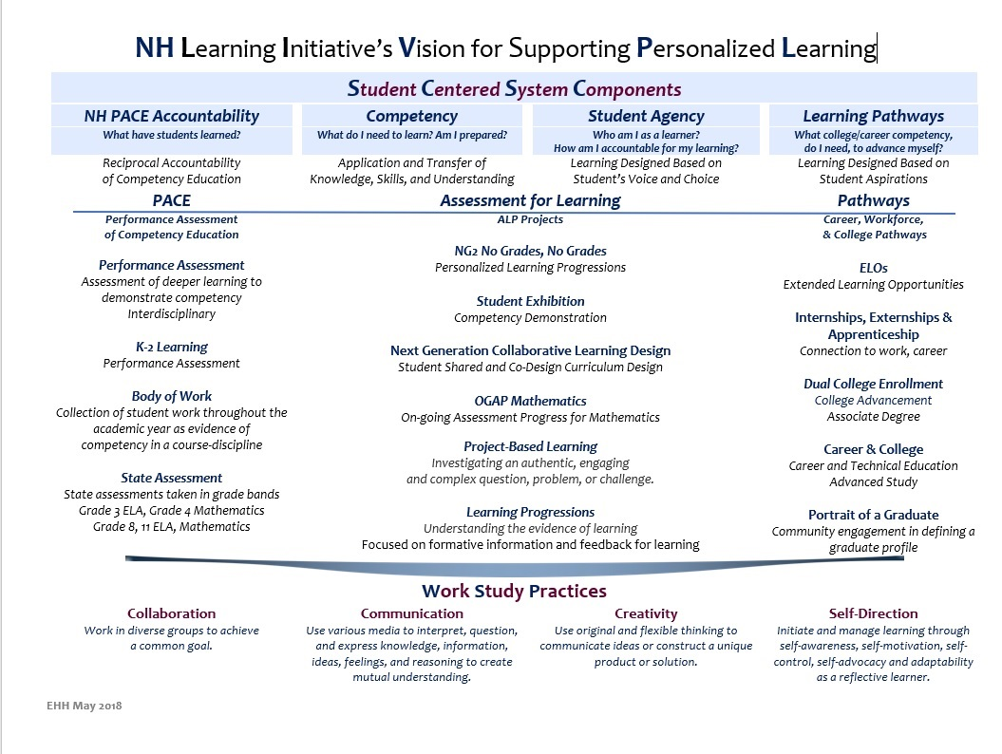

Slide 6
Status of New Hampshire PACE
Performance Assessment for Competency Education
25 Districts
13,461 Students participating
54 district leaders
58 teacher content leads
256 teacher task developers
Tasks Developed and Validated
Math 30
ELA 30
Science 24

Slide 7
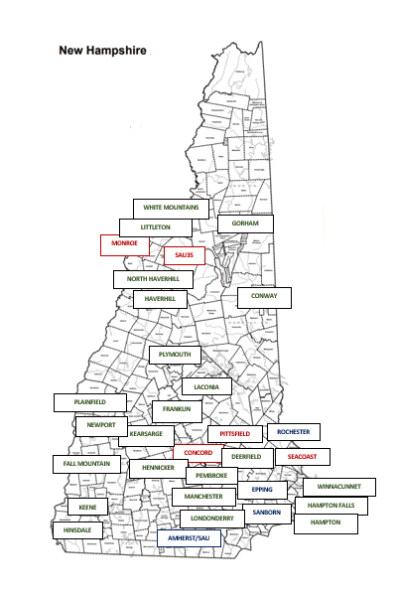
NHLI Programs and roles
School ReTool- School Administrator Support, Trainer
STEAM AHEAD- Stem Education, Fiscal Agent
Buck Institute Project Based Learning Manchester NH, partner
CEEDAR Teacher Support, NHDOE partner
Competency-Based Education, Education Experts
Work Study Practices, Education Experts
System Change, Education Experts

Slide 8
Delivering on the promise
NHLI is engaged in program support and leadership in 39 school districts in New Hampshire
NHLI partners with the NHDOE for NHPACE promoting competency education and student performance
NHLI presented the NH State Science Competencies based on the Next Generation Science Standards working in collaboration with the NHDOE
NHLI is partnering with the BUCK Institute to support project-based learning
NHLI’s work with the Assessment for Learning grant is focused on personal learning pathways, learning progressions, student codesign in their learning, and student defense of learning K-12

Slide 9
NHCBE Support
Endorsement of our work and continued support of our mission

