Slide 1

Preparing NH’s Workforce for Success

Slide 2

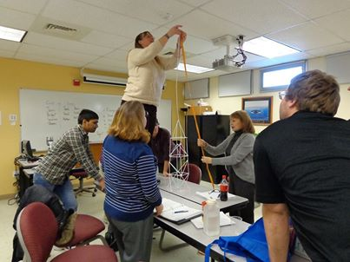

WorkReadyNH
Tuition-free, hard and soft skill training, and credentialing to meet the needs of job seekers, career builders, and employers.

Slide 3


Soft Skills Training
Simulated workplace environment (60 hours)
Interpersonal Skills & Teamwork Integrity
Professional & Personal Acceptability Initiative
Dependability & Reliability Communications
Professional & Personal Acceptability Lifelong Learning
“ Skills dealing with interviewing, positive thinking, conflict resolution and interpersonal skills have changed my approach to meeting employers expectations.”
“…I gained new confidence along with practical interpersonal skills that will carry with me for life.”

Slide 4
Essential Workplace Skills
ACT KeyTrain (Assessment & Skill Building)
WorkKeys (Credentialing)
Top Three Cognitive Skills*
Reading for Information
Applied Mathematics
Locating Information
National Career Readiness Certificate (NCRC)
*skill requirements of 85% of 20,000 jobs in the most recent 5 years
Work ready?... Prove it!

Slide 5
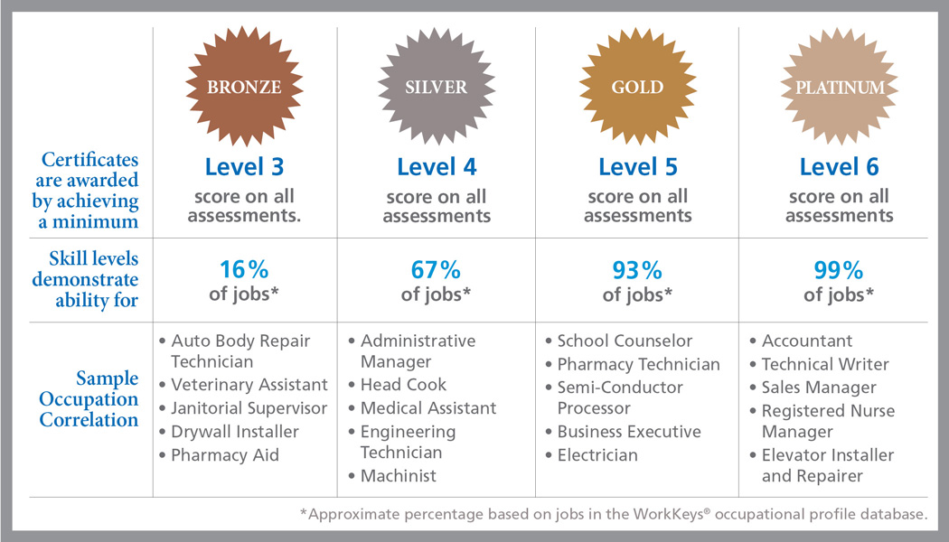
National Career Readiness Certificate Levels
Grads * 19% (296) 60% (937) 21% (321) 1%(7!)
1-7 scale
Level 1 & 2 not work ready
-7
WorkReadyNH Grads = 1,561 (as of November 14, 2014), graduation rate 77%

Slide 6
The Big Picture
link address: http://youtu.be/J2NMYxJTPgc
Notes:
http://www.youtube.com/watch?v=J2NMYxJTPgc&feature=player_embedded
http://youtu.be/J2NMYxJTPgc

Slide 7

NCRC Benefit to Employers*
Streamlined hiring process
Significant decrease in turnover rate
Better quality candidates
Reduction of costs related to hiring and training
Improved productivity
Better attendance rates
Decreased quality defects and deviations
* case studies on ACT’s website www.act.org/workforce/case
Notes:
From case studies found on ACT’s website www.act.org/workforce/case

Slide 8
Next Steps
Employer awareness & support of WorkReadyNH & NCRC;
Working group to help determine value of NCRC assessment/credential and feasibility becoming a “Work Ready Community”;
Future of WorkReadyNH.
Currently there are 21 ACT Work Ready States (Oct 2014)

Slide 9
For More Information
Mandy Fraser
WorkReadyNH State-Wide Liaison
Community College System of NH
(603) 230-3534
(603) 230-3500 ext. 7034
mfraser@ccsnh.edu
http://www.ccsnh.edu/WorkReadyNH
https://www.facebook.com/WorkReadyNH

