Slide 1
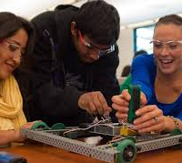
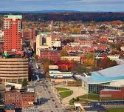
Kreiva Academy Public Charter School
A 6th to 12th Grade Experience Coming to Manchester in the Fall of 2018
Presented by:
The Foundation for Educational Insight
Michelle Mathieu, Karen Henderson, Brianna Sargent-Merrill, Aranka Bullen, Kara Hewett, and Sarah Shor
Notes:
Hello. Thank you for giving us a chance to speak today. We have been watching the work of the NHCBE for quite a while and are excited to share our charter school project with you today and to take a more active role in the NHCBE’s work moving forward.

Slide 2
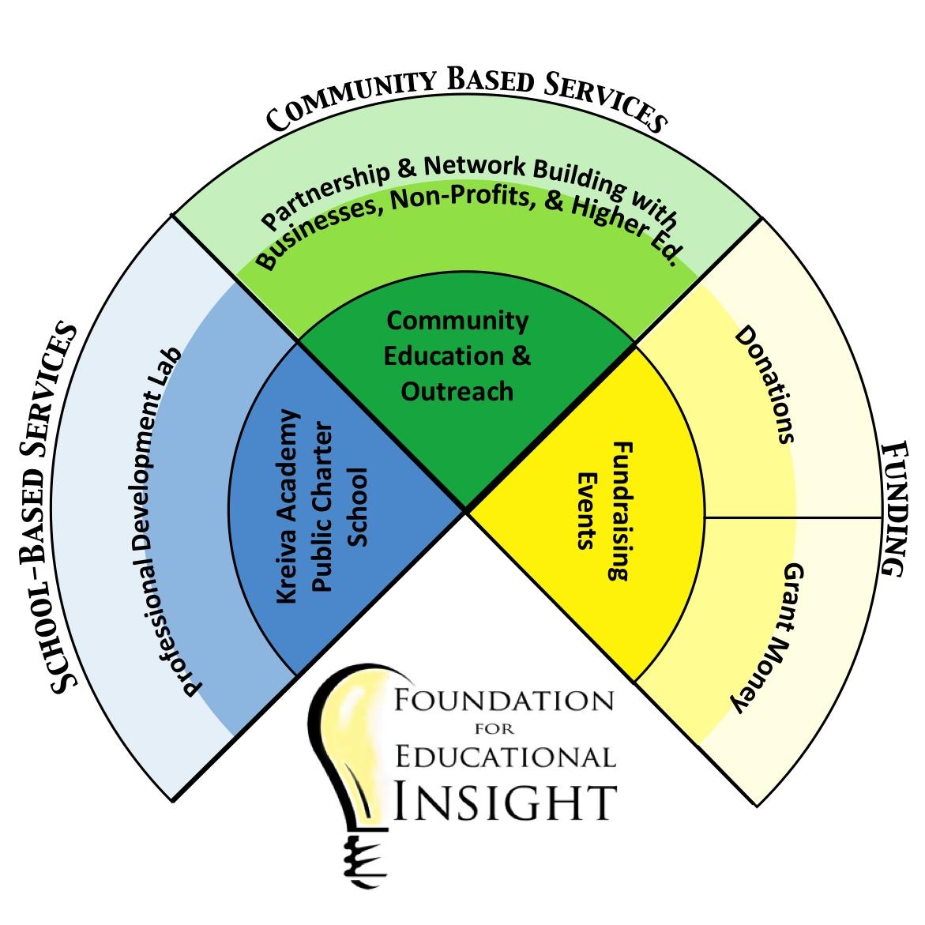
The FEI strives to empower every NH student with access to a quality education suited to their personal needs and driven by their goals.
Notes:
We are the Foundation for Educational Insight.
We are driven by the believe that every child is entitled to an education that respects their learning needs and helps them meet their future goals.
We are both a service organization, working toward these goals through the School and Community-Based Programs we have established,
and a support and development organization, ensuring the sustainability of these Services by building partnerships and coalitions, and attracting financial resources to the important work they do.
One of our strategic goals is to help families in the Granite State better understand their educational choices and select the best fit for their child - be that district school, private, charter, or homeschool. Along the way, we discovered a large group of students in the Greater Manchester Area who are seeking a secondary school setting that isn’t currently available to them.
Creating a new charter school, focused on a rigorous, comprehensive, competency-based education, was directly in line with our Mission: empowering every NH student with access to a quality personalized education.
Kreiva Academy Public Charter School’s application is now on schedule to be presented to the Board of Education in August.

Slide 3


Self Awareness Adaptability Courage Knowledge Abilities Global Understanding
Vision
Mission & Vision
Taking Responsibility
Being Courageous
Focusing on Growth
Showing Integrity
Embracing Diversity
Honoring Accomplishment
Growth Innovation Citizenship Respect Empowerment Equity
Foundational Principles
Notes:
Kreiva’s Mission establishes a student-centered community that embodies a growth mindset where challenge, risk taking, and mistakes are welcomed as necessary to learning and innovation.
Kreiva’s Foundational Values guide our day-to-day activities and interactions. (CLICK)
We strive to put Kreiva's Pillars of Success into action as individuals and an entire community, continuously committing to make Kreiva a learning and working environment where people feel safe, challenged, and valued. (CLICK)
Our Vision for Kreiva rests on these Pillars: That we inspire students with a personalized education that fosters self-awareness, adaptability, and the courage to reach beyond their perceived limits. (CLICK)
The knowledge abilities, and global understanding students acquire prepares them to be successful in their ever-changing future.

Slide 4

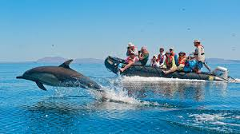
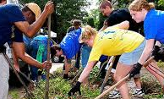

Focused on Students
Individual Growth Plans (IGPs) establish a map for future coursework and learning opportunities.
Regular assessment informs updates to these IGPs as the student grows.
Personalized
Kreiva Academy Is...
Students learn by doing.
Regular reflection deepens learning and elicits more meaning.
Experience-based
School and outside experiences are woven together as equal partners in students educational lives.
Projects and module topics are chosen for their relevance.
Relevant
Active student participation shapes their school experience.
Extended Learning Opportunities (ELOs) encourage “anytime anywhere learning.”
Adaptive
Notes:
Classes are broken into 5-8 week topic-based modules, where students are grouped by interest and preparation according to Individual Growth Plans. (CLICK)
We believe that to make schools work, we need to let schools be more in the world and let the world be more in schools. Inspired by the EL Education model, classes are designed to involve students in “real world” issues. Student do work and take action that impacts their local communities and beyond. (CLICK)
Student work is shared in community exhibitions where they display their progress and receive feedback from the people it impacts. (CLICK)
Krieva values the social nature of learning, but we also recognize that circumstances and learning needs vary. In recognition of the opportunities that exist beyond our classrooms and school day, we offer a robust Extended Learning Opportunities program, allowing students to adapt their program to meet their individual needs.

Slide 5
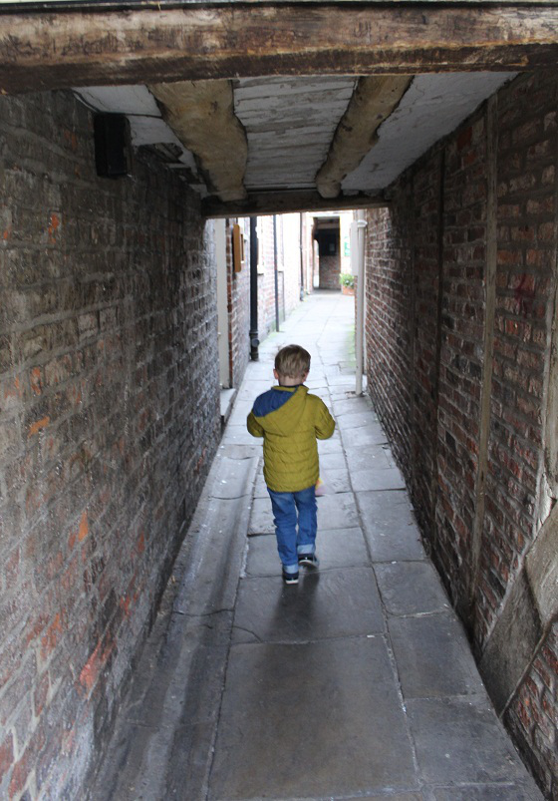

Structured
Or Flexible?
Notes:
Schools need an element of planning and structure to dependably achieve success with the diverse range of students they will serve.
The right kind and amount of structure provides students with a sense of comfort and security in their environment that fosters learning. (CLICK)
Conversely, student achievement has also been shown to significantly improve when they given more flexibility.
Students are more engaged when they have the ability to shape their learning.
Open-ended, innovation-based learning is shown to yield dramatic results in terms of increased creativity and critical thinking skills.
Which is the right approach? Kreiva wants students to be able to reach beyond their limitations. Imagine the students in these pictures aspire to reach as high as possible.
The student in the tunnel will only be able to reach as high as the structure of the tunnel will allow.
The student in the field will only be able to get as high as his muscles can jump. (CLICK)

Slide 6
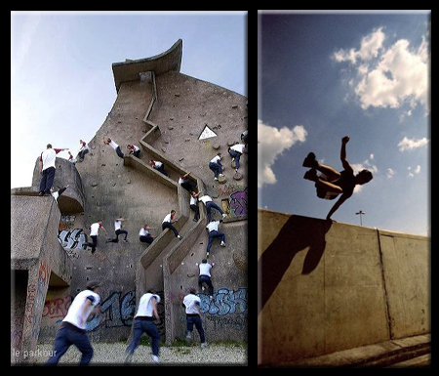
Structured Flexible
And
Kreiva Academy Is...
Notes:
Education needs to balance support and flexibility, boundaries and freedom.
At Kreiva Academy you see students using the boundaries to assist them in reaching their ultimate goals.
Different students choose different paths - some more challenging than others- but the structure is there to support and assist them along the way.
The role of educators is to provide guidance to help students understand the responsibilities that accompany each potential choice and to point them towards new learning opportunities. In this environment, students learn to accept challenges and find their own solutions.

Slide 7

Challenging ...
How do you continuously engage and offer the right level of challenge to a diverse group of students who are progressing at different rates and in different directions?
Kreiva Academy Is...
Notes:
A great deal of Kreiva’s design is built in response to the question: How do you continuously engage and offer the right level of challenge to a diverse group of students who are progressing at different rates and in different directions?
Compare learning a topic to doing pull-ups. Everyone approaches the process with different challenges and abilities. For some it is too easy, and for some it is completely impossible.
To make it more complicated, each student’s capacity to achieve the task may differ from month to month, depending on circumstances at home, health, and countless other factors.
We worry about each student’s engagement and self-esteem as they interact in this way with their learning. (CLICK)

Slide 8
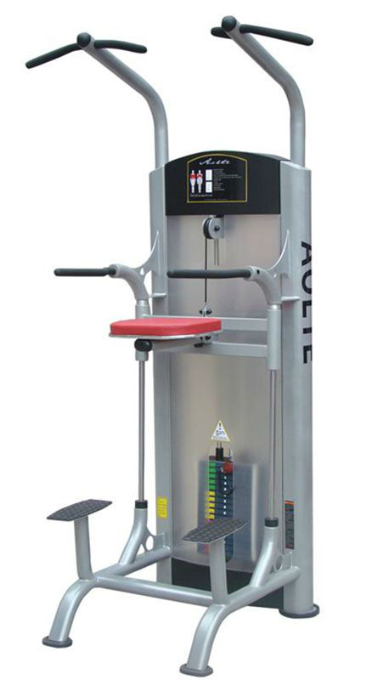
Challenging & Supportive
Notes:
At Kreiva, our curriculum is built around interchangeable Learning Targets. This, together with the Individual Growth Plans, Extended Learning Opportunities, and short class modules allow us to regularly adapt a student’s program to meet their changing needs.
This is akin to a pull-up machine. Depending on your ability to do pull-ups at each workout, you can adjust a counter-weight that helps support your body - or add weight if you need more rigor. You are able to challenge yourself to the peak of your ability each time you work-out, without facing boredom or an unattainable goal.
Kreiva attempts to maintain the optimum conditions for learning by regularly assessing and adjusting a student’s learning environment. Their classes are neither too easy or too hard for long.(CLICK)

Slide 9
Education for Life: Learning in Three Domains
“There are two educations. One should teach us how to make a living and the other how to live.” -John Adams
“Education is not preparation for life; education is life itself.” -John Dewey
Kreiva Academy Is...
Intellectual
Personal
Professional
Notes:
John Adams once said, “There are two educations. One should teach us how to make a living and the other how to live.”
John Dewey said, “Education is not preparation for life; education is life itself.”
New Hampshire schools perform well in providing students the academic foundations they need for success. But as you know, there has been less focus placed on preparing students for the responsibilities they will have as 21st Century citizens seeking jobs or leadership roles in their communities.
To provide a complete education, schools should reasonably resemble the balanced lives we hope students will live when they graduate.
To achieve this goal, we believe it is essential to focus on student growth in three key domains: intellectual, personal, and professional.

Slide 10




Education for Life: Learning in Three Domains
Intellectual
Class Modules
Crew
KREIVA
Professional
Futures Program
Personal
Professional
Pathways
Notes:
The Intellectual Domain includes the academic content that are expected of all New Hampshire middle and high school students according to the College and Career Ready Standards
It is addressed primarily in the class modules each session.
The Personal Domain includes the skills involved in managing a balanced and happy personal life and will be the primary focus of daily Crew meetings, a component of our Futures Program.
The Professional Domain includes the technical and interpersonal skills necessary for success in civic and professional settings and is the purpose behind Kreiva’s Professional Pathways, another component of the Futures Program.
Underlying everything at Kreiva, is a culture of growth. Simply put, encouraging our staff and students to embrace the Growth Mindset will empower them to view challenges not as potential failures, but as greater learning opportunities. Not I can’t, but I haven’t yet.

Slide 11
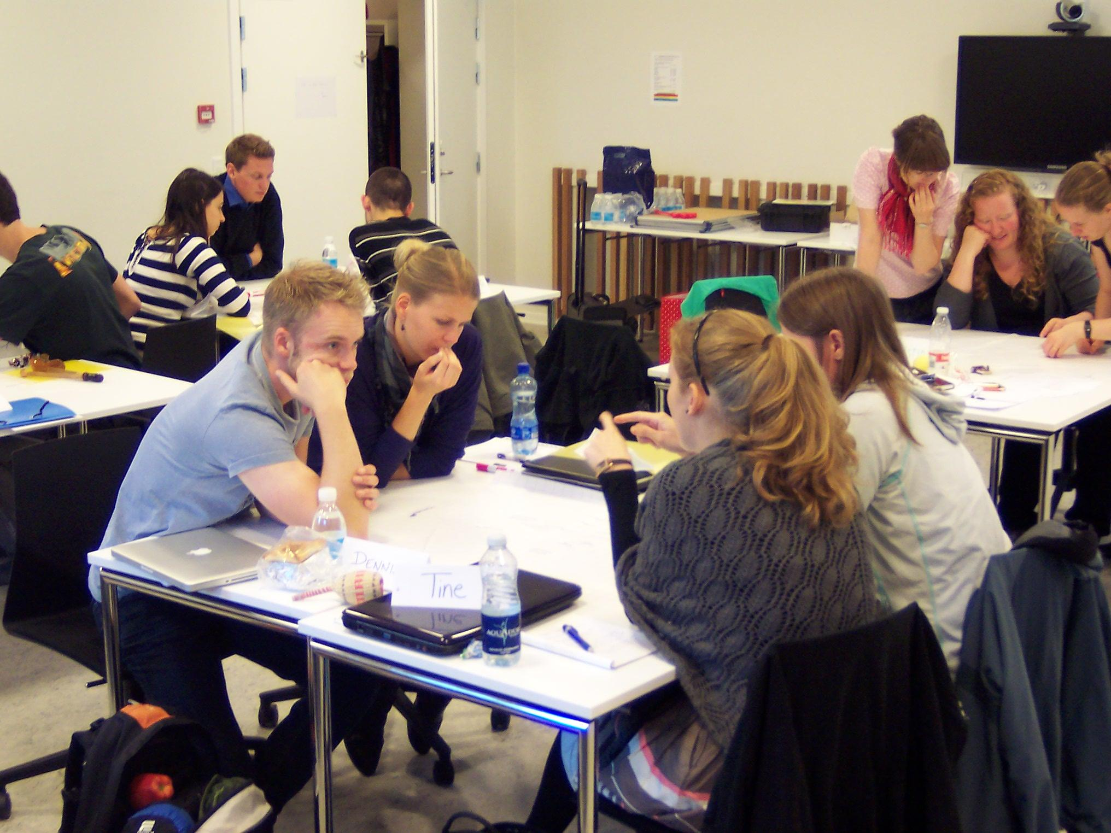
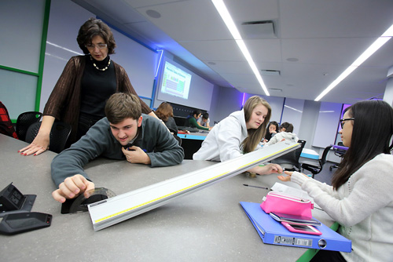
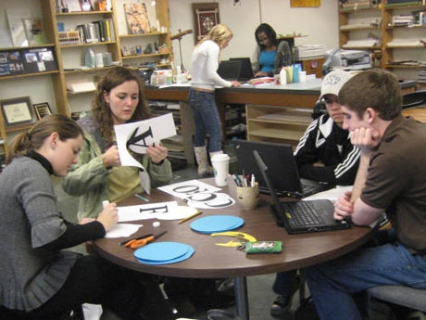

Who Needs Kreiva Academy?
Students who want to actively engage their learning and have a voice in the shape of their education throughout middle and high school, particularly those who:
are aging out of student-centered elementary charter schools.
crave creativity, autonomy, and/or flexibility in their schooling.
want to learn a rigorous, college-prep curriculum in a different way.
want to get credit for the learning they do in their work, hobbies, or volunteer commitments.
want to explore post-secondary work and educational options with guidance and in context.
want to develop career connections with area businesses and organizations while still in high school.
Notes:
As we mentioned, this project started in response to a sizeable population of families in the Greater Manchester area who were telling us they could not find a middle or high school setting where they felt their child fit.
The exact details behind each story were as diverse as the people telling them, but from these discussions came the initial inspiration for Kreiva Academy.
We expect many of our applicants will come from students aging out of the many student-centered elementary charter school programs throughout the south-central part of the state. Members of these school communities strongly communicated a desire to have another secondary school option.
Beyond those coming from the elementary charter schools, we welcome any NH student looking to open their minds, become part of a community, accept challenges, explore themselves and their future, and engage with their learning in unexpected ways.

Slide 12



















We connect our students to the Granite State—hopefully for good—through our partnerships and collaborations, including:
Businesses
Non-profit organizations
Colleges and universities
Technical schools
Trade organizations
You?
Notes:
Beyond the lessons we teach during the school day, Kreiva is looking to play an active role in combating some of the biggest challenges facing our state, including the aging population and its effect on the economy.
Our Learning Expeditions, service learning, and ELO opportunities will continuously encourage students to take an active role in shaping the state in which they live.
We also look forward to working with organizations like Stay, Work, Play NH, NH Made, and the Granite State Ambassadors to expose our students to the cultural and economic opportunities in the state, and help them make connections, so they choose to stay here after graduation.
As you can see from the logos of all the organizations with whom we have discussed collaboration on some level, we have a growing network that will help us along the way. For our model to succeed, we need to keep that network growing.
If you are interested in finding out more, the best resource right now is our FB page - it’s the easiest to keep up to date.
I also welcome texts, emails, or calls from anyone interested in finding out more about us. We will post all of our contact info at the end.

Slide 13

Kreiva Academy Public Charter School’s Current Needs
Immediate Needs
Letters of support to the NH Board of Education by Aug. 15th
Summer Curriculum Development Grant: $55K
Fiscal sponsor until 501C3 processing complete
Legal & Accounting advice
Board members: FEI and Kreiva Boards
For Operation in 2018
Student Mentors and Internship sites
Technology grants:
Targeted one-to-one computer environment
Contact Facebook: /feinh.org Website: www.feinh.org Phone: 603-540-4528 Email: info@feinh.org
Notes:
This list includes some of our most pressing needs. Feel free to ask any one of us for more details.

