Slide 1

Let’s Rally around a Common Goal!

Slide 2
ED2 and 10,000 MENTORS were endorsed by the NHCBE.
THANK YOU!!!
But, exactly what does the endorsement mean moving forward?

Slide 3
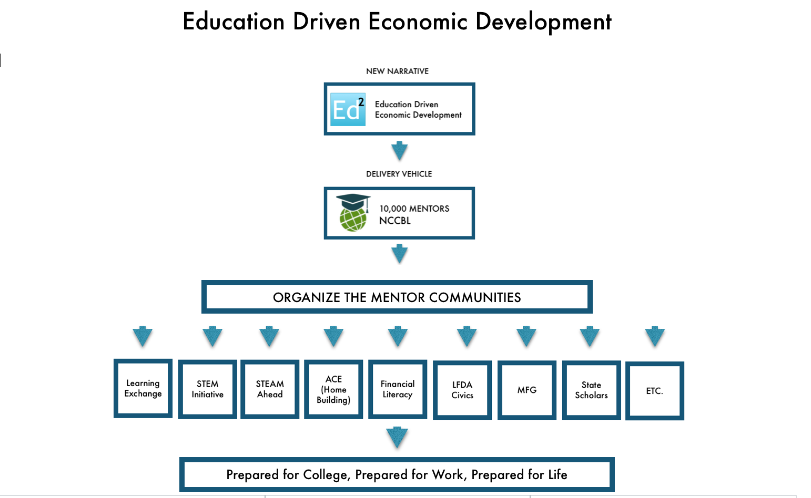

Slide 4
The CHALLENGE
Many good New Hampshire companies are struggling to find the skilled workforce they need to grow. Additionally, New Hampshire is on a multi-decade decline in its ability to attract high growth businesses. The old narrative of quality of life and low taxes is no longer enough to attract these workforce needy firms to our state. As a result, young people are leaving to find jobs elsewhere, therefore, reducing the availability of the ready workforce to reverse the trend.

Slide 5
The Options
Import from out of state or out of country
Grow our own talent

Slide 6

The INTENT of our PROPOSAL
Focus on a common goal: Education Driven Economic Development
Support NHCBE’s initiatives through 10,000 MENTORS

Slide 7

The NHCBE has endorsed many excellent plans.
NHDOE
BIA
Stay, Work, Play
10,000 MENTORS
STEAM Ahead
STEM

Slide 8
“ED2 makes it easier to understand how the many worthwhile efforts underway that the group has endorsed fit into the big picture. They are all subsets of Education Driven Economic Development.”
Jim Roche, President
Business and Industry Association

Slide 9
The SOLUTION
Leverage New Hampshire’s pioneering success in competency-based learning to build a new narrative that tells businesses that, in New Hampshire, we will make your company a full partner in our education system by creating an ongoing stream of internships that match student interest to your workforce needs.

Slide 10
“10,000 MENTORS is the vehicle we need to build the future skilled workforce in advanced manufacturing.”
Zenagui Brahim,President
NH Manufacturing Extension Partnership

Slide 11


Slide 12


