Slide 1

A system’s View:
Education from Birth to Tomb
Brian Hettrick – ENA Board Member and Secretary

Slide 2
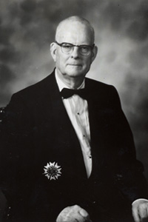

Slide 3


ExcellenceNorth
Alliance
(ENA)

Slide 4

The Ecosystem
ENA
Business
Education
Government
Community

Slide 5
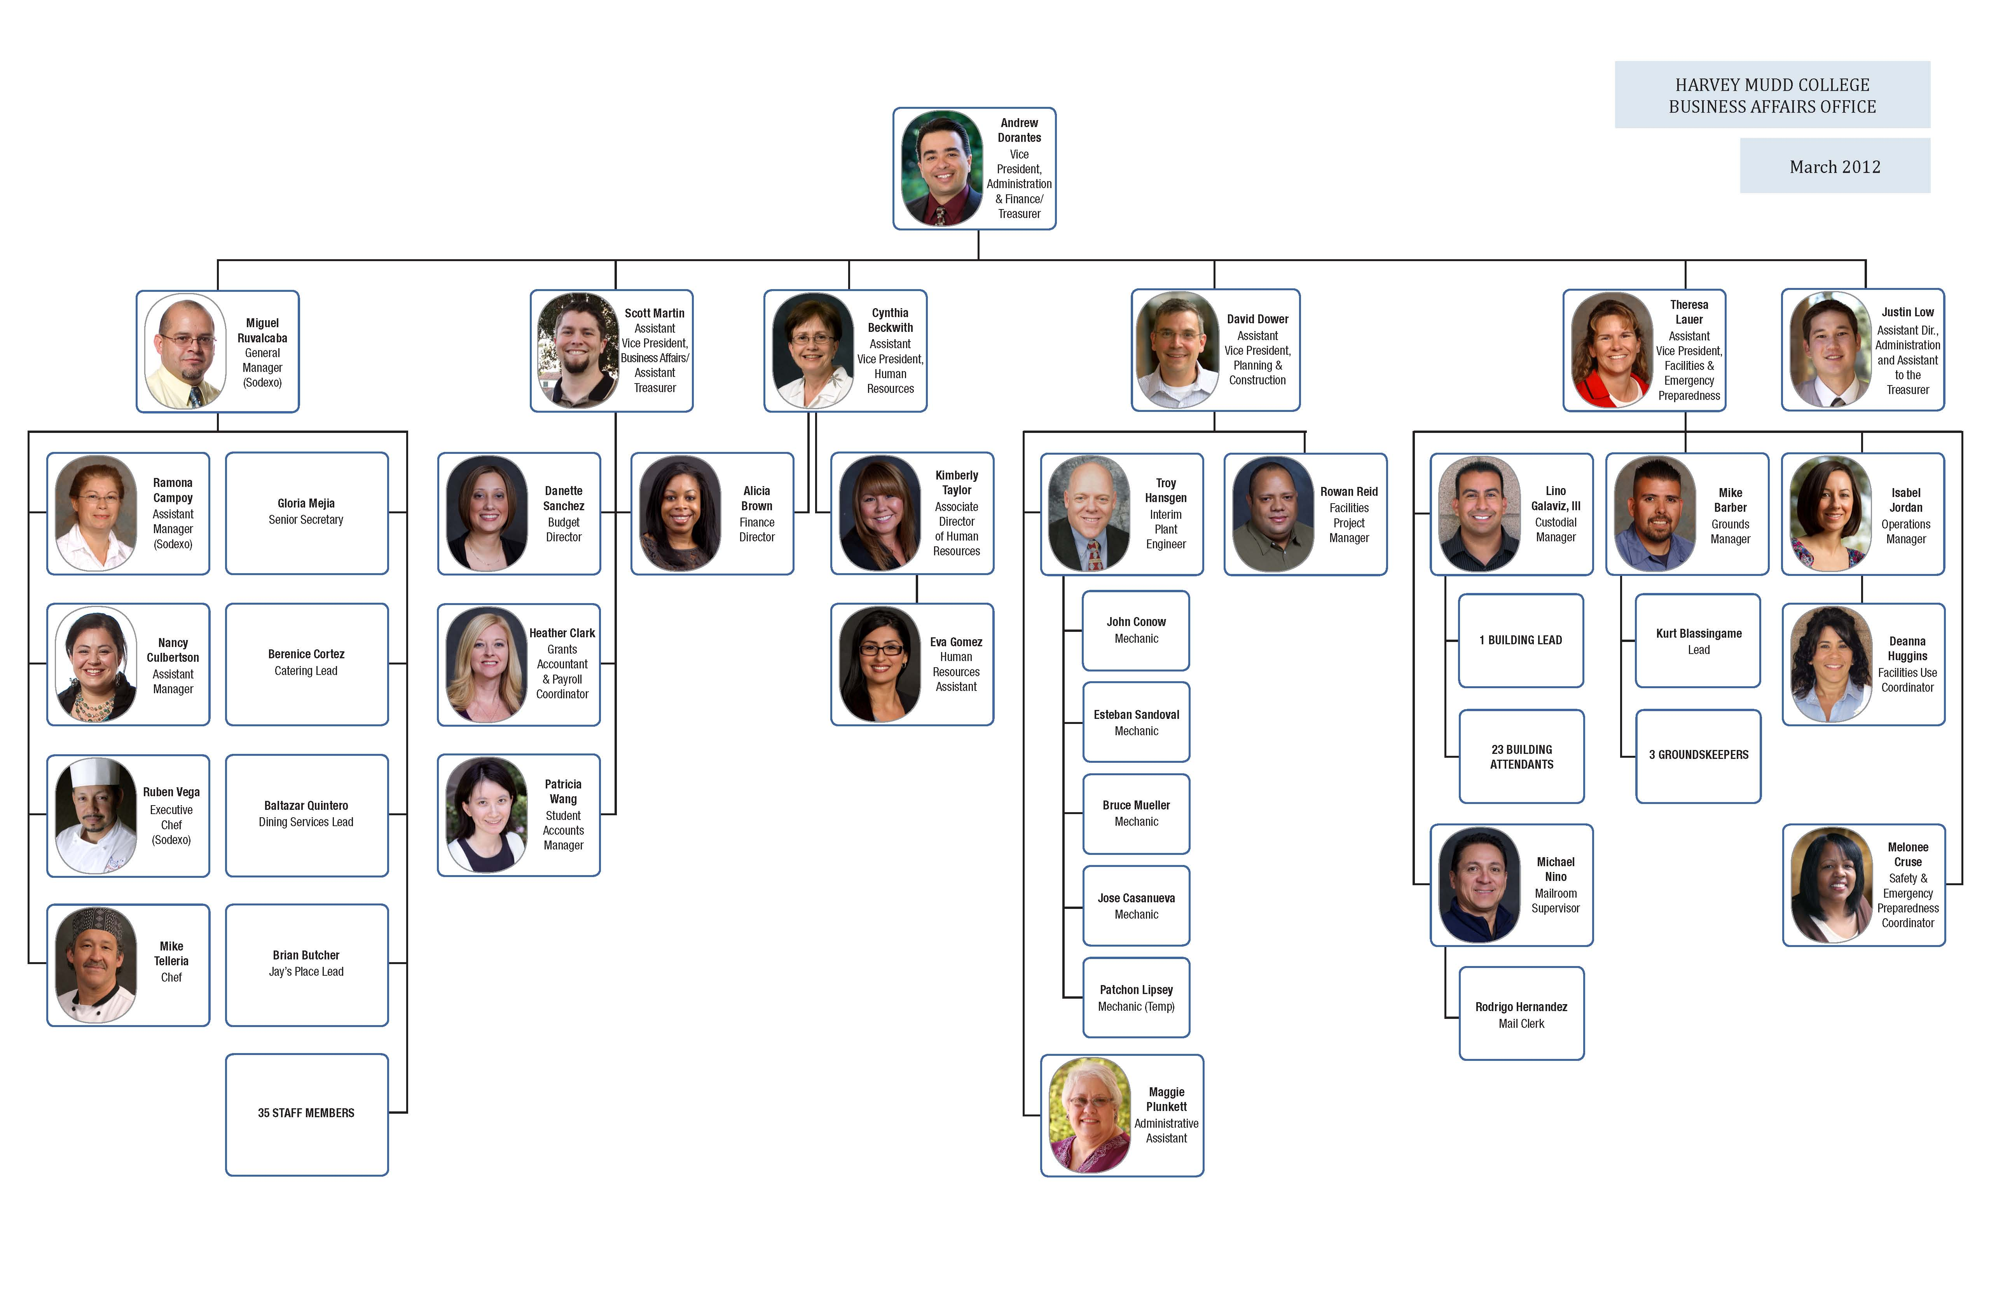

NEWTONIAN “and” QUANTUM
X
99.9%
Quality
Ops
Eng
Finance
The Organization of the Future

Slide 6
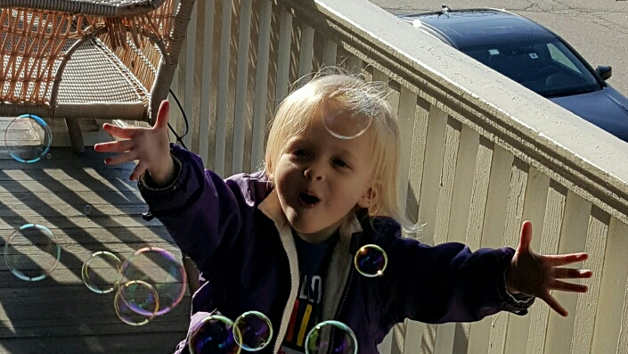

Slide 7
Thank you!
Q & A

