Slide 1

New Hampshire Scholars
NHCBE
June 22, 2017

Slide 2
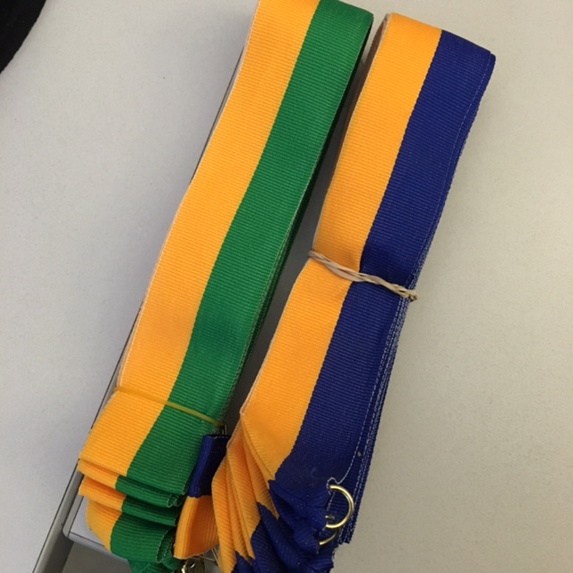
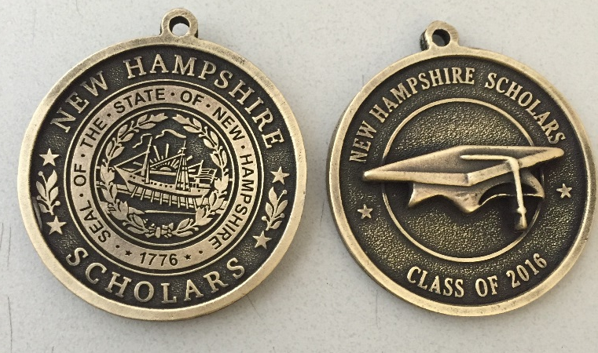
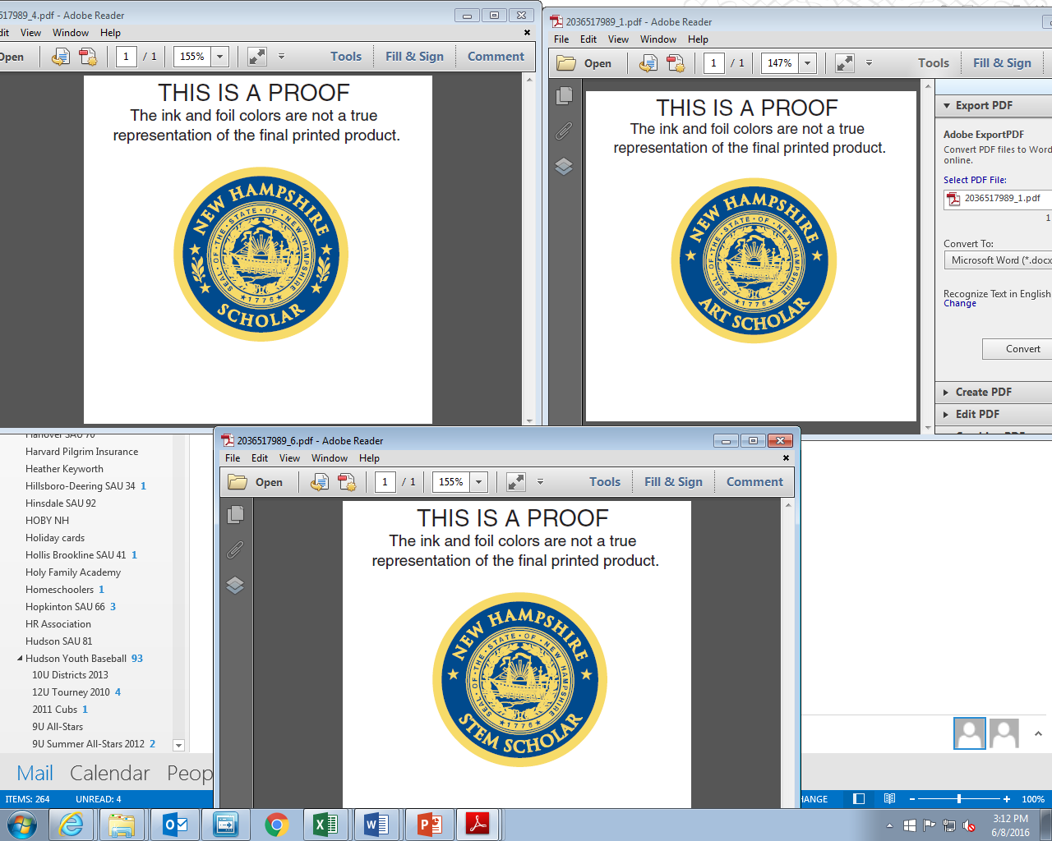
Senior Award Ceremonies
5,000 Grads in Class of ’17 Including:
1,300 STEM Scholars
600 Art Scholars
300 Earned Both STEM & Art
Business leaders and college reps assisting in presenting medallions at various high school events
Notes:
Still compiling data from this year’s year end reports…
STEM is doubled from 2016 – 773
0 in 2016 earned both
Art was same

Slide 3
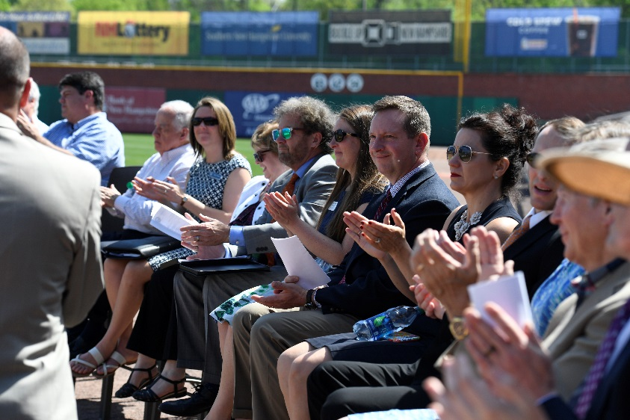

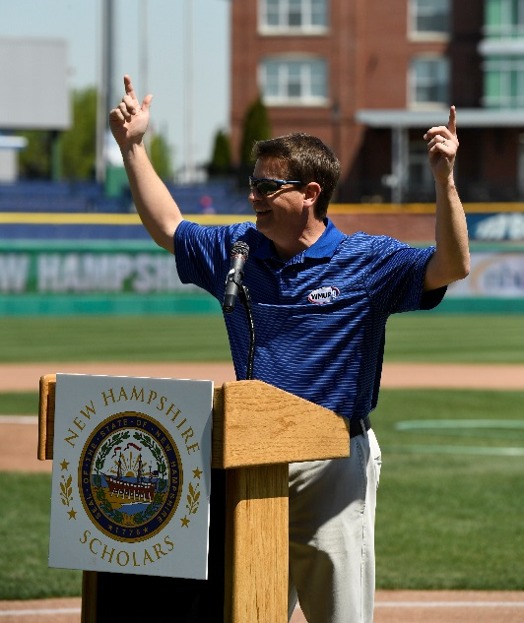
NH Scholars Day 2017
Northeast Delta Dental Stadium
More than 3,000 students from 50 high schools attended

Slide 4
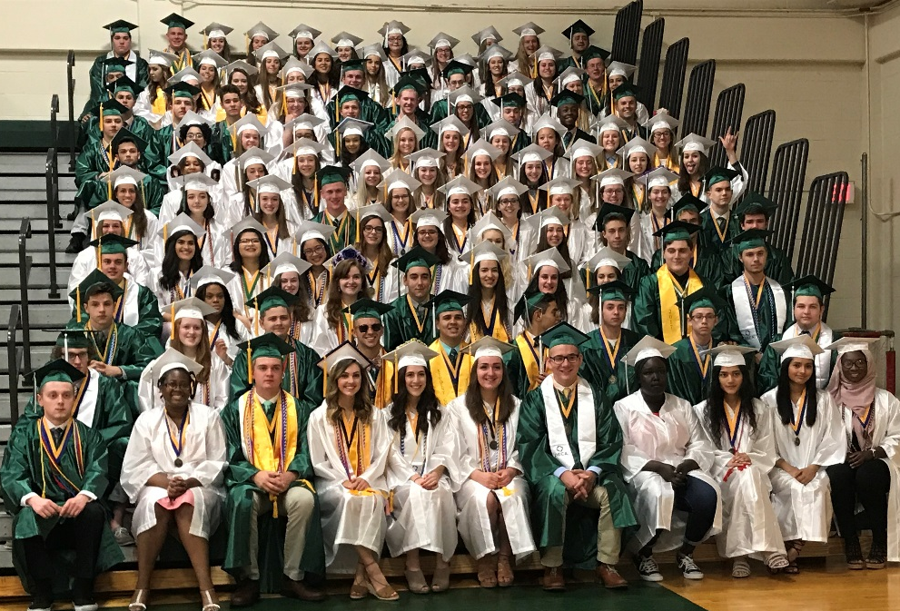
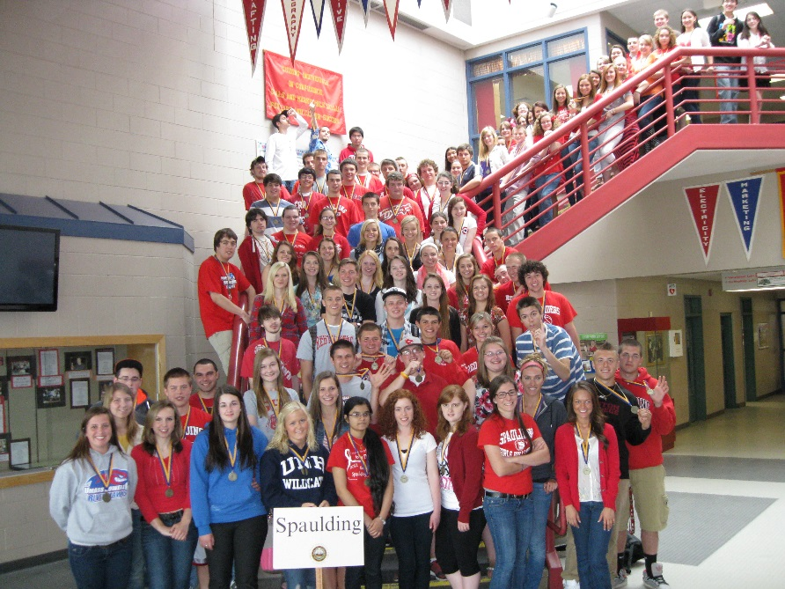
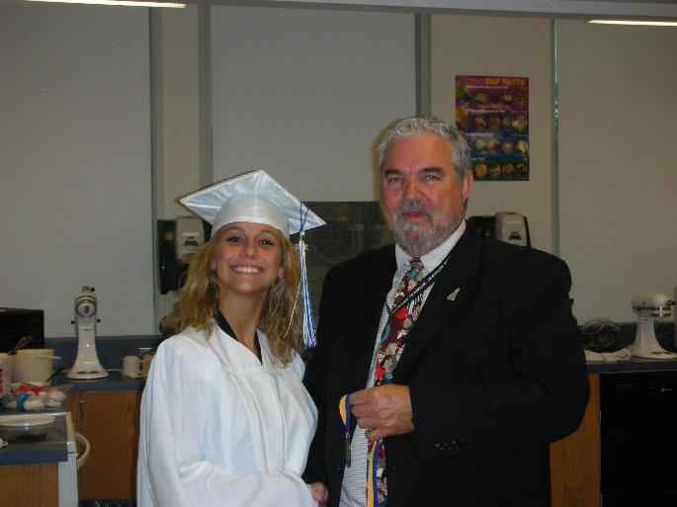
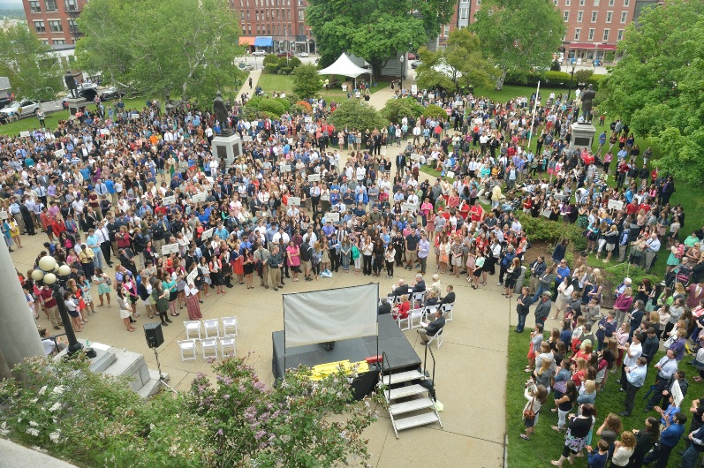
The impact of nh scholars
Notes:
Higher Education
Patty Lynott and Susan Huard both spoke to the effectiveness of NH Scholars in preparing students for college level work and effectiveness while on campus. Susan reports that 100 scholarships have been given to NH Scholars students going to MCC since 2014. Patty reports that NH Scholars have greater than a 90% retention rate at SNHU compared to the 75% average. In other words, NH Scholars students are prepared for college level coursework and graduate on time far greater than other students.
Business Community and Workforce Development
Fred Kocher talked about the impact NH Scholars has on the future workforce. With school age (5-19), Young Adults (20-29), and Working Adults (30-64) all showing large population declines from now through 2025, it is critical to educate our own. Fred believes there is no other program in NH that prepares students for college and the workforce like NH Scholars.
K-12
Marge Chiafery spoke of the large impact NH Scholars has had at Merrimack High. It established a level of expectation for students and provides continuous reinforcement of ways for students to succeed. The business partnerships have been an important component for schools. They have also found success bringing current college students/former NH Scholars back to high school to speak to today’s students. Marge thinks there is a huge opportunity to connect K-12, Higher Education and Business.
The Committee of Conference approved budget includes the new Governor’s Scholarship Program. The GSP would provide $1,000 to every NH resident who is Pell-eligible and attending a NH public or private college. If the student was a NH Scholar, s/he will receive $2,000 – and real demonstration of the economic value of earning the Scholar status! The program will be phased-in with only first time, full time students eligible in FY18 and incorporating each subsequent HS class. Whether this version of the budget is approved by the House and Senate is anyone’s guess….but regardless, nice statement of importance of being a NH Scholar!

Slide 5
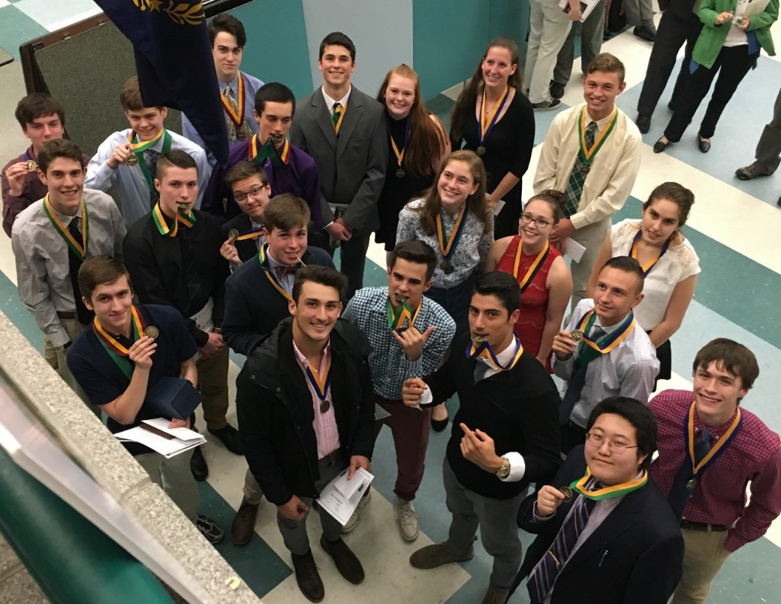
budget
Current Budget
Corporate Sponsors
Sustainability

