Slide 1

New Hampshire Scholars
NHCBE Meeting
June 27, 2016

Slide 2
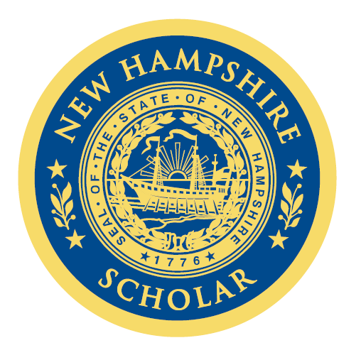
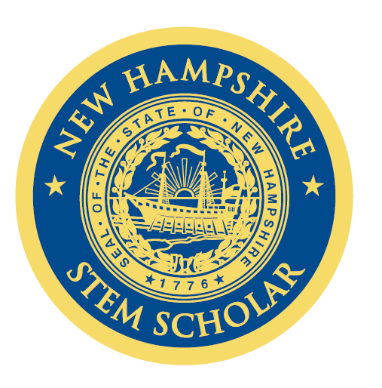
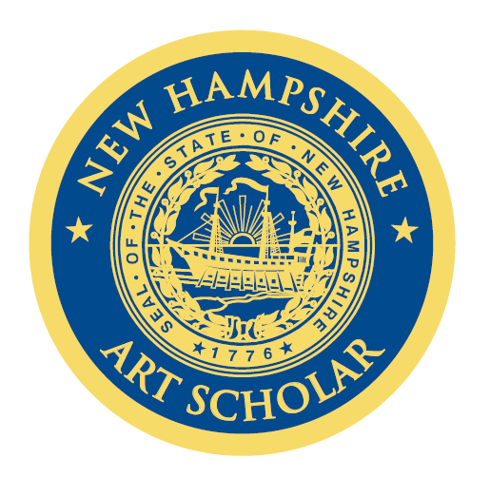
Pathways 78 Partner High Schools Statewide 5 more to go!
 | 2016 # of NH Scholars Original Pathway | 2016 # of NH Scholars STEM Pathway | 2016 # of NH Scholars ART Pathway | Total NH Scholars
Totals | 3,786 | 772 | 571 | 5,129
74%
15%
11%

Slide 3
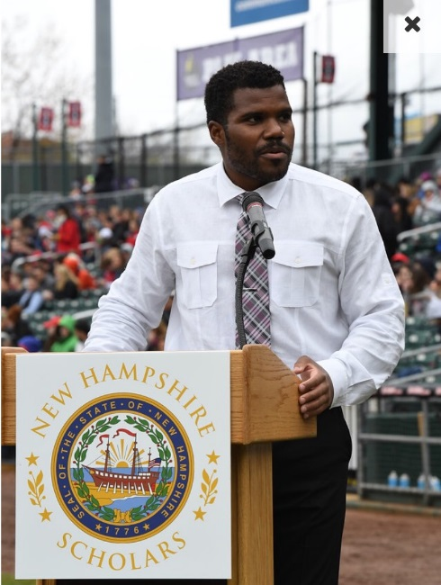
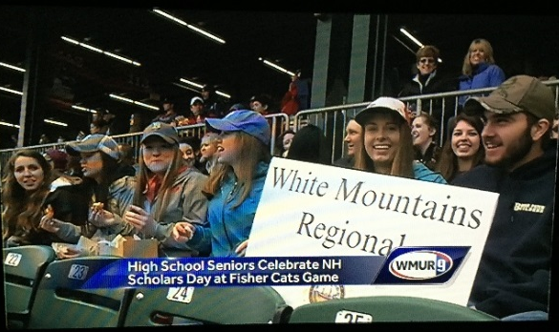
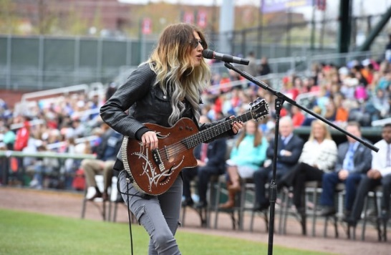
NH Scholars Day 2016
May 5th
Northeast Delta Dental Stadium
Over 3,000 students and community leaders attended
Outstanding media coverage
https://www.youtube.com/watch?v=3O4rO-S4Hbg

Slide 4












2015-2016 sponsors

Slide 5
FUNDING STATUS 2016-2017
Commitment of $135,000
Corporate Sponsors Needed of $65,000
Budget Highlights
NH Scholars Day - $10,000
Bus Transportation - $15,000
Breakfast of Champions - $3,000
College Access Conventions – 3 x $5,000 = $15,000
Berlin, Manchester, Keene, possibly others
Recognition Medallions - $11,000 for 5,500 students
Publications and Media - $11,000

