Slide 1
New Hampshire Scholars
NHCBE Meeting
April 14, 2016

Slide 2
Pathways
 | 2016 # of NH Scholars Original Pathway | 2016 # of NH Scholars STEM Pathway | 2016 # of NH Scholars ART Pathway | Total NH Scholars
Totals | 4,066 | 661 | 535 | 5,262
77%
13%
10%

Slide 3
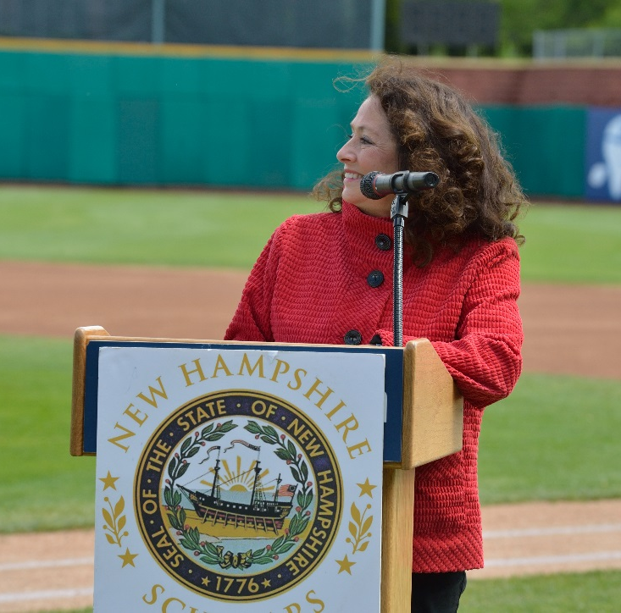
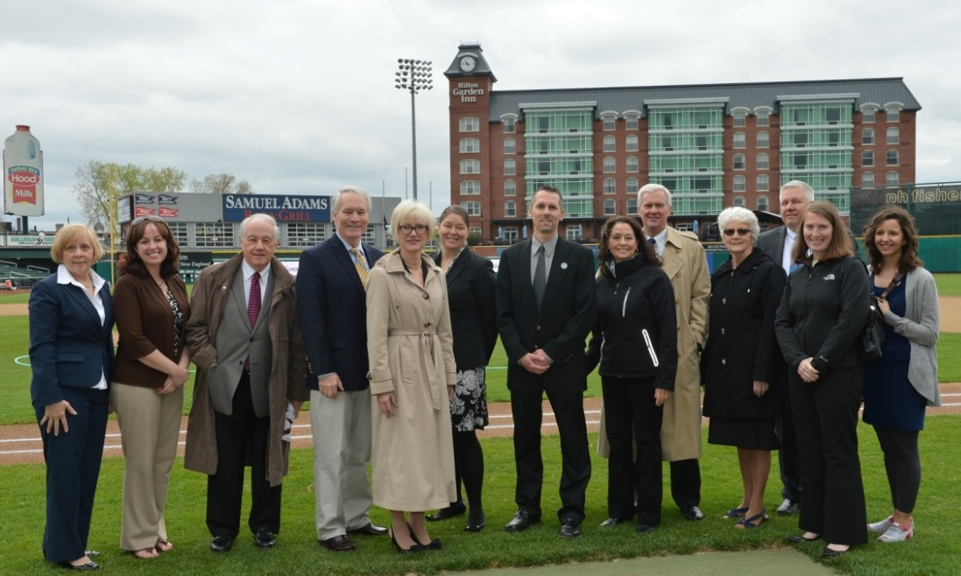
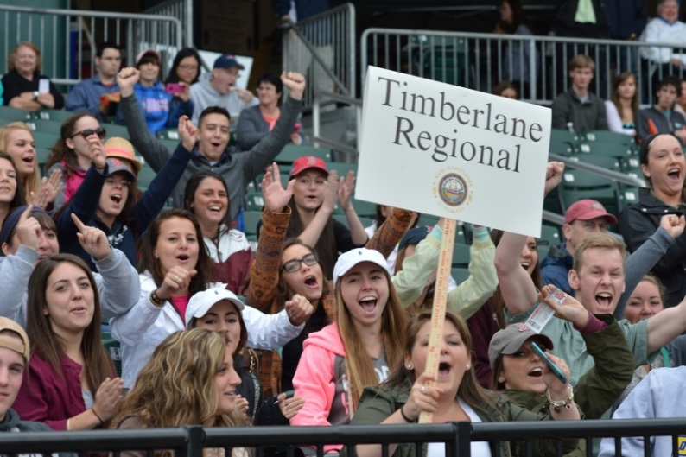
NH Scholars Day 2016
May 5th
Northeast Delta Dental Stadium
Nearly 5,000 students and community leaders expected to attend

Slide 4
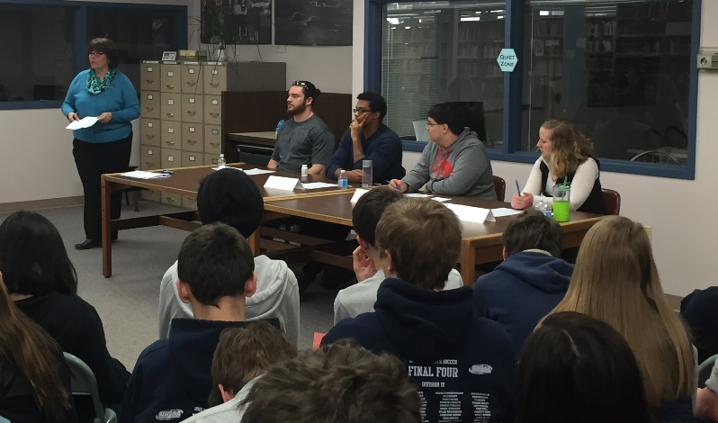
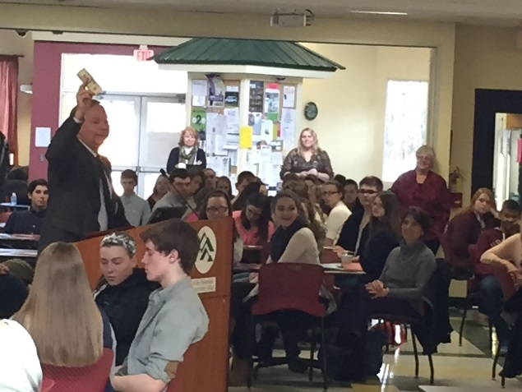
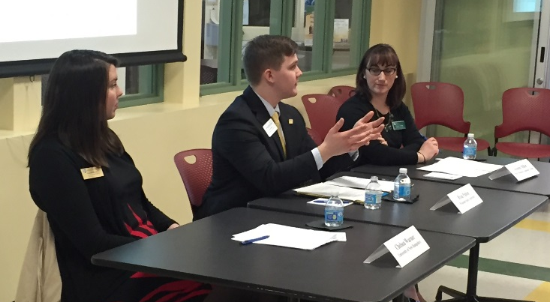
College Access Convention
April 8th, White Mountains Community College, Berlin
200 high school sophomores
“College is Possible” theme
How to Prepare. How to Apply. How to Pay.

Slide 5
A Local Success Story
Merrimack High School NH Scholar
Invented the Chemicube
Mentored by Matt Pierson
Nanocomp Technology

