Slide 1

NH scholars update
Implemented stem pathway
Colleges providing significant scholarships
Overwhelming positive response from high schools
New schools signed on
Positive media coverage and outreach opportunities
Advanced Manufacturing Council & CTE Centers

Slide 2
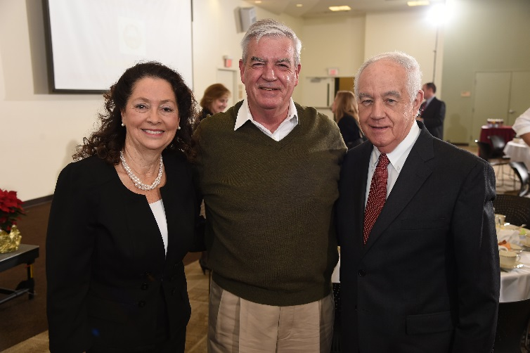
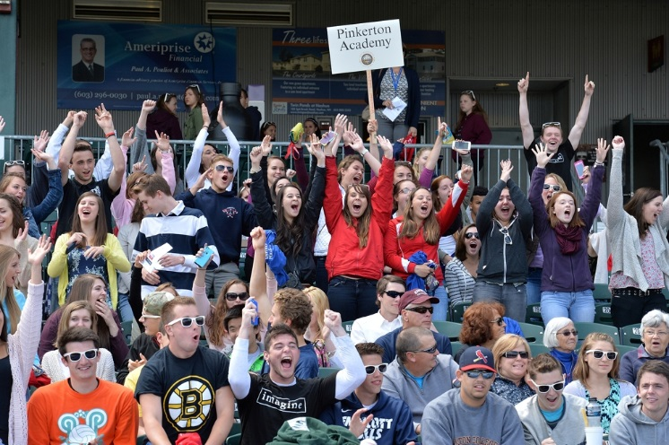
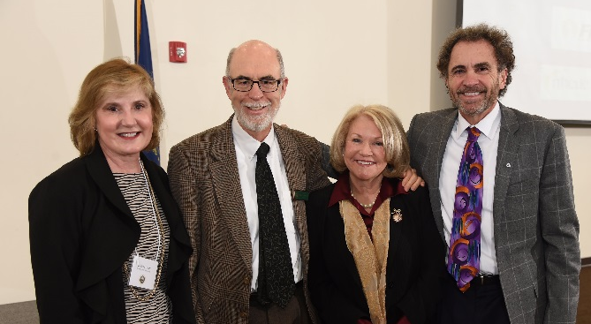
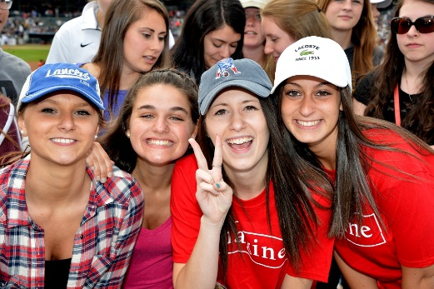
breakfast OF CHAMPIONS
NH SCHOLARS DAY
December 11, 2015
More than 200 attendees
Business recognition
Networking/dialog
May 5, 2016
4,000+ students expected
Student recognition
Northeast Delta Dental Stadium

Slide 3

funding
Primary funding from NH Department of Education
Earlier reported that we were $40,000 short
Great response from corporate sponsors
Ongoing discussion with NHDOE and other potential sponsors

Slide 4









Thanks to our corporate sponsors
$20,000 raised! Still $19,000 short for NH Scholars Day buses, medallions and publications

