Slide 1

Challenging All Students to Own Their Future

Slide 2
Assessment without opportunity is dead.

Slide 3
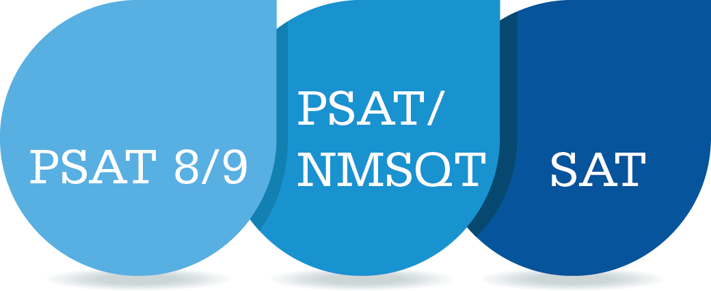
Readiness Baseline
Check-in and Focus
Connect to College

Slide 4
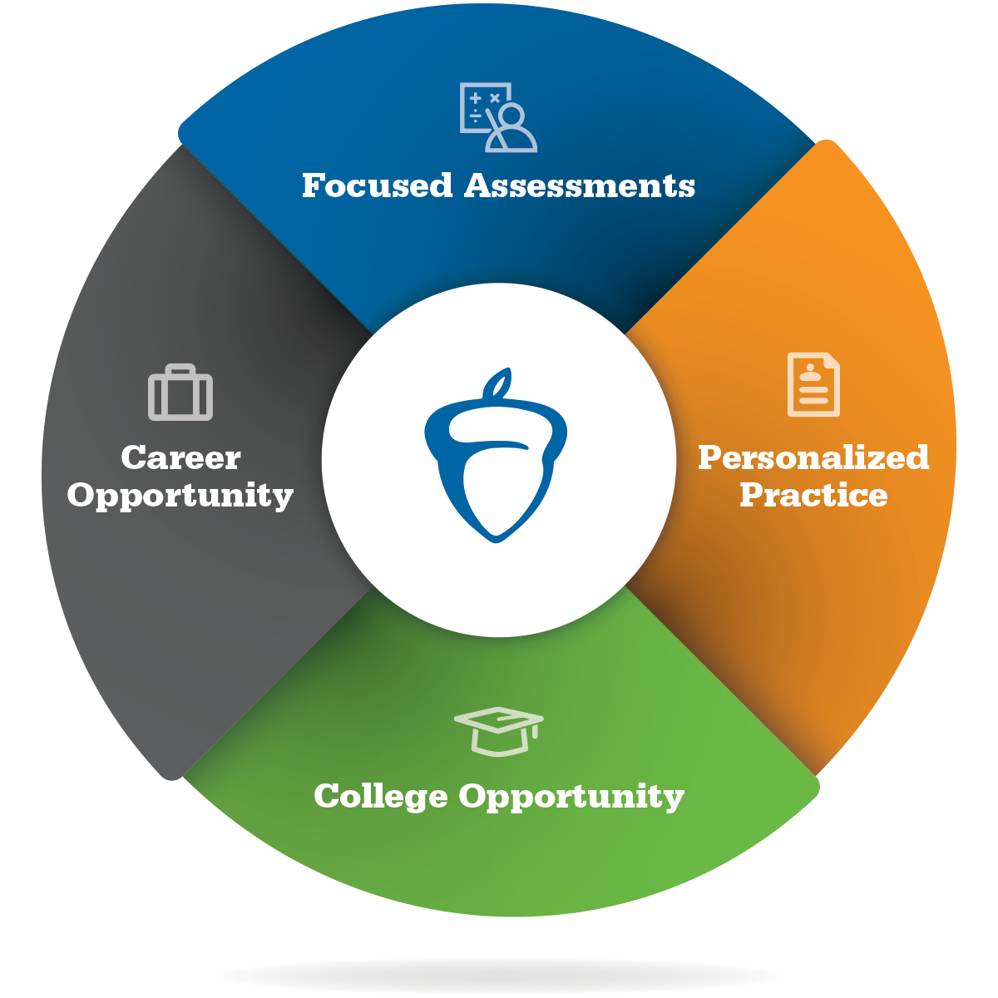
The College Board Readiness & Success System
Beyond tests. More opportunities.
Easier for students to navigate a path through high school, college and career
Extraordinary, exclusive partnerships that deliver unprecedented benefits to students, educators, and states/districts

Slide 5

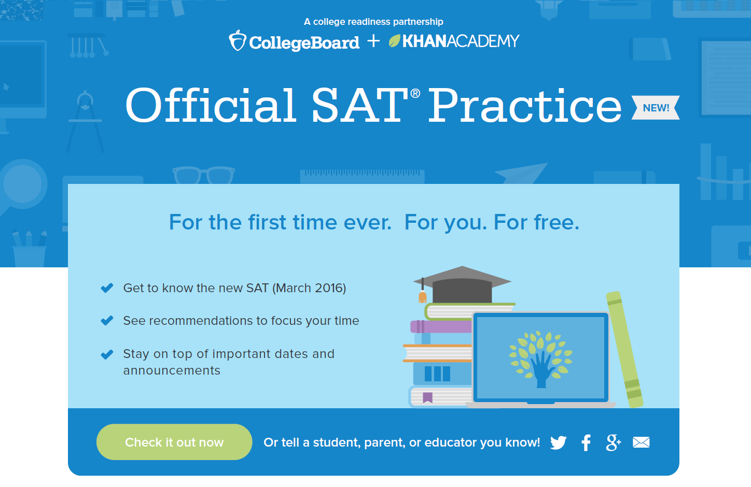
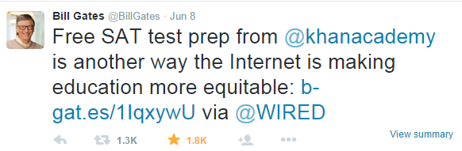


More than 5 million visits, 300K unique users, and over 3.1 million items completed
www.satpractice.org

Slide 6

Additional funds for student scholarships
AP Potential: Inviting students to take advantage of the opportunities they’ve earned
Exam and college admission fee waivers
Tools to help plan for college

Slide 7

Planning tools that engage students in thinking about their future
Delivering skills that matter for jobs of the future, including coding, which opens doors for all.
Achieving career readiness comes from productive preparation, not from taking another test

Slide 8
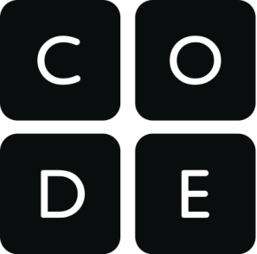
“Powering Up: The campaign to teach computer science to a digital nation”
From the Washington Post:
“Seattle-based Code.org, founded by two tech entrepreneurs, and the College Board, the New York-based non-profit that administers the SAT and Advanced Placement tests, are offering to help 35 of the country’s largest school districts teach new computer science classes.”
PSAT 8/9 potential
Use Code.org
Coding career success

Slide 9
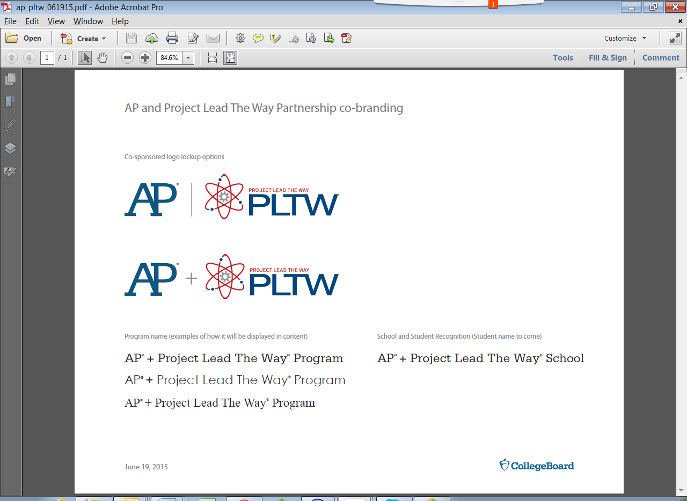
AP + Project Lead the Way
The Challenge
By 2020, 92% of STEM jobs will require postsecondary education and training; only 42.6% of SAT takers in the class of 2014 met the SAT College and Career Readiness Benchmark
AP + PLTW Program
Preparing more students for degrees and careers in STEM
Connect AP and PLTW courses to create college and career pathways in Engineering, Biomedical Science, and Computer Science
Career-focused opportunities sponsored by key industry partners
New credential to recognize and reward students

