Slide 1

Locally Driven Innovation:
An Update and Request
April 25, 2019
NH Coalition for Business and Education (NHCBE)

Slide 2



















We Represent Many Voices that Share a Common Goal
We include grasstops and grassroots leaders from K-12, postsecondary, business & industry, and the nonprofit sector.

Slide 3

Core Guiding Principles
We believe:
In a broad view of college and career readiness where students can pursue an educational experience that aligns to a wide variety of career options.
K-12 public education should serve each and every NH student well.
Empowering students and families with the knowledge they need to make informed decisions.
Celebration of student success drives change.
Local innovation and cross-sector partnerships are key to student success.
Good data drives good decisions.

Slide 4
The Ask: Support for Year 2 of Subgrants
$20,000 for Four New Subgrants*
Here’s why:
We need to prepare our future workforce and keep NH competitive and prosperous.
There is tremendous work taking place in NH. We must lift up good models.
*The NH Charitable Foundation has already committed $5,000.

Slide 5
2018-2019 Subgrantees
.

Slide 6
We deepened existing initiatives:
Manchester, NH
After-school, credit-bearing courses for refugee, immigrant and other underrepresented students.
Courses include: computer science, environmental studies, college admissions, career exploration, and other courses.
136 students participated in Fall semester
90% earned credit
With our funding:
Additional course offerings
Expanded reach (more students)
Expansion to middle school and community centers (Manchester Police Athletic League)

Slide 7
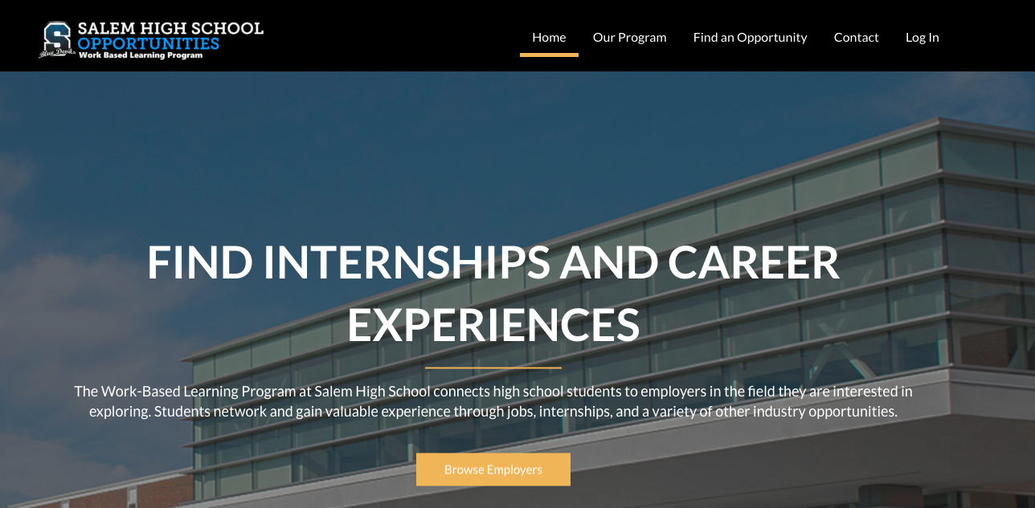
2) We created tools and models for advancing workforce development:
Salem High School: Largest high school internship program in the state
550 students in CTE in 2018-2019

Slide 8
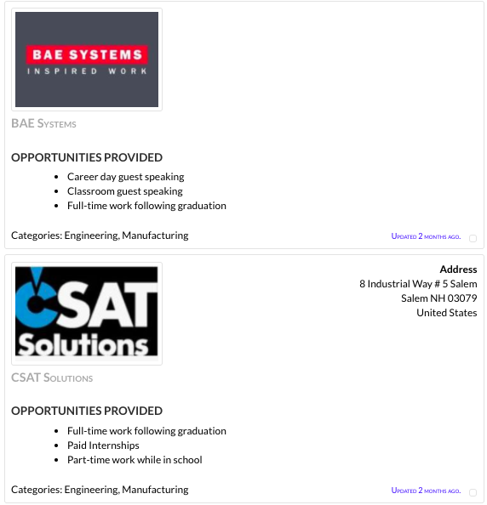
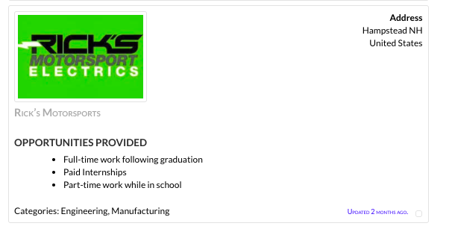
Salem BizEd Connect Model
Portal for students and businesses
Real time information
SNHU student designed

Slide 9
3) Brought new resources to New Hampshire:
Careers CLiC is piloting the TIPS program in the following New Hampshire high schools
Access Academy (St. Anselm College)
Manchester Central High School
Manchester High School West
Manchester Memorial High School
Manchester School of Technology
Concord High School
Farmington High School
Hanover High School
Hillsboro-Deering High School
Hopkinton High School
Mascoma Valley Regional High School
Oyster River High School
http://careersclic.org/career-preparation/

Slide 10
The Ask: $20,000 for Four New Subgrants by May 31st*
Funders will receive acknowledgement in all publicity and will be invited to the presentation of awards at our summer workshop.
100 % of the gift will go towards projects.
Will you join us?
*The NH Charitable Foundation has already committed $5,000.

Slide 11
Thank you!
Learn more: thenhalliance.org
Jessica Rodriguez
Director of the NH Alliance for College and Career Readiness
jessica@reachinghighernh.org
786.632.8226

