Slide 1








Notes:
650
Students

Slide 2


Notes:
10
Students

Slide 3
Notes:
30%
Students

Slide 4
Notes:
50%
Students

Slide 5
Notes:
60%
Students

Slide 6

www.ManchesterProud.org

Slide 7
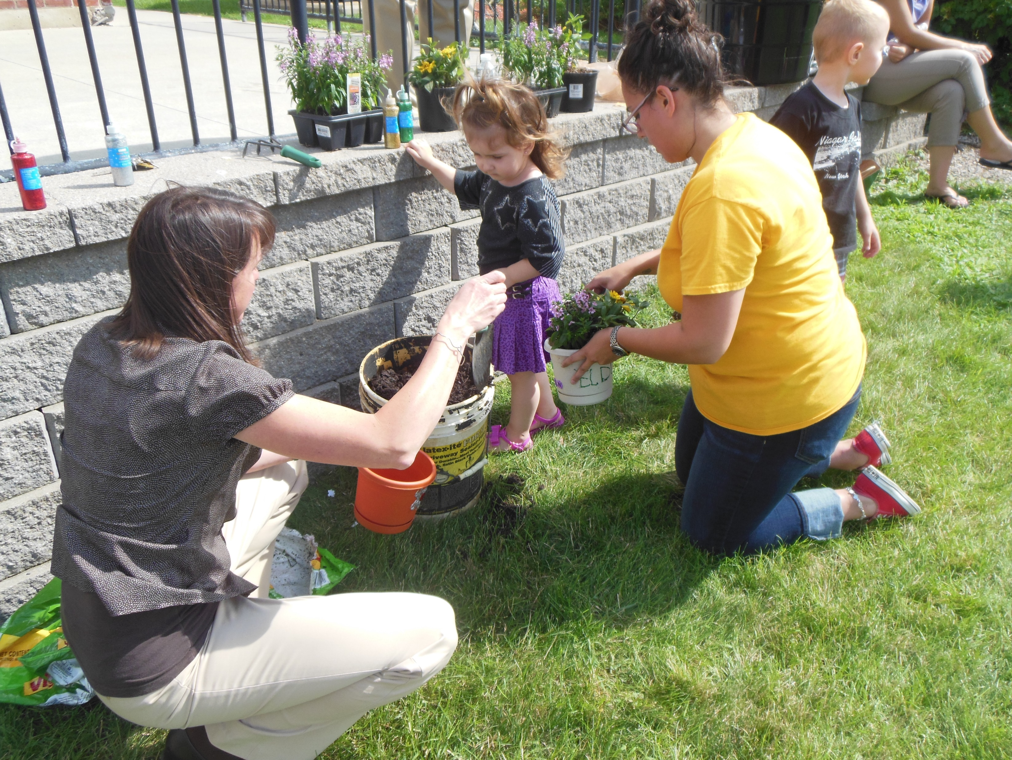

A Community Based Movement, Committed to:
Bringing Manchester together to create a shared VISION of what our public schools can be
Creating an innovative, comprehensive strategic PLAN to guide us to our Vision
Ensuring that our Plan to enable all of our students to ACHIEVE greater success is fully realized

Slide 8
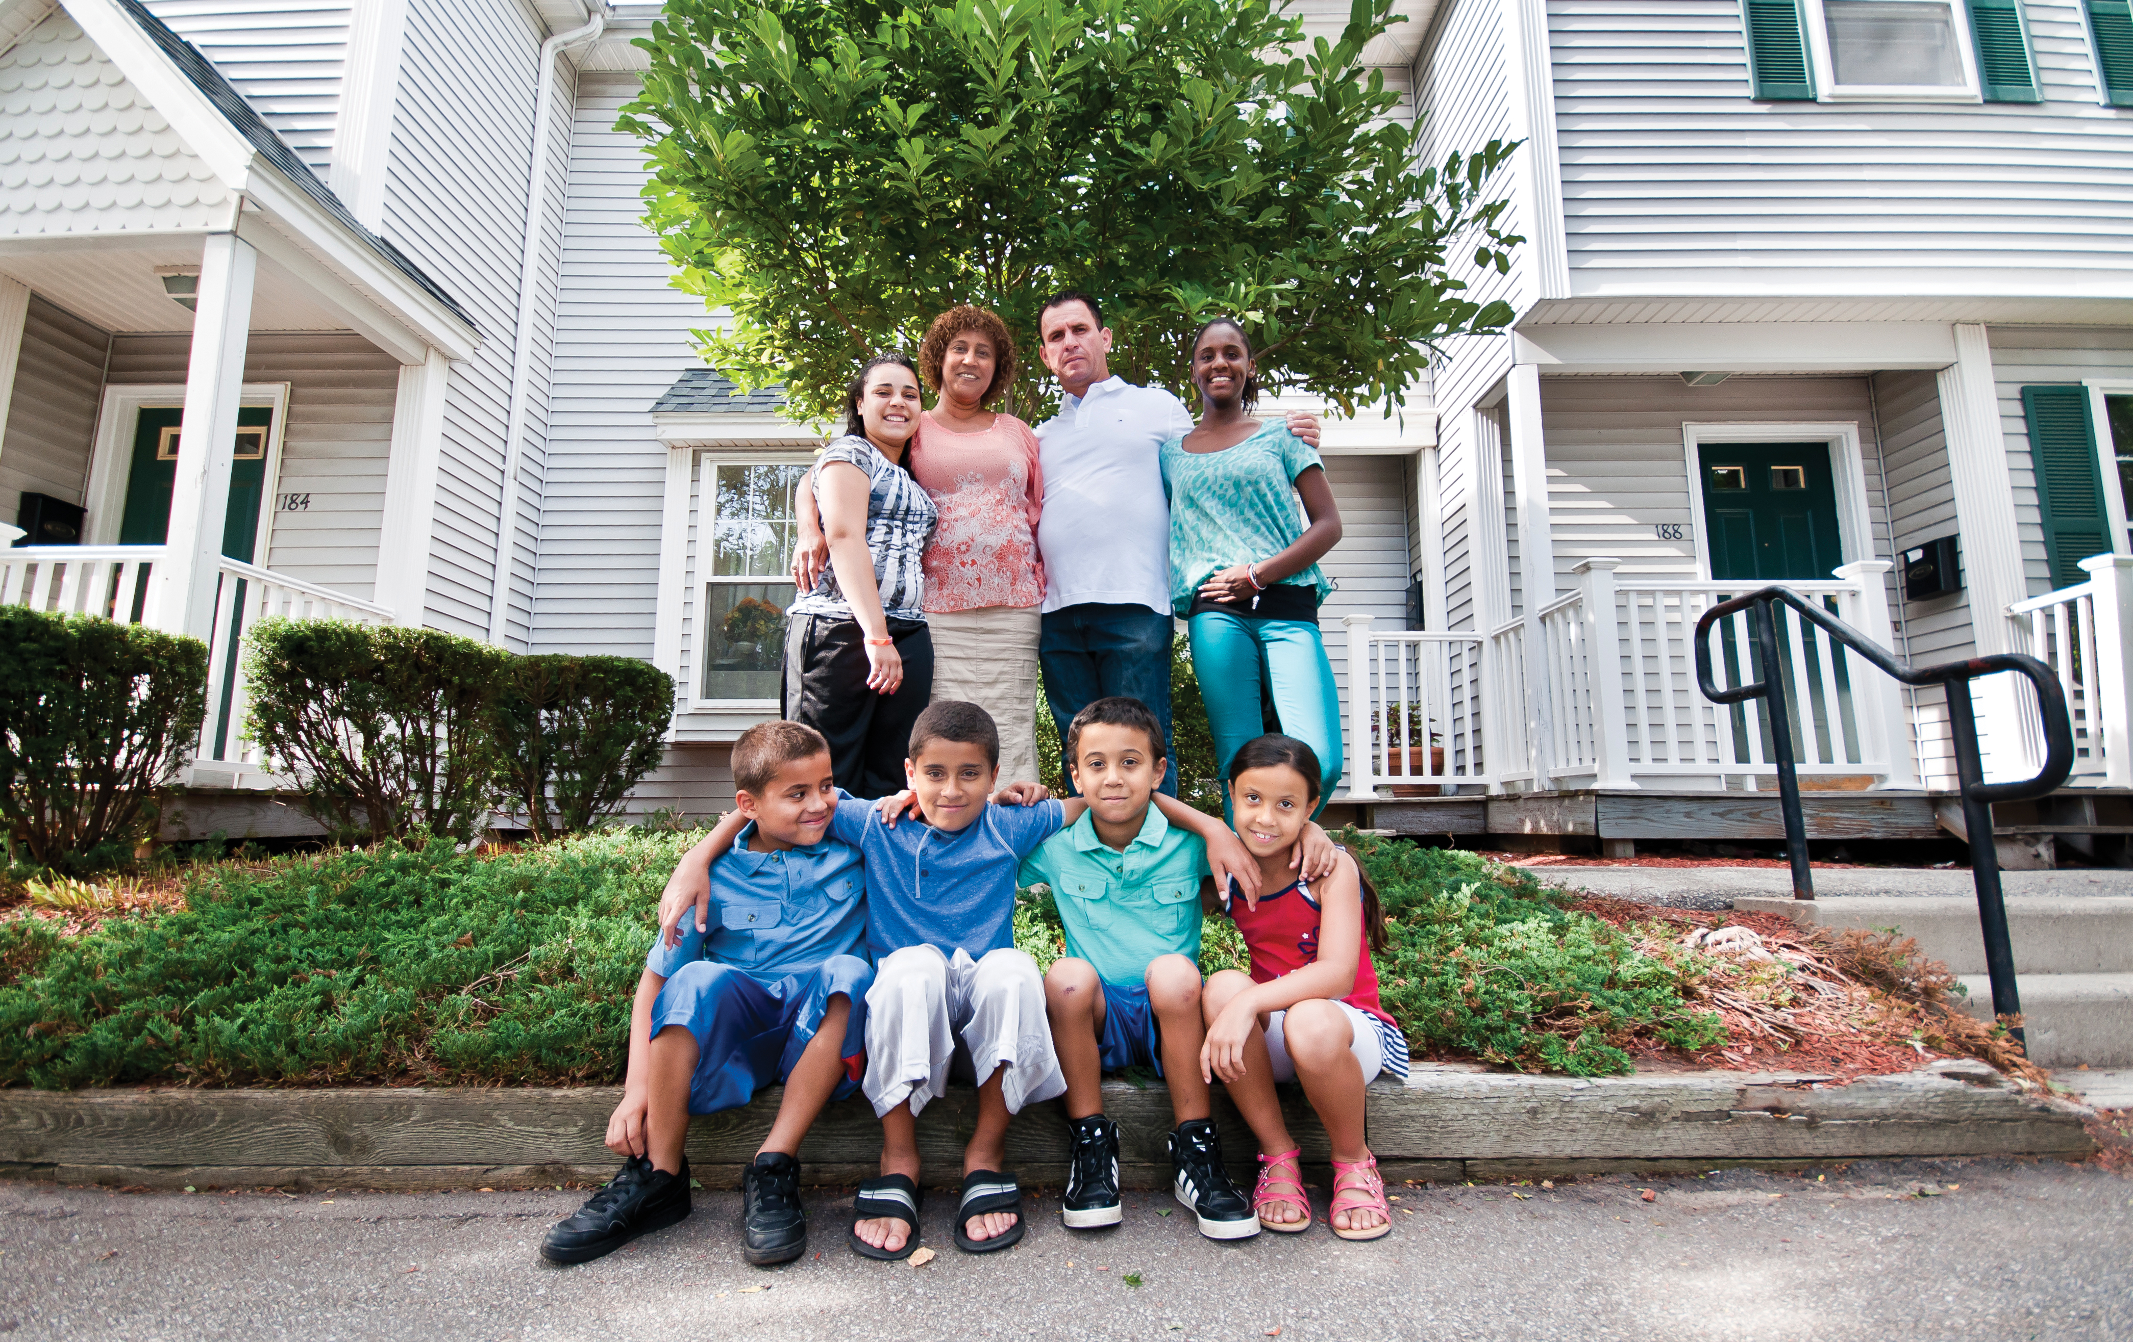
28% + 72% = Benefits for ALL of Manchester’s Residents:
Educational and career opportunities for our kids
Good jobs from companies that choose to grow in Manchester
Safer and more welcoming neighborhoods
Higher property values, enhanced by reputation of our schools
Celebration of our unique ethnic and cultural diversity
Promotion of productive and respectful civic engagement

Slide 9
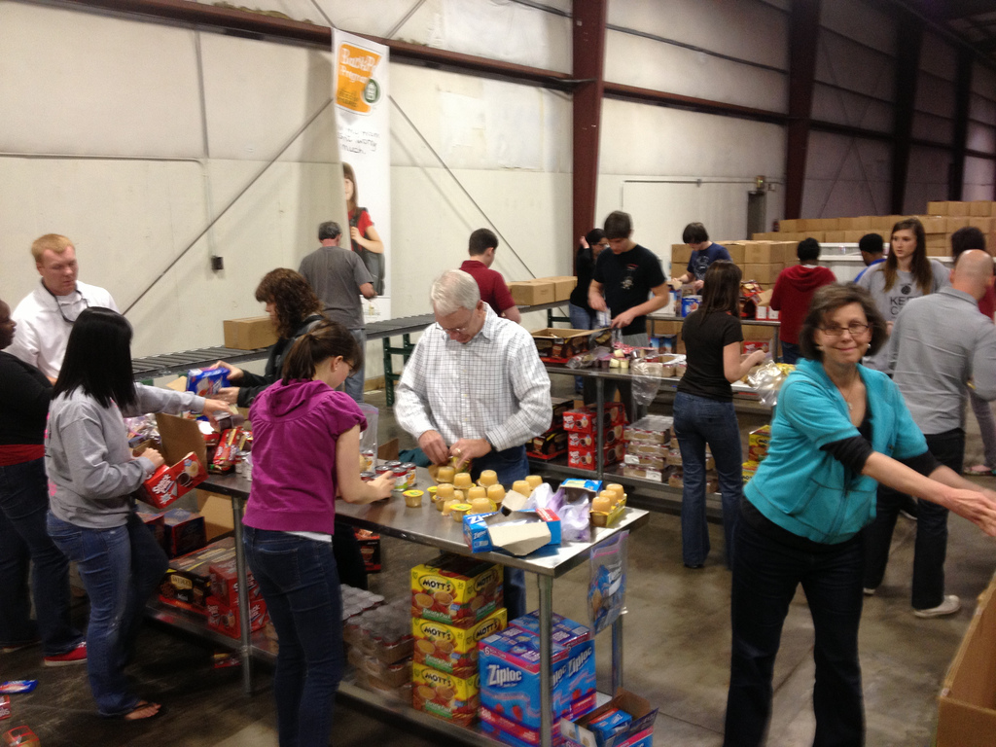
Early, enabling milestones:
Founders with credibility and passion
Superintendent of MSD, Dr. Bolgen Vargas, an active participant
Mayor Joyce Craig pledges her full support
Leadership of all five bargaining units endorse
Greater Manchester Chamber of Commerce Board unanimously endorses
Granite United Way steps-up as Fiscal Agent
100+ most notable businesses and non-profits sign-on as “Champions”

Slide 10
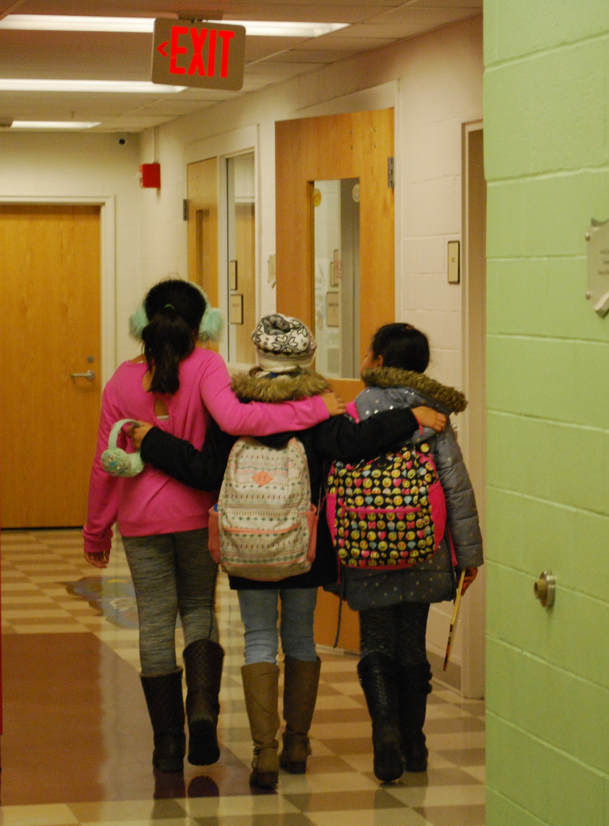
Our Proposal to Manchester’s School Board:
Manchester Proud will privately fund a comprehensive, innovative plan for the future of our public schools.
Essential Elements:
Visioning – Common values and aspirations for what our schools can be
Community Engagement – Plan by and for the residents of Manchester
Definitive Goals – Clearly defined, measurable initiatives, with accountability
Leveraging Existing Resources – Strategically link community assets with our schools
Equitable, inclusive, achievable, and inspiring – For the good of ALL

Slide 11
$600,000
Project Management
Community Engagement
Planning
Communications

Slide 12
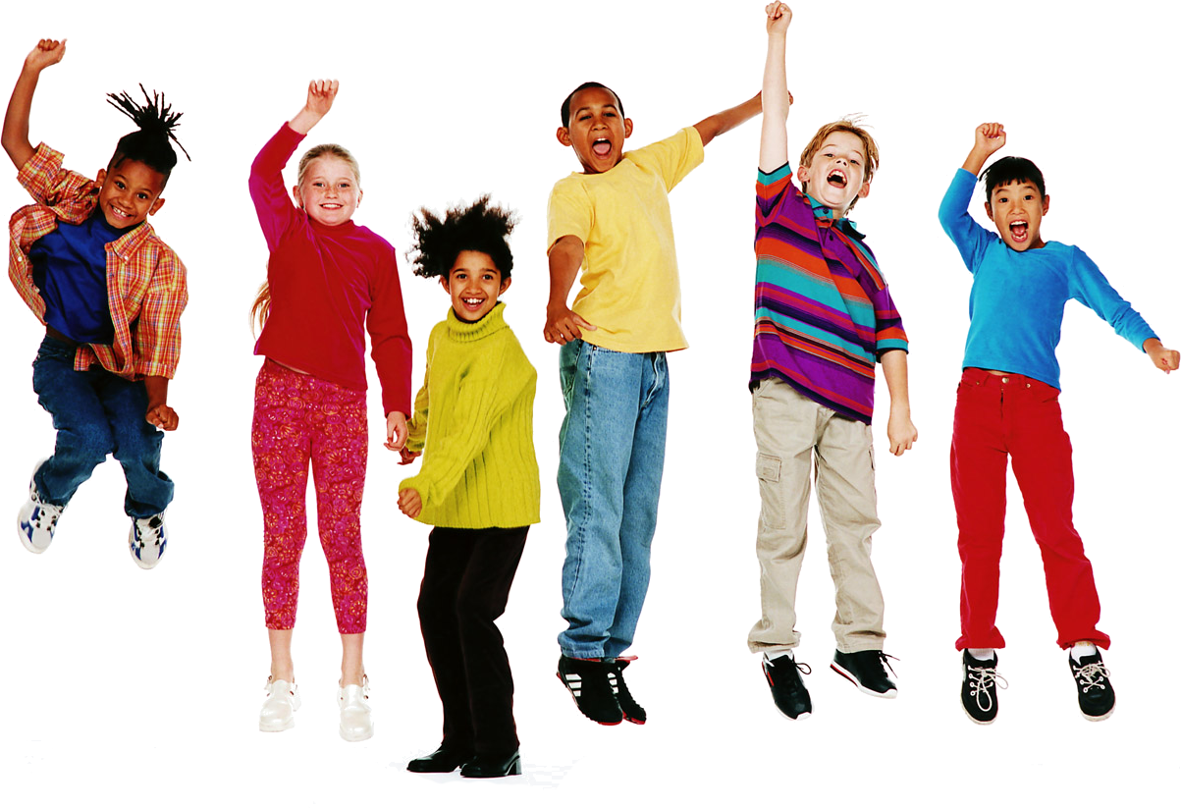
On May 14th, 2018
Manchester Board of School Committee
Unanimous vote of endorsement – with standing ovation!

Slide 13
The Spirit of a Community Movement:
Champions
Champions Council
Consultant Selection
Work Group
Community Celebrations
Fundraising
Resource Mapping
Communications
Work Group
Work Group
Work Group
Work Group

Slide 14
What’s Happening?
120
1000
1
7
450,000
788
60
22

Slide 15
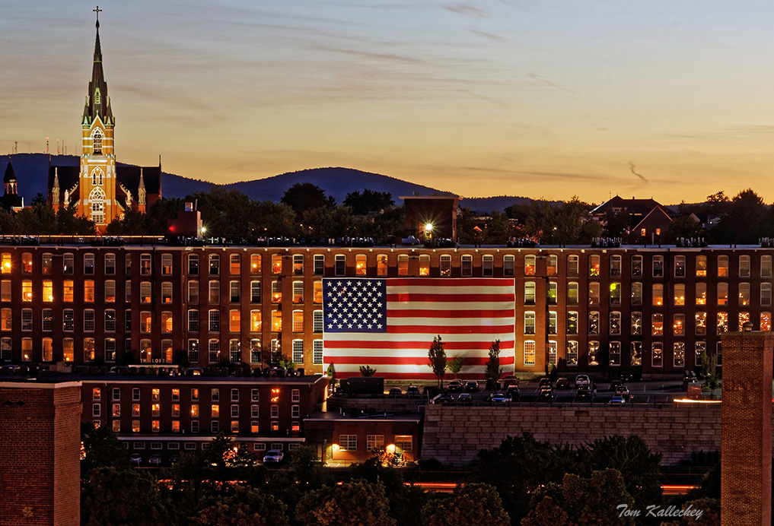
What have we learned so far?
Nationally recognized innovations – by creative and hard-working teachers/administrators
Daily challenges are profound – and can only be met with community support
Our business community is motivated by deep concerns about workforce
Manchester will be a winner – IF we become known as:
The City with great schools – Where families want to raise their kids!

Slide 16


www.ManchesterProud.org

