Slide 1
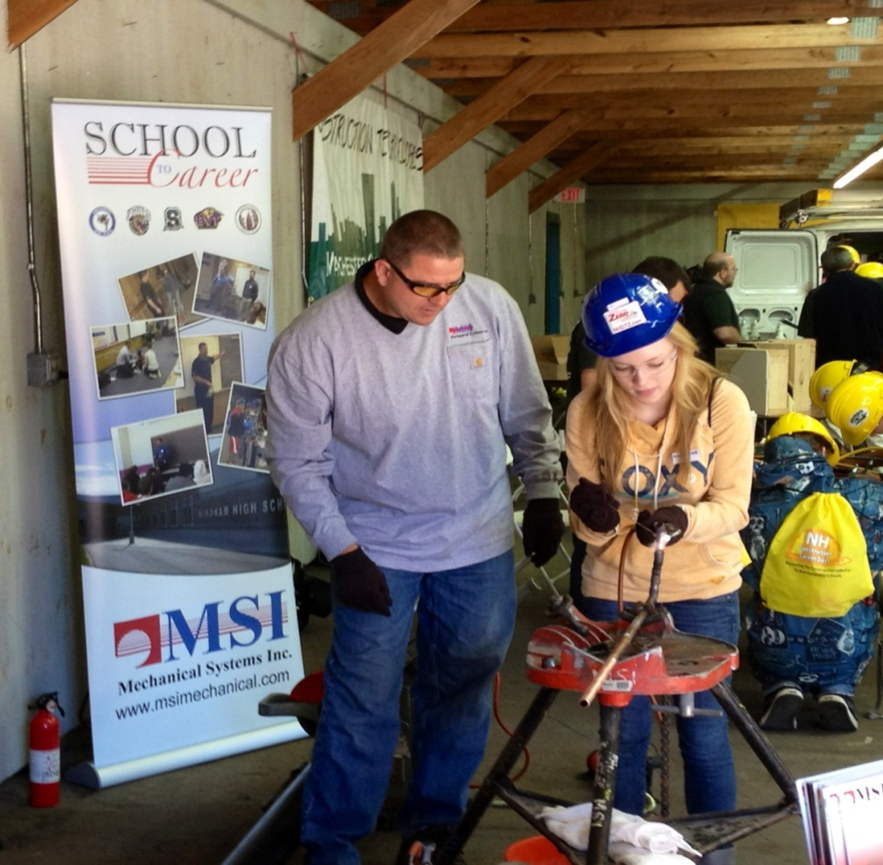

Presentation to
New Hampshire Coalition
for Business and Education

Slide 2

A Career in Construction
Since 2006 the Construction Industry has lost more than 2 million jobs. Partially due to the economy, but mostly from aging workforce.
The construction industry employs more than 7.7million people in the United States.
Average age of retirees is 55 years old

Slide 3
A Career in Construction
HVAC by example: The U.S. Department of Labor has predicted that the market will grow 34% or 90,000 jobs between now and 2020.
It’s just not the Construction Industry that is experiencing a workforce shortage…
Manufacturing - 82% of U.S manufacturers cannot find a sufficient number of qualified workers for the 600,000 open jobs.

Slide 4
A Career in Construction
Why is there a shortage?
There is a strong emphasis on 4-year degrees versus attending a Technical School
Lack in Career Technical Education
Baby Boomers retiring

Slide 5










A Career in Construction
2/3 of undergraduate students leave school with $26,600
in debt.
With $600 billion worth of new projects each year, construction makes up about
10%
of America’s Gross Domestic Product.
IT’S ONE OF THE COUNTRY’S LARGEST INDUSTRIES
Annual Salaries by Craft
The top 10% of plumbers and pipefitters earned more than $79,000 in 2012 [BLS].
$48,756
$53,294
$45,540
$54,737
Carpenter
Electrician
HVAC Technician
Pipefitter
$51,830
$46,721
$56,904
$60,234
Plumber
Sheet Metal Worker
Welder
Instrumentation Technician

Slide 6
A Career in Construction
Year to Date Performance: 2013, 2014, and ABC’s 2015 Forecast Non-Residential
Indicator | 2013 | 2014 | 2015 | % Change 2014-2015
Construction Spending | Millions seasonally adjusted Annual Rate Source: | Source: U.S. Census Bureau
Lodging | $13,585 | $16,180 | $18,963 | 17.2%
Office | $37,620 | $44,489 | $51,474 | 15.7%
Commercial | $50,992 | $55,920 | $61,568 | 10.1%
Health Care | $41,484 | $38,681 | $39,532 | 2.2%
Educational | $77,996 | $77,197 | $76,965 | -0.3%
Power | $90,639 | $109,605 | $134,705 | 22.9%
Manufacturing | $47,945 | $53,234 | $60,101 | 12.9%
Total All Industries | $568,561 | $606,102 | $650,954 | 7.4%

Slide 7
Employment Change
Percentage of projected employment change, by selected construction occupation. Wage and Salary Employees 2004-2014

Slide 8
A Career in Construction
What can we do?
Change the image of skilled careers in the mechanical trade both with parents and with secondary education institutions.
Educational community needs to embrace the construction industry as a career and promote it (guidance counselors).
Offer Cooperative Programs in High Schools and at the College Level.
There are 87 high schools in NH and only 27 have the
Career Technical Education programs.

Slide 9
A Career in Construction
What are we doing?
New Hampshire Construction Career Days. More than 5,000 high school students have participated since the program started in 2009.
Developing Young Professional Group within Associated Builders and Contractors (ABC NH/VT) Chapter.
MSI Mechanical Systems Inc. specifically is offering School-to-Career Program in Massachusetts.
Why not in NH? We need more CTE Programs in NH Schools.

Slide 10
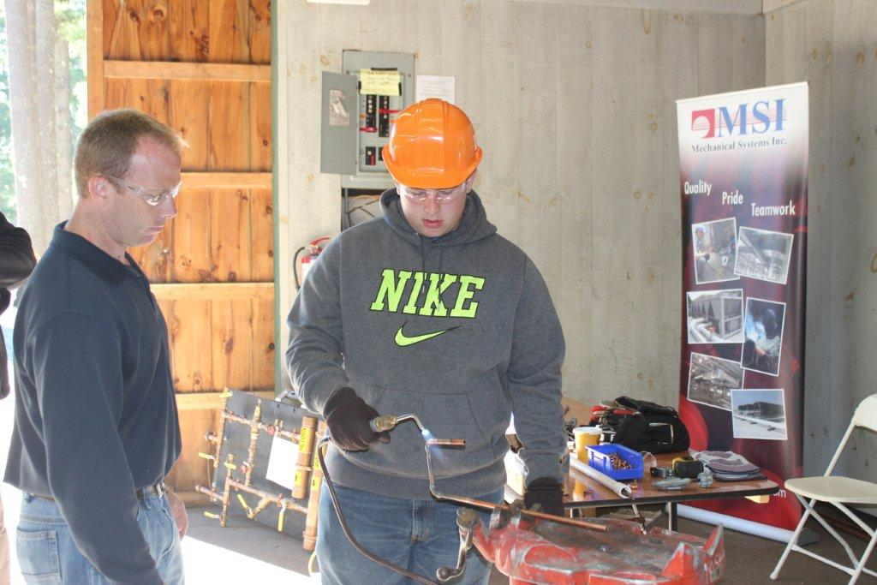
School to Career

