Slide 1
Education Funding and Policy in NH New Hampshire Center for Public Policy Studies
Board of Directors
Eric Herr, Chair
David Alukonis
John Garvey
Katherine M. Hanna
John Herney
David Hess
Donnalee Lozeau
Dianne Mercier
Catherine A. Provencher
James Putnam
Todd I. Selig
Michael Whitney
Directors Emeritus
William H. Dunlap
Sheila T. Francoeur
Donna Sytek
Brian F. Walsh
“…to raise new ideas and improve policy debates through quality information and analysis on issues shaping New Hampshire’s future.”
Notes:
For those of you who don’t know who we are. The Center is a non-partisan “think tank” that looks at New Hampshire specific issues.
Hope you
walk away curiouser
with a better understanding of ‘the Seacoast’
Having an understanding of the Seacoast as compared to the rest of the state
Grounded in the major policy issues you will be asked to take a leadership role on in the future
Justice, Education, Arts and Culture, Economic Development, Environment, Government
Oh yeah, did I say ‘More Curiouser?’
Supported by half sponsored research and half private donations.
We strive for private donor support to remain unrestricted in the subject matter we study and to retain complete editorial independence.
Especially on issues that can be controversial - like the recent work we’ve done on the State Budget.

Slide 2
Claremont II Decision:
1997
The education decision → “The responsibility for ensuring the provision of an adequate public education and an adequate level of resources for all students in New Hampshire lies with the State.”
The tax decision → “To the extent that the property tax is used in the future to fund the provision of an adequate education, the tax must be administered in a manner that is equal in valuation and uniform in rate throughout the State.”
General goals of reducing variability in tax rates and per pupil expenditures
Notes:
In 1997 the New Hampshire Supreme Court issued it’s second decision in the Claremont case.
That decision consists of the Court’s answers to two separate questions. The situation that the State has now found itself in, would not occur if either decision had gone the other way.
The State’s responsibility, and therefore the necessity of a uniform property tax rate is dependent on the definition of “adequate education.” Anything schooling that is above and beyond “adequate” is, under this ruling, not a constitutionally mandated requirement of the State and, therefore, need not be funded with a rate that is uniform among the towns and school districts.
Thus, a critical question is “What constitutes an ‘adequate’ education?” The Court specifically charged the legislature with developing such a definition but has indicated that it will monitor the action in this regard.

Slide 3
Creating a benchmark
2006 NH Supreme Court case determined that “adequate education” was never sufficiently defined by Legislature.
New definition is for “opportunity” for an adequate education
“Inputs” – course offerings, staffing, funding, etc.

Slide 4
Notes:
Used the input criteria of the Minimum Standards to create a “Universal Cost”
However, not every standard is included in the definition of adequacy or in the cost
Nurses, teachers aides, central administration NOT included
Custodial services, maintenance, and transportation included
Which really are essential?
Student-Teacher ratios were based on NH’s approval standards (ED 306)
Instructional staff salaries based on state average for BA level with 3-years experience
Administrative staff based on average of bottom quartile of salaries.
Formula also provides for technology, professional development, facilities operations, and transportation.
Formula does NOT provide for school nurses, district administration, teacher aids, or food services

Slide 5
The development of Stabilization Aid
HB337 (2011 session): Legislature changes state education aid.
Eliminated Fiscal Capacity Disparity Aid
Graduated to Flat Free and Reduced Lunch
Stabilization Aid created via HB 337 → Af a city/town was to receive less $ in FY12, the state made up the difference through a new funding vehicle (stabilization grants).
HB337: FY13 and every fiscal year thereafter, the dollar amount of a municipality’s stabilization grant to remain unchanged.
This provision was amended in the 2015 session (HB2). Starting in FY17, reduced by 4% of original amount. Gradual phase out over 25 years (FY41).

Slide 6
Current Status
Along with advocating for the reversal of cuts, many of the communities that have united believe the whole system of funding public education is broken and must be revisited.
HB356 (establishing a committee to study education funding and the cost of an opportunity for an adequate education)
Budget includes $125,000 for Franklin.
HB525: House Education has “retained”, meaning no vote this year

Slide 7
Demographics are changing with declines in students
73 high schools
100 SAUs
160+ school districts

Slide 8
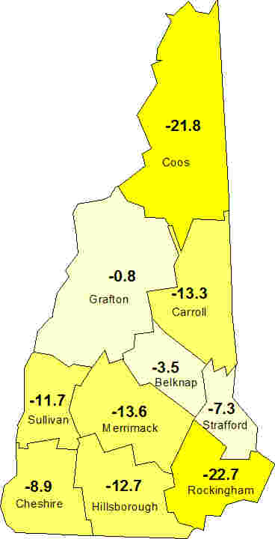
Decline in 5-19 year-old population, 13% statewide (2010-2025)

Slide 9
Adequacy: Population projections anticipate further reductions -> Less $

Slide 10
Simulating the impact - a fuller picture of education funding changes
Adjusted for inflation, every other year
using an inflation factor excluding healthcare
Per Pupil
Universal Cost
Differentiated
Aid
Stabilization Aid
Economically disadvantaged
$1,750 per low-income student
English language learners
$685 per student
Special education students
$1,882 per student
Poor performers
$685 for each 3rd grader who tests below grade level in reading
Decline at
4% Per Year

Slide 11
Projecting Total State Aid

Slide 12
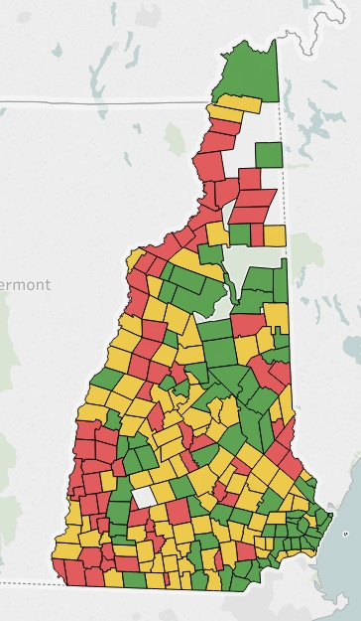
Potential Impact of Stabilization Grant Changes
Stabilization Accounts for 10% or more
Stabilization Accounts for 0 – 10%
No Impact
Headed for a rural education crisis

Slide 13
Winners and Losers

Slide 14
Net reduction in state resources devoted to K-12 financing

Slide 15
Characteristics of ‘Winners’ versus Losers

Slide 16
New Catalyst for Litigation? Communities coalesce to stave off “unconstitutional” cuts to state education funding
Berlin, Charlestown, Claremont, Derry, Franklin, Northfield, Pittsfield
Their ask: To rescind the gradual elimination of “stabilization grants”, a component of state aid for K-12 education ($151 million in FY17)
Why? Loss of dollars = “horrific consequences”
Media coverage: NHPR, Concord Monitor, Eagle Times
HB525: House Education has “retained”, meaning no vote this year

Slide 17
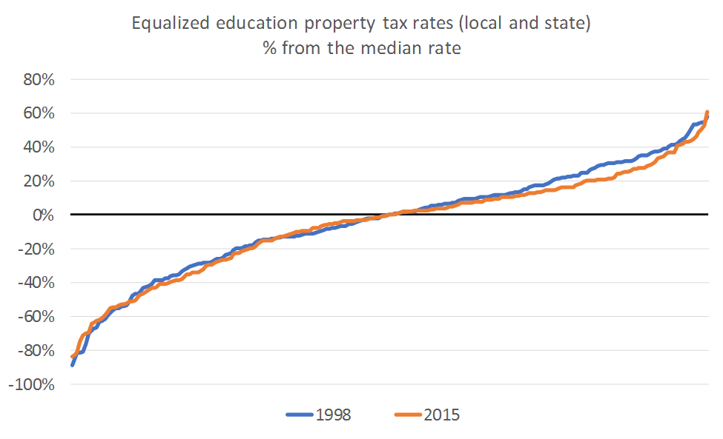
Impact on Primary Goals of Claremont Case? No Impact on Tax Equity

Slide 18
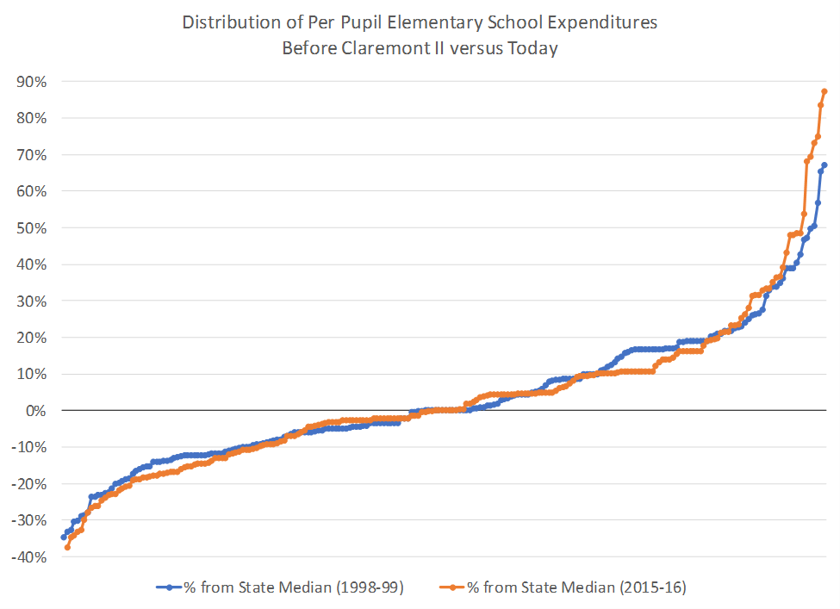
No Impact on Expenditure Equity

Slide 19
New Hampshire Center for Public Policy Studies
Board of Directors
Eric Herr, Chair
David Alukonis
John Garvey
Katherine M. Hanna
John Herney
David Hess
Donnalee Lozeau
Dianne Mercier
Catherine A. Provencher
James Putnam
Todd I. Selig
Michael Whitney
Directors Emeritus
William H. Dunlap
Sheila T. Francoeur
Donna Sytek
Brian F. Walsh
Want to learn more?
• Online: nhpolicy.org
• Facebook: facebook.com/nhpolicy
• Twitter: @nhpublicpolicy
• Our blog: policyblognh.org
• (603) 226-2500
“…to raise new ideas and improve policy debates through quality information and analysis on issues shaping New Hampshire’s future.”

