Slide 1

COMPUTER SCIENCE
FOR
NEW HAMPSHIRE

Slide 2
WHY CS for NH?
Computers and software have changed our society and workplace
Technology affects every field - computational thinking & skills are foundational for all jobs
  Nearly every business or industry is looking for employees with these skills
  Computing jobs are now the #1 source of new wages in US
  Computer occupations make up 45% of STEM employment
  Computer occupations are open to a broad range of the workforce – from user support specialists to statisticians and big data analysts

Slide 3
WHY CS for NH?
The projected demand in NH is strong
Occupation | 2016 Jobs | 2021 Jobs | Change | % Change
Computer and Information Systems Managers (11-3021) | 1,897 | 2,078 | 181 | 10%
Computer and Information Research Scientists (15-1111) | 184 | 204 | 20 | 11%
Computer Systems Analysts (15-1121) | 2,263 | 2,606 | 343 | 15%
Information Security Analysts (15-1122) | 357 | 410 | 53 | 15%
Computer Programmers (15-1131) | 1,902 | 1,895 | -7 | 0%
Software Developers, Applications (15-1132) | 4,849 | 5,416 | 567 | 12%
Software Developers, Systems Software (15-1133) | 1,553 | 1,725 | 172 | 11%
Web Developers (15-1134) | 683 | 785 | 102 | 15%
Database Administrators (15-1141) | 486 | 532 | 46 | 9%
Network and Computer Systems Administrators (15-1142) | 1,936 | 2,076 | 140 | 7%
Computer Network Architects (15-1143) | 472 | 525 | 53 | 11%
Computer User Support Specialists (15-1151) | 2,754 | 2,994 | 240 | 9%
Computer Network Support Specialists (15-1152) | 623 | 680 | 57 | 9%
Computer Occupations, All Other (15-1199) | 820 | 882 | 62 | 8%
NAICS data, NHDED

Slide 4
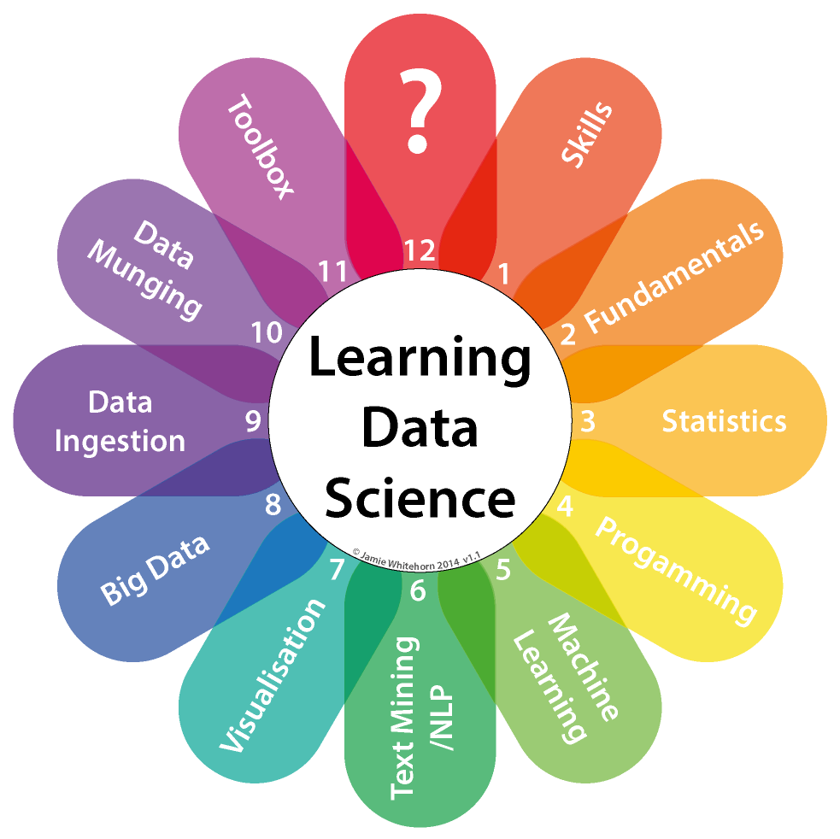
WHAT is CS?
CS is more than digital literacy (word processing) or coding
CS is helpful for all kids, no matter their age, race or gender
K-12 computer science includes five core concept areas:
  Computing systems
  Networks and the internet
  Data and analysis
  Algorithms and programming
  Impacts of computing

Slide 5

WHAT IS CS4NH?
CS4NH is a working group that includes business/industry, nonprofits and K-12/higher education who are working collaboratively to bring computer science to all New Hampshire K-12 students
CS4NH is connecting with entities
that have expertise in bringing CS
into the classroom, including the
national initiative CSforALL
We are looking to develop a model
that is uniquely New Hampshire

Slide 6
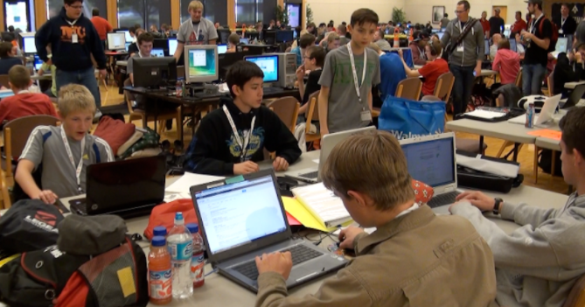
WHAT Are CS4NH Goals?
Develop a shared statewide plan to:
Ensure that all NH students can acquire solid computational skills before they graduate from high school and
Ensure that all NH students have access to and can participate in quality K-12 computer science
educational opportunities

Slide 7
WHAT is being DONE?
What is being done:
Developing CS certification standards
Developing Ed. Prep and professional development offerings aligned with those standards
Supporting districts, schools in CS curriculum planning
What will be done:
Adopt K-12 CS academic standards
Recommend changes to school approval standards and graduation requirements to encourage broader participation in CS

Slide 8
How Can You Help?
Support CS4NH Goals:
  Ensure that all NH students have access to and can participate in high-quality CS educational opportunities and acquire good computational skills before they graduate from high school
  Recognize that providing coursework in these areas will greatly benefit today’s students
Grow CS4NH Coalition:
  Establish a shared vision and a statewide agenda
Participate in CS4NH Outreach:
  Statewide perspective is important – recognize that an effort is gaining momentum, a plan is being developed and it will be shared with school districts and school boards across NH for input

Slide 9
How Can You Help?
To learn more or get on our e-mail list, contact:
Dave Benedetto, STEM Integration and Computer Science Admin, NH Department of Education
David.Benedetto@doe.nh.gov
Matt Cookson, Executive Director, NH High Tech Council
Matt@cooksonstrategies.com

