Slide 1





Progress Report • April 25, 2019

Slide 2

Assessment in NH classrooms
87% engagement
100% content acquisition
85% of teachers said they would use SFTS again in their classrooms
2. Partnership with American U
Notes:
Teachers reported ‘Lack of Time’ as 2nd largest barricade for teaching STEM in the classroom (SFTS 2018 Assessment Survey).
Teachers reported ‘Lack of Resources’ as #1 largest barricade for teaching STEM in the classroom (SFTS 2018 Assessment Survey).
Michael K. Daugherty, Journal of STEM Teacher Education, Volume 49, March 2014, page 49, Elementary STEM Education: The Future for Technology and Engineering Education? "...by the time students reach fourth grade, a third of boys and girls have lost an interest in science."
Science Teachers' Learning: Enhancing Opportunities, Page 69, National Academies Press, 2015 : "Schools in the highest quartile of student poverty are 30 percent more likely than schools in the lowest poverty quartile to have a teacher without a science."
** Standardized testing largely emphasizes Reading + Basic Math
** Nearly 75% of early elementary educators feel ill-equipped to teach science effectively, and with confidence.

Slide 3

3. BioFabUSA Initiative
Objective: Raise student awareness of bioengineering/regenerative medicine
Sponsored by US Department of Defense
Partners:
ARMI (Advanced Regenerative
Manufacturing Institute)
UNH Leitzel Center
NH Science Teachers Assoc.
4H Clubs of NH
Notes:
Teachers reported ‘Lack of Time’ as 2nd largest barricade for teaching STEM in the classroom (SFTS 2018 Assessment Survey).
Teachers reported ‘Lack of Resources’ as #1 largest barricade for teaching STEM in the classroom (SFTS 2018 Assessment Survey).
Michael K. Daugherty, Journal of STEM Teacher Education, Volume 49, March 2014, page 49, Elementary STEM Education: The Future for Technology and Engineering Education? "...by the time students reach fourth grade, a third of boys and girls have lost an interest in science."
Science Teachers' Learning: Enhancing Opportunities, Page 69, National Academies Press, 2015 : "Schools in the highest quartile of student poverty are 30 percent more likely than schools in the lowest poverty quartile to have a teacher without a science."
** Standardized testing largely emphasizes Reading + Basic Math
** Nearly 75% of early elementary educators feel ill-equipped to teach science effectively, and with confidence.

Slide 4
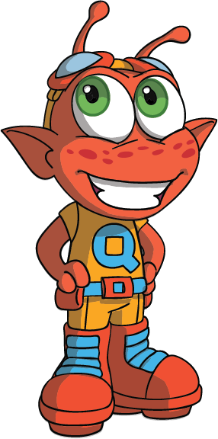
Project 1: Produce a STEM From The Start teaching module for K-2 students
$25,000 budget; DoD is covering half
Seeking $12,500 in matching funds
Project 2: Produce 8 videos that illustrate practices of biogen scientists, engineers
$16,000 budget; DoD is covering half
Seeking $8,000 in matching funds
Notes:
Teachers reported ‘Lack of Time’ as 2nd largest barricade for teaching STEM in the classroom (SFTS 2018 Assessment Survey).
Teachers reported ‘Lack of Resources’ as #1 largest barricade for teaching STEM in the classroom (SFTS 2018 Assessment Survey).
Michael K. Daugherty, Journal of STEM Teacher Education, Volume 49, March 2014, page 49, Elementary STEM Education: The Future for Technology and Engineering Education? "...by the time students reach fourth grade, a third of boys and girls have lost an interest in science."
Science Teachers' Learning: Enhancing Opportunities, Page 69, National Academies Press, 2015 : "Schools in the highest quartile of student poverty are 30 percent more likely than schools in the lowest poverty quartile to have a teacher without a science."
** Standardized testing largely emphasizes Reading + Basic Math
** Nearly 75% of early elementary educators feel ill-equipped to teach science effectively, and with confidence.

