Slide 1
Advanced Placement (AP) Program Opportunities for New Hampshire
Arthur Doyle
The College Board

Slide 2
AP Opportunities for New Hampshire
Based on the proven fact that many young people can complete some college-level studies while in secondary school, AP represents a desire of colleges and schools to foster such challenging educational experiences.
AP accomplishes this by providing a faculty developed curriculum, teacher professional development, and college-level examinations. Colleges and universities, in turn, grant credit and appropriate advanced course placement, or one of these, to students who have performed well on AP examinations.

Slide 3
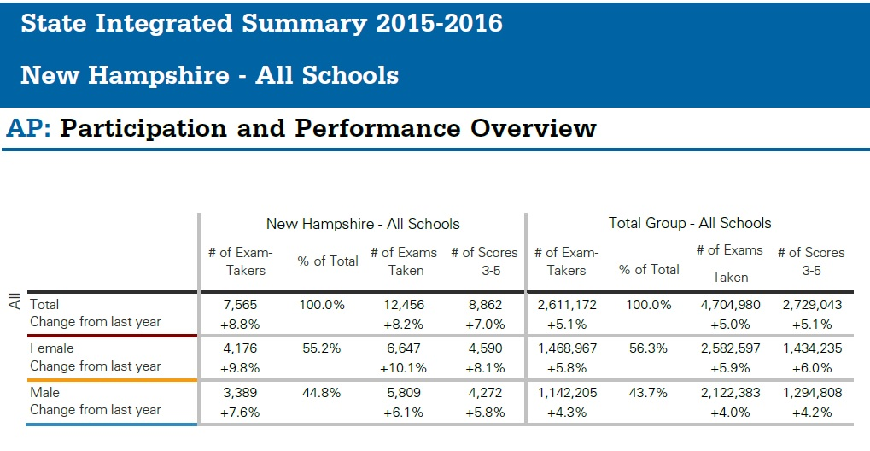
AP Opportunities for New Hampshire

Slide 4
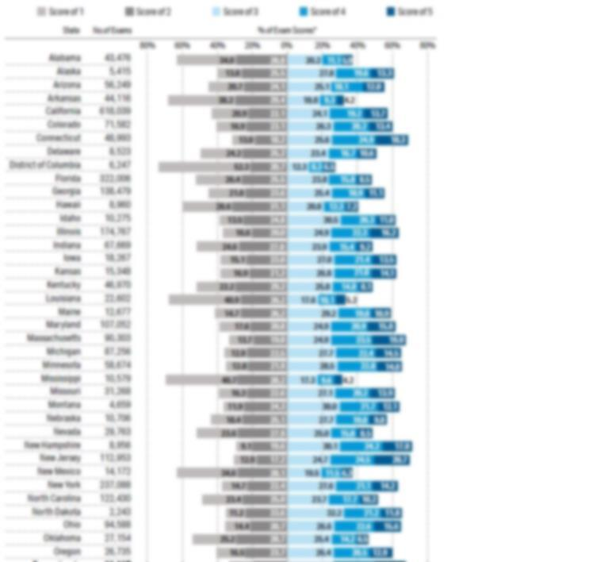
2016 AP DATA COHORT REPORT

Slide 5
4,719 NH high school graduates took an AP exam in their senior year in May 2016. What percent of them did NOT send their AP report to any college or university?

Slide 6
Measuring a NH AP Score reporting Gap and Opportunity
40% or 1,883 of the 4,719 New Hampshire 2016 high school graduates who took an AP examination in their senior year did not send their AP report to any college or university.
This represents a 4% increase over 2013.
Of the 11,982 AP examinations taken by those 4,719 New Hampshire high school seniors the results of 3,725 exams or 31% of the examinations taken by those seniors were not sent to any college or university.

Slide 7
Measuring a NH AP Score reporting Gap and Opportunity
Of the 3,725 AP exams taken by the 1,883 non-report sending seniors:
54% or 2,017 of the exams had a passing AP grade
(score of 3, 4, or 5).
Of the 2,017 exam grades of 3, 4, or 5 not sent to a college or university:
Over 19% or 390 of those exams had earned the highest AP exam grade (score of 5).

Slide 8
Measuring a NH AP Score reporting Gap and Opportunity
While a few states are similarly situated, NH remains the only state where the number of AP score reports not sent by the state’s 2016 high school senior year AP examination takers to any in-state higher education institution (2,036) is greater than the number of AP score reports not sent to any higher education institution (1,883).

Slide 9
Measuring a NH AP Score reporting Gap and Opportunity
77% of the 1,758 New Hampshire high school senior AP exam takers not sending AP scores to colleges in 2015 were matched for college enrollment via the National Student Clearinghouse.
Of the 1,359 matched New Hampshire students who did not send AP scores that year , 254 enrolled at public 4-yr in-state colleges, 228 at public 4-yr out-of-state colleges, 74 enrolled at private 4-yr in-state colleges, 687 at private 4-yr out-of-state colleges, and 88 enrolled at in-state public two-year colleges.

Slide 10
Measuring a NH AP Score reporting Gap and Opportunity
Of the 1,359 matched NH non-sending students in 2015:
18.7% enrolled at 4-year, public,
in- state institutions
16.8% enrolled at 4-year, public,
out-of-state institutions
6.4% enrolled at 2-year, public,
in-state institutions
5.4% enrolled at 4-year, private,
in-state institutions
50% enrolled at 4-year, private,
out-of-state institutions

Slide 11
Sample University AP Score Sending Statement
Submitting Your Scores
The easiest way to ensure that the U receives your AP scores is to name us as a recipient when you sign up for exam(s). You can use this procedure even if you take the exam as a junior in high school; the U will keep your scores until your senior year. If you do not name the U as a recipient when you take your exam, just contact the College Board and request that scores be sent to the U Office of Admissions.

Slide 12
Thank You.
Contacts:
Arthur J. Doyle Peter-Greg Sison
Higher Education Engagement Educational Manager, Higher Education Services
The College Board The College Board
1601 Trapelo Road, Suite 12, Waltham, MA 02451 1601 Trapelo Road, Suite 12, Waltham, MA 02451
T 781-663-2711 M 617-892-0264 T 781-663-2735 M 781-506-6200
adoyle-nonemp@collegeboard.org psison@collegeboard.org

