Slide 1

Instagram: learn_at_vlacs
Twitter: VLACS
Facebook: VLACS
Our website: vlacs.org
Notes:
Everyone here is well aware of the predicament we face: Record low unemployment and a lack of qualified employees to sustain continued growth.

Slide 2
Students determine when, where, and how to learn based on their needs, interests, and talents

Slide 3



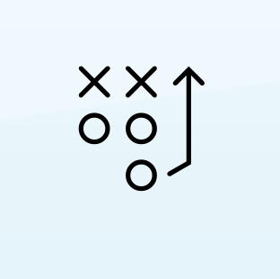

Learning Journeys
Courses
Projects
Experiences
Teams
College

Slide 4

Learning Journeys
Courses
Projects
Experiences
Teams
College
Career Connections

Slide 5
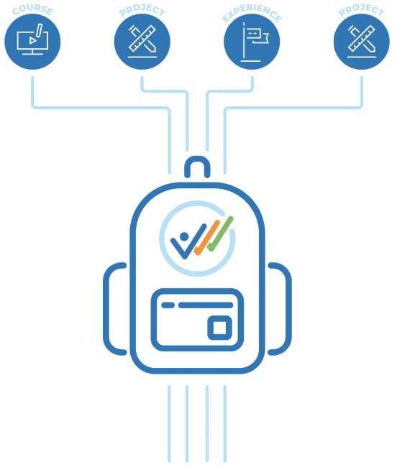
Learning Backpack
.5 Credit

Slide 6

Learning Journeys
Courses
Projects
Experiences
Badges
Teams
College
Fully customizable and competency-based
On-site or virtual
Options
Service learning
Entrepreneurship
Travel
Internships
Paid our unpaid work experience
Pre-apprenticeships
Apprenticeships

Slide 7
Learning Journeys
Courses
Projects
Experiences
Badges
Teams
College
Evidence-based
Stackable
Transferable
Controlled by users
Free, open-source, and accessible anyone
Source: https://badge.wiki/wiki/What_Are_Open_Badges%3F

Slide 8
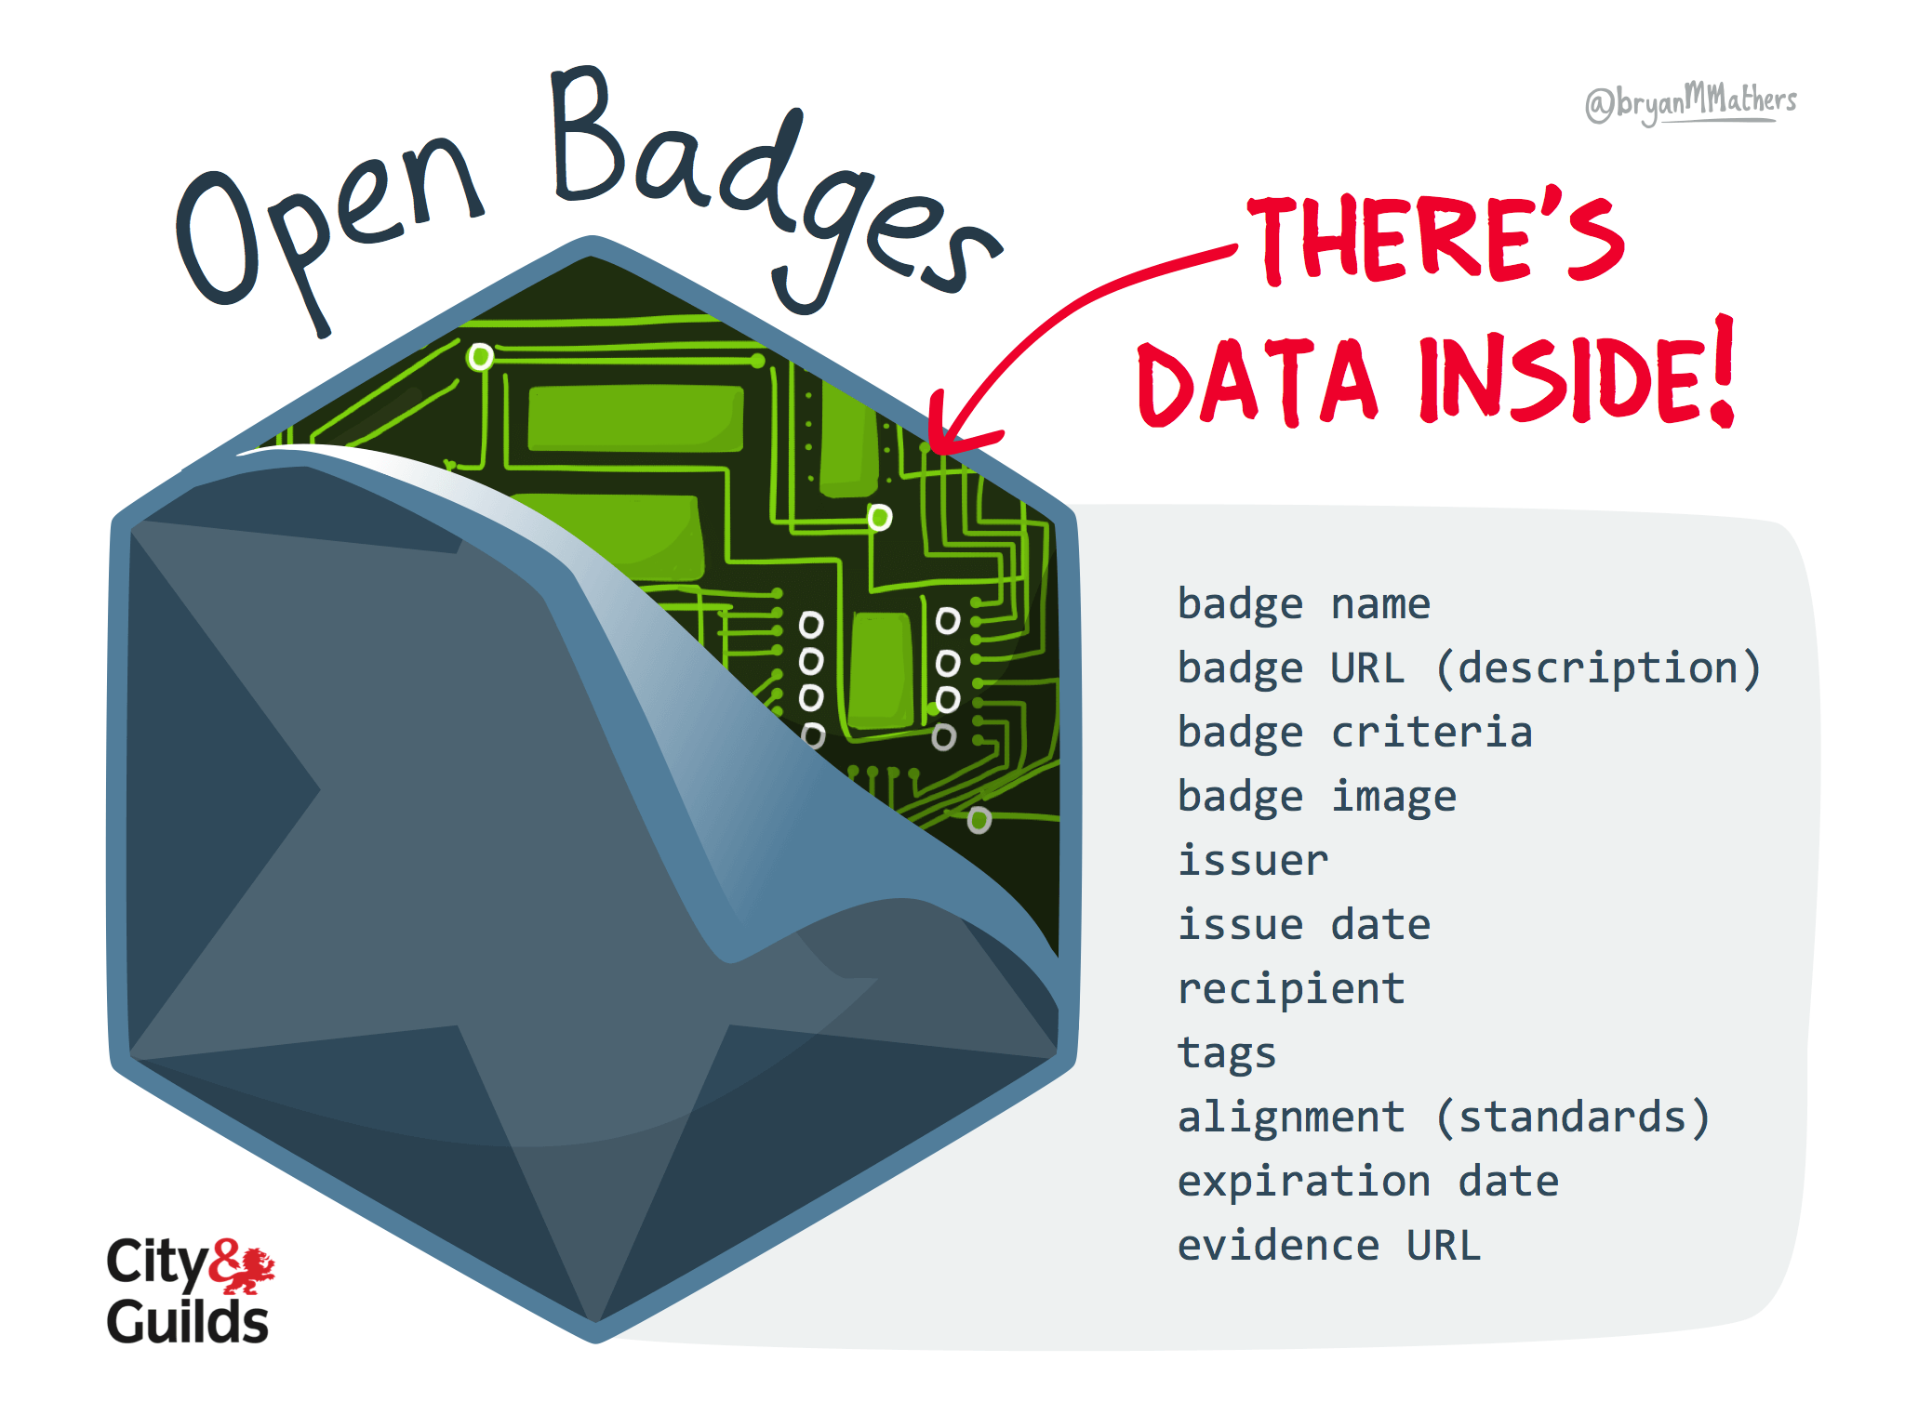
By @bryanMMathers, licensed under CC-BY-ND

Slide 9
BADGE CATEGORIES
See document #3
Health Science
Technology
Business
Tourism & Hospitality
Art
Science and Engineering
Future Focused Careers
Fitness
ACT WorkKeys
Notes:
134 badges in 9 categories, over 100 new courses/badges/competency groups

Slide 10
INDUSTRY CERTIFICATIONS
See document #4
Career readiness
Health Science
Technology
Business
Notes:
59 Industry certifications

Slide 12
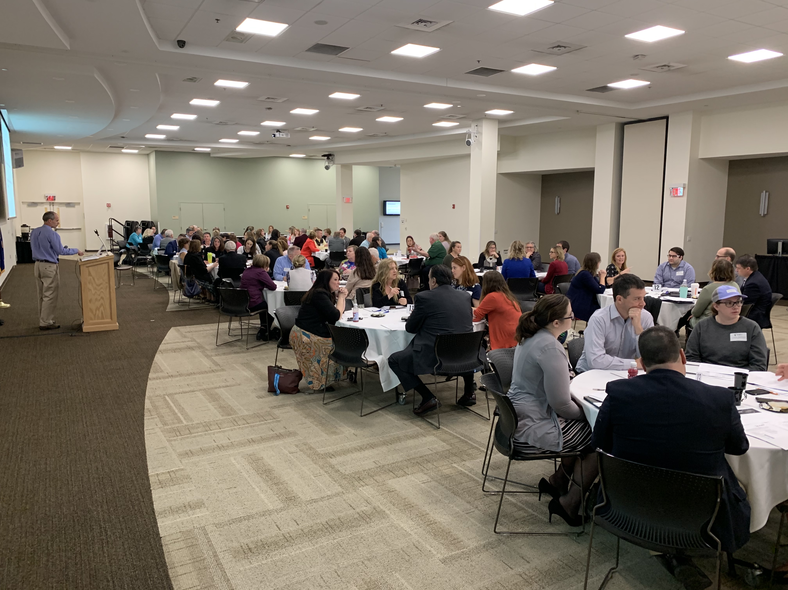

Slide 13
WORK-BASED LEARNING
Career exploration sessions via video
Job shadows
Career mentorship
Career related competitions
Informational interviews
Paid and unpaid internships
Projects
Service learning
Entrepreneurship
Paid or unpaid work experience
Volunteering
Pre-Apprenticeships
Apprenticeships
Notes:
59 Industry certifications

Slide 14
Instagram: learn_at_vlacs
Twitter: VLACS
Facebook: VLACS
Link to our website: vlacs.org
Notes:
Everyone here is well aware of the predicament we face: Record low unemployment and a lack of qualified employees to sustain continued growth.

