Slide 1
65x25 Work Group Recommendations
June 27, 2016

Slide 2
Objective
Share recommendations on the following for the Coalition’s consideration and approval:
  Definition of a high-quality postsecondary credential
  Target populations and number of credentials to get to 65x25
  Strategies to reach 65x25
  Structure to support and sustain statewide effort to reach 65x25

Slide 3

The Result & Goal Statements
New Hampshire’s citizens have the education necessary to meet their life goals, as well as the current and future economic needs of the state
65% of 25-64 year olds will have a high-quality postsecondary credential by 2025
Notes:
As a reminder, this is the result and goal statement the Coalition previously adopted.

Slide 4
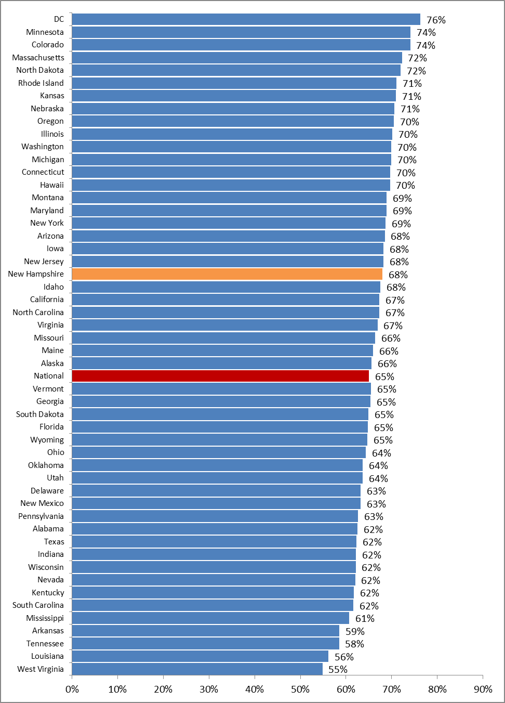
68% of NH jobs will require postsecondary education – compared to the national estimate of 65%
Notes:
Reminder of why we came to setting a goal of 65x25...

Slide 5
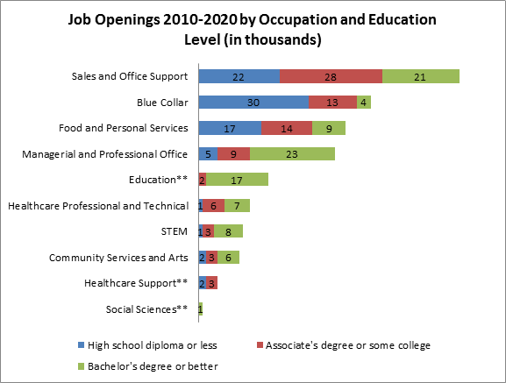
Notes:
Most of the job openings will require education beyond a high school diploma.
Most job openings in management and professional office, STEM, social sciences, education and healthcare professional and technical occupations will require postsecondary education. About three out of five workers in healthcare support jobs will need to have some college, an associate’s degree or better.
More than two-thirds of jobs in sales and office support occupations will require at least some college education. For example, about 44 percent of sales professionals in wholesale and manufacturing and 72 percent of sales agents in securities, commodities and financial services will have a bachelor’s degree or better.
Close to one out of three jobs in blue-collar occupations will also require postsecondary education or training.

Slide 6
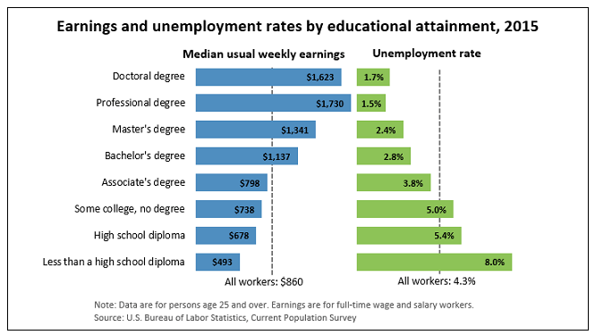
Notes:
These are national figures, but the same trends follow for each state. Higher level credentials generally result in higher wages and lower unemployment for individuals.

Slide 7
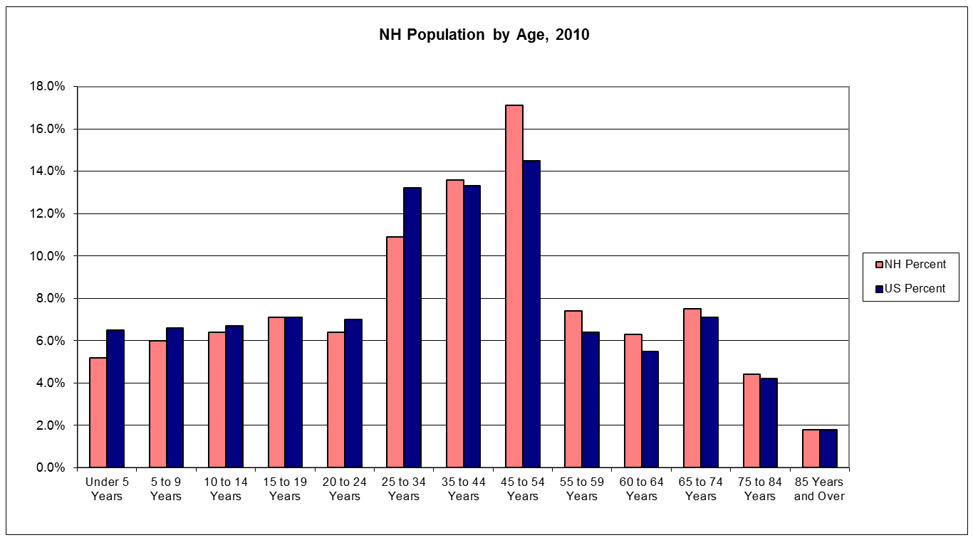
New Hampshire’s Population By Age Distribution

Slide 8
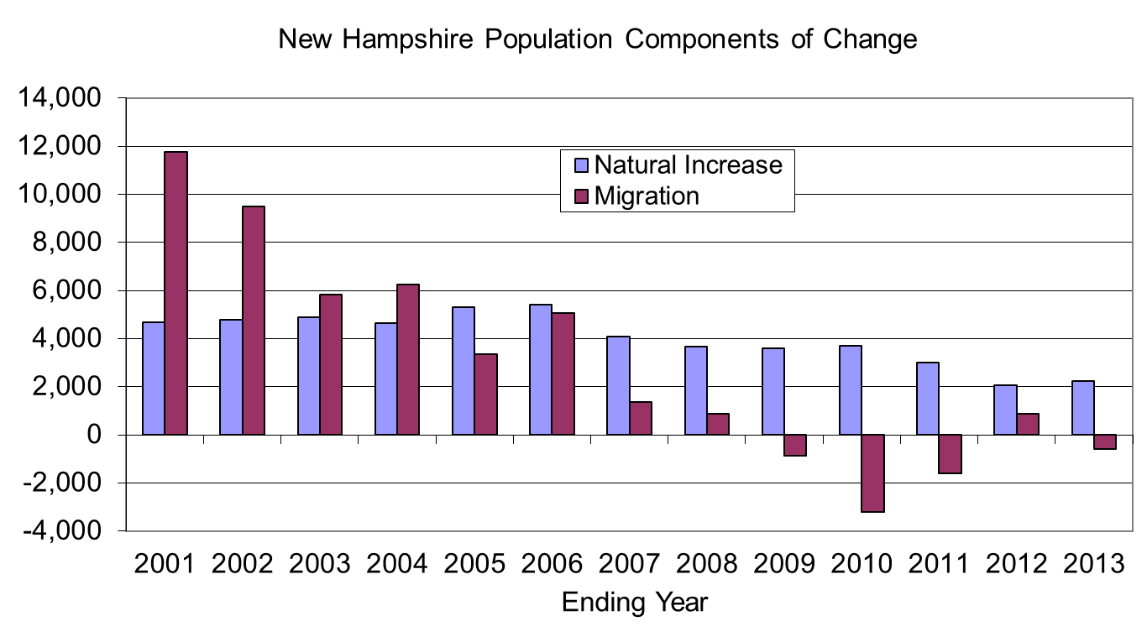
New Hampshire’s Population Change Pattern

Slide 9
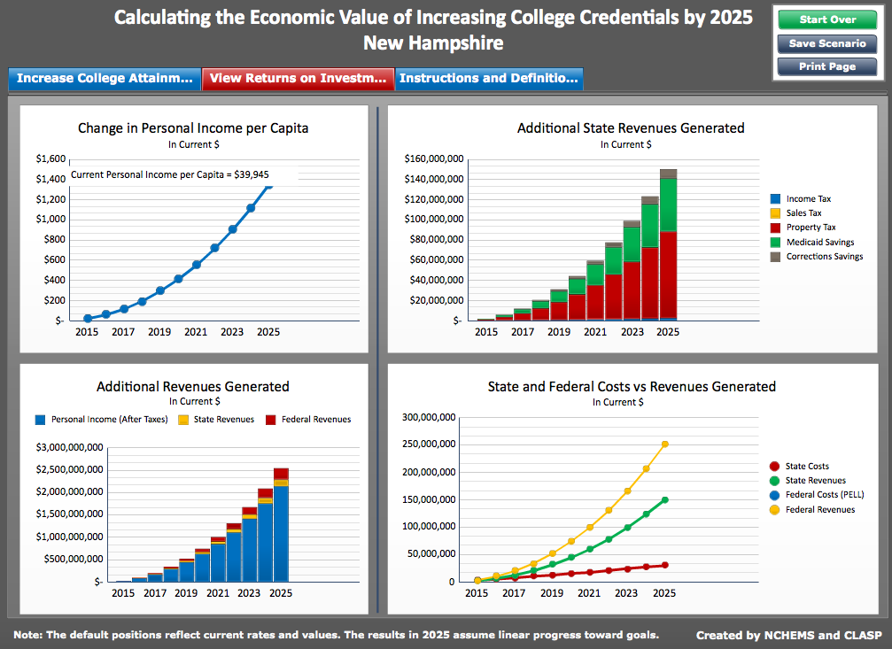
Return on Investment after Reaching Goal
Notes:
Reaching these figures for the state requires meeting the needs of jobs for postsecondary credentials.
To be clear, the path to these postsecondary credentials is through completion of meaningful secondary credentials.
But what we are holding ourselves accountable to in 2025 is reaching 65% with a high quality postsecondary credential.
From CEW:
Meeting the demand for educated workers will pay off in
higher wages for workers,
greater tax revenue for federal, state and local governments
reduced need for government aid programs.
more productive workers will boost employer profits and support higher rates of economic growth.

Slide 10
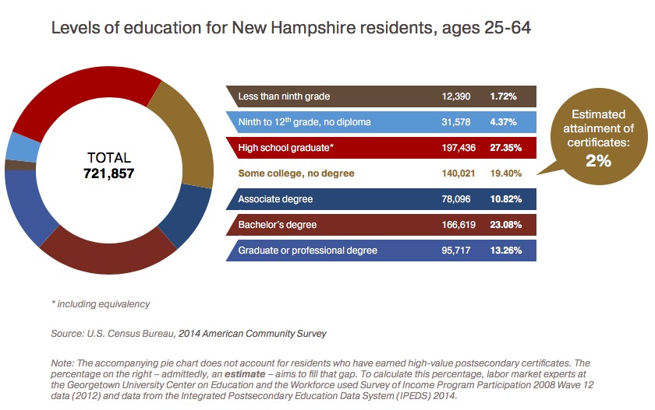
Focusing on Some College, No Degree
Notes:
NH has 140,000 with some college, no degree and another 197,000 with only a high school diploma.
Lumina, working with Georgetown Center on Education and the Workforce, estimate that 2% of our population has a ”good” certificate = means you’ve earned from a postsecondary institution, are working in the same field, and make 20% more on average (by gender) than you would life you only had a high school diploma.
We offer a broader definition of ”high quality credential” and actually estimate our rate of people with a sub-associate credential of value to be approximately 5%.

Slide 11
Progress Toward the Goal
% of NH adults 25-64 years old who hold an associates degree or higher
Source: American Community Survey
Notes:
Remember, however, that the path to 65% will include sub-associate credentials. Using the 5% mentioned on the previous slide, we estimate that NH is actually at approximately 53% now.

Slide 12

Defining “High-Quality Postsecondary Credential”
A ”high quality credential” is one that inspires an individual to deeper learning in a subject of their choosing, is valued by employers, and will be beneficial in the individual’s career or personal pursuits.
Finer Point
  New Hampshire Center for Public Policy Studies plans to work with the BIA to survey employers regarding what is valued.
  Additional surveys could be conducted to better understand needs of non-profits and individuals.
  Target timeframe for BIA survey is summer 2016.
Notes:
It has been suggested that the survey include for-profit and non-profit employers.

Slide 13
Measures of Success
Progress Measures (previously approved)
  Supply (credentialed workers) : Demand (jobs requiring postsecondary education) ratio
  Postsecondary Enrollment (% of high school graduates enrolling immediately after graduating)
  In-state Enrollment (% of resident students remaining in-state for college)
  Postsecondary completions (completions per 100 full-time equivalents )
  Proportion of 25-49 year olds enrolled (as percent of 25-49 year olds without a Bachelor’s degree)
Develop next level of progress metrics
  New Hampshire Center for Public Policy Studies intends to convene a working group to begin to identify state workforce development metrics that align with other statewide efforts.
  K-12 Pathways workgroup to develop measures to monitor progress toward every K-12 student obtaining a career related credential or degree

Slide 14
Number of Credentialed Adults Needed in NH by 2025: 454,019
2014
2025
Working-age adults (25-64 years old)
721,857
698,491
65%
Number of adults w/ associates or higher
340,432
Number of certificate holders
40,451
Total # of adults with credentials
380,883
454,019
53%
65%
Source: Census, NHOEP, IPEDS
Notes:
Aided by analysis provided by Steve Norton at the NH Center for Public Policy Studies and modeled off of TN. The 40,451 represent the 5% of certificate/credential holders in the state.
Georgetown projects that NH will need to fill 783,160 jobs. To be clear, these are total jobs, which are held by workers of all ages. People may also hold more than one of these jobs, so it is not a one-to-one fit.

Slide 15
Number of ADDITIONAL Credentials
Needed in NH by 2025: 83,819
Number of credentialed individuals
needed in NH in 2025
454,019
Estimated number of credentialed residents in 2025 at current attainment rate (53% of 698,491)
370,200
Total additional credentials NH needs to produce and retain by 2025
83,819
Source: Census, NHOEP, IPEDS

Slide 16
2013-14 NH Credentials Awarded by Sector: 20,768
Source: IPEDS
Notes:
For context, NH produces approximately 20,000 credentials per year. However, a significant proportion of SNHU credentials are awarded online to students that do not live in NH and have no intention of moving to NH.
54% private; 46% public; SNHU awards approximately 3,800 degrees to out-of-state online students annually. Thus realistic degree production base is roughly 17,000.
The group did not set higher education sector targets, but rather focused on population targets. This chart is simply to provide context for our current levels of production by our higher education sector.

Slide 17
Breaking Down 84,000 Credentials
How does NH begin to operationalize 84,000 to make it an actionable amount?
By Target Population
  Who are the populations that effect 84,000?
    Adults
      Approx. 340,000 adults with HS diploma or some college, no degree
    Traditional-age students
      Steadily declining population
    Migration
      Need to attract and retain adults with high quality postsecondary credentials

Slide 18
Breaking Down 84,000 Credentials
As one potential graphical representation, NH would need to increase the number of adults with high quality credentials by 1,867 per year to reach 84,000 by 2025
  Assumes each year that NH minimally produces the same number as the previous year and produces an additional 1,867 credentials
 |  |  |  |  |  |  |  |  | 1,867
 |  |  |  |  |  |  |  | 1,867 | 1,867
 |  |  |  |  |  |  | 1,867 | 1,867 | 1,867
 |  |  |  |  |  | 1,867 | 1,867 | 1,867 | 1,867
 |  |  |  |  | 1,867 | 1,867 | 1,867 | 1,867 | 1,867
 |  |  |  | 1,867 | 1,867 | 1,867 | 1,867 | 1,867 | 1,867
 |  |  | 1,867 | 1,867 | 1,867 | 1,867 | 1,867 | 1,867 | 1,867
 |  | 1,867 | 1,867 | 1,867 | 1,867 | 1,867 | 1,867 | 1,867 | 1,867
 | 1,867 | 1,867 | 1,867 | 1,867 | 1,867 | 1,867 | 1,867 | 1,867 | 1,867 | Grand Total
Annual Total | 1,867 | 3,733 | 5,600 | 7,467 | 9,333 | 11,200 | 13,067 | 14,933 | 16,800 | 84,000
Year | 2017 | 2018 | 2019 | 2020 | 2021 | 2022 | 2023 | 2024 | 2025
Notes:
This is one way to represent a possible path toward 65% by 2025. It may be more likely that the progression is a curve, whereby production may start off slower and pick up in out-years. However, this is one way to begin to understand the numbers that NH will need to aspire toward.

Slide 19
Breaking It Down by Target Population
 | Total | Annual Production (2017-25)
New Credentials Needed | 84,000 | 1,867
Target Populations:
Adults | 34,000 | 756
Traditional Age | 31,000 | 689
Net In-Migration* | 19,000 | 2,111
* This is an annual average in-migration of 25-64 year olds with a high-quality postsecondary credential (simply 19,000 divided by 9 years remaining until 2025). The methodology differs from the annual figures for adults and traditional age students, where the amount displayed is compounded each year.
Notes:
These figures can move or adjust, but the purpose is to begin to make 84,000 concrete and actionable.
34,000 adults are 10% of NH’s population with either only a HS diploma or some college, no degree
Traditional age population assumes a 2% increase in production across higher education – HE subcommittee expressed that this is a stretch but still doable, plus retaining another 2% in NH after graduation.
In-Migration – 19,000 = 2,111 annually WITH a postsecondary credential

Slide 20
Strategies to Achieve 65x25
Strong focus on engaging and supporting adults, in particular those with some college, no credential
  Not possible to achieve the goal with traditional age students alone
Strategies will require effort across multiple partners:
  High schools / CTE
  2- and 4-year postsecondary institutions; public and private
  Employers
  Government entities
  Non-profit organizations

Slide 21
Achieving 65x25
Goal | Strategies | Target Group | HS / CTE | 2-year HE | 4-year HE | Non-profits | Employers | Gov’t
Increase number of adults with high quality credentials | Adoption of focused prior learning assessments (PLA) Outreach to adults that started but did not complete a degree (“non-completers”) in NH Outreach to non-completers within 2- and 4-year institutions | Adults with some college, no credential |  | X | X |  | X
Attract and retain more individuals with high quality credentials in NH | Link students to internships, practicums and apprenticeships Support programs targeting young adults to live and work in NH Support efforts to enroll more out-of-state students Identify efforts to attract adults with high quality credentials to live and work in NH | HS and college students | X | X | X | X | X | X
Increase employer participation in efforts that support employees with continuing their education and completing their degree | Explore, plan and implement an employer initiative that supports this goal, such as Next Step Maine or other similar effort. | Adults |  | X | X |  | X
Notes:
NOTE:
These goals are not numbered by importance but simply for ease in reference.
The strategies are not prioritized. The work group did go through to identify the strategies that they believed deserved attention, but they did not rank order these.
In the next stages of work, this is something that should be considered.

Slide 22
Achieving 65x25 (cont.)
Goal | Strategies | Target Group | HS / CTE | 2-year HE | 4-year HE | Non-profits | Employers | Gov’t
Improve career pathways | Develop sector-specific workforce education pathways | Adults with some college, no degree | X | X | X |  | X | X
Increase number of NH high school students attending college in NH | Facilitate achievement of initial credentials in HS Support dual enrollment programs (e.g., Running Start, early college programs) Expand competency-based learning Expand experiential learning | NH high school students | X | X | X |  | X
Improve postsecondary persistence and completion | Implement policies and programs that reduce time to credential and removes barriers to completion, including: Guided pathways Block scheduling Structured schedules Full-time is 15 credits Co-requisite remediation courses Implement outreach program to contact students who have failed to register on-time Develop robust transfer programs | All students with focus on working adults/non-traditional students/low skilled workers |  | X | X

Slide 23
Achieving 65x25 (cont.)
Goal | Strategies | Target Group | HS / CTE | 2-year HE | 4-year HE | Non-profits | Employers | Gov’t
Increase affordability | Student loan forgiveness partnerships for employees/ educational benefit Support scholarships for target groups Support increase in state funding for higher education | Adults with no credential; traditional age NH students |  | X | X |  | X | X
Notes:
The workgroup also developed a spreadsheet of programs/efforts underway that align to each of these goals and strategies.
One suggestion is that some high priority initiatives could be:
Guided Pathways
Strengthening STEM foundations
Personalized learning plans (starting in middle school)
Early colleges
Work-based learning

Slide 24
Structural Support to Sustain 65x25
A visible and credible business-led initiative that:
  Has a steering committee comprised of representatives from partner entities in order to set overall goals and strategies for implementing recommendations from the 65x25 work groups
  Has staff able to carry out strategies
  Includes a public report-out mechanism to inform on progress toward goals
  Develops and implements a communications/marketing plan
  Is a source for collecting and interpreting data
  Has sufficient corporate/foundation support to hire staff and secure data collection

Slide 25
Recommendations of the 65x25 Workgroup
To approve:
  Definition of a high-quality postsecondary credential
  Target populations and number of credentials to get to 65x25
  Strategies to reach 65x25
  Structure to support and sustain statewide effort to reach 65x25

