Slide 1
NH Computing Education
Landscape Report
Notes:
Not going to make the case for CS education today – assume you already know it is critical to the future success of our students and business
Funding was provided through ECEP – Expanding Computing Education Pathways, a National Science Foundation project involving 17 states, NH is one of them
Assess NH computing education
Produce baseline information in secondary education, higher ed and business and industry
The report also recommends actions for all stakeholders
Computer science education aligns with 65x25

Slide 2
Notes:
Thanks WSJ for helping me make my point!!

Slide 3
Landscape Report
Three critical areas:
Secondary education
Post-secondary education
Business/industry

Slide 4
Secondary Education
NH public high school students: 57,422
Student Enrollment: 12,446
High Schools & CTE Centers: 85
Courses Offered: 927
Notes:
A statistically significant survey of NH high schools and colleges – lots of courses being offered that are “computer-related”
These definitions were not clear and a lot of work was done to categorize them

Slide 5
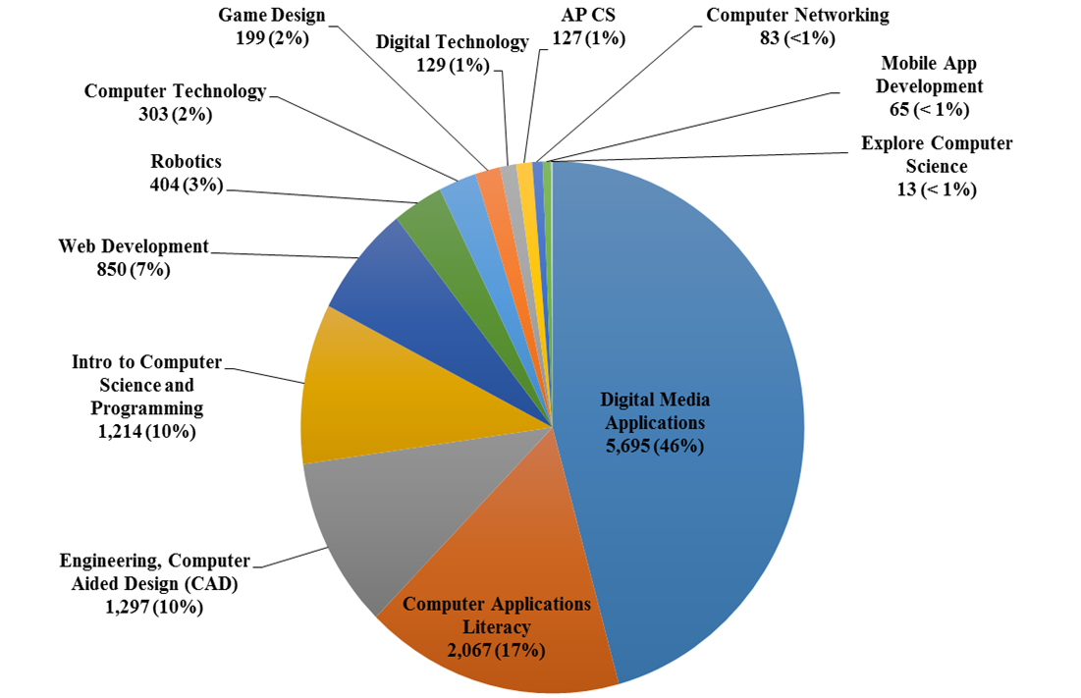
Enrollment in computing-related classes by subject categories
Notes:
We knew AP CS would be very low in NH.
63% of the students in the study are participating in the largest categories of “computer” courses
Digital Media (computer animation, video production, digital media arts, graphic design)
Computer Applications Literacy (intro to computing, computer applications, computer literacy, digital literacy, software applications)
This is a great place to start integrating computer science into the on-going courses.

Slide 6
Post Secondary Education
25 institutions of higher education were surveyed
18 show graduates in computer programs
In 2016 - 260 bachelor’s degrees were granted
51 graduates or 19.6% were women

Slide 7
Business & Industry Focus Group
Business and industry representatives indicated the technology skills IMPORTANT and ESSENTIAL for any individual entering the workforce are:
Strong human relations skills
Willingness to learn - Life-long learners
Understand why technology is relevant
Competent in basic technologies
Notes:
Previously, businesses have been asked what IT Skills do they need in their company: web services, C#, foundational network concepts, network security. For our business focus group we asked the participants this question.
This is consistent with what we have heard over the last several years, talking to businesses
Special Note: In the original 17 ECEP states, several conducted landscape studies. NH was the only state to include business and industry!

Slide 8
Recommendations
Develop a more efficient way to access and collect data about computing education in NH.
Reclassify courses to distinguish between computer science and computing-related courses.
Develop K-12 CS pathways following the K-12 Computer Science Framework and NH Business and Industry’s skills that are important and essential for All NH Students.
Publish NH school districts’ progress toward NH K-12 CS Standards Implementation.
Notes:
There are a number of recommendations, in no particular order, in the report and a lot of the work is in progress already.
CS4NH has a state plan – we are happy to share – which tracks the progress on our priorities and aligns with many of the recommendations in this report

Slide 9
Recommendations
Provide training and materials for all teachers to integrate NH K-12 CS Standards into all existing courses, with initial focus on those teachers teaching in subject areas: Digital Media Applications, Computer Applications and Web Development
Market computer science career information to students enrolled in subject area: Digital Media Applications, Computer Applications and Web Development.
School districts integrate skill building in critical thinking, collaboration, communication and creativity into all courses.
Notes:
There are a number of recommendations, in no particular order, in the report and a lot of the work is in progress already.

Slide 10
Recommendations
Focus on enrolling more young women in CS.
Local business, industry and education representatives meet regularly to ensure that business needs are being met and that NH students graduate career/college ready with the technology skills important and essential for ALL NH Students.
NH teacher preparation programs integrate NH K-12 CS Standards at all grade levels.
Notes:
There are a number of recommendations, in no particular order, in the report and a lot of the work is in progress already.

Slide 11
Landscape Report
For further information about CS4NH work or the NH Computing Education Landscape Study and Report, please contact:
Dr. Rosabel Deloge (Rosie)
Chair, CS4NH
rosabel.deloge@gmail.com
Terry Wolf
Vice-Chair, CS4NH
terrywolfnh@gmail.com
Notes:
The report can be emailed to the group
Questions?

