Slide 1

Workforce Development
Solutions Reporting

Slide 2
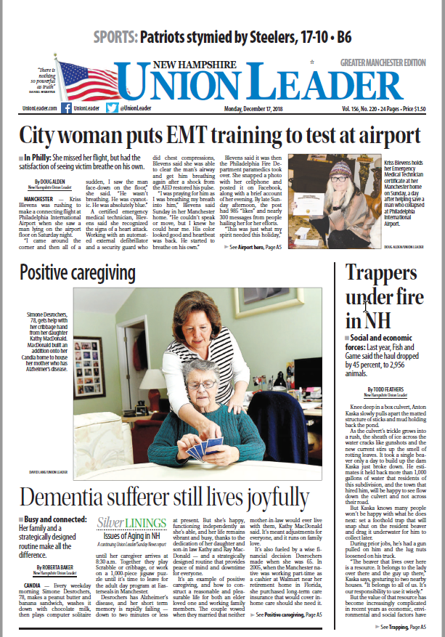

Solutions Journalism Series
FUNDER
Endowment for Health

Slide 3
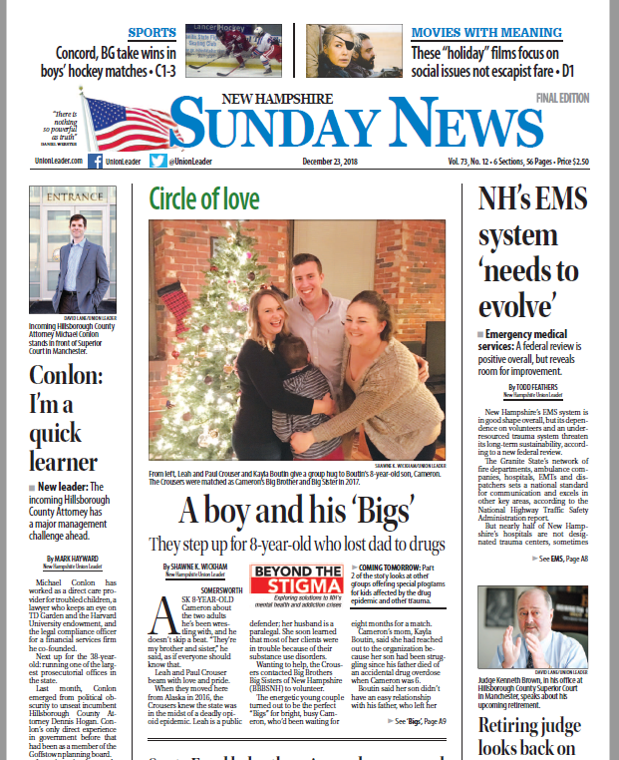

Solutions Journalism Series
FUNDERS
NAMI-NH National Alliance on Mental Illness
Dartmouth-Hitchcock
New Hampshire Charitable Foundation
Private Donors

Slide 4
Solutions Journalism
In-depth focus on a response to a problem and how the response works in meaningful detail
Focuses on effectiveness, not good intentions, presenting available evidence of results
Discusses the limitations of the approach
Seeks to provide insight that others can use
Solutions Journalism Network

Slide 5
Solutions Journalism
Do
Don’t
Explore mutual goals
Get your Board up to speed early
Draw up a good “pre-nup”
Connect reporter with experts
Cross the firewall of editorial independence
Dictate coverage to the editor or reporter
Confuse journalism with framing
Expect to agree with every headline

Slide 6
Why SoJo?
Attracts new audience & strengthens engagement
(Sunday/166,000 readers Daily/140,000 readers)
Facilitates the flow of information and strengthens accountability
Helps restore trust
Understandable language
Subject matter experts
Connects the dots so NH understands why this is an important issue pen Hangout

Slide 7
Workforce Development Solutions
Two-year reporting project
Full-time reporter, plus travel
$140,000
Seven donors @ $10,000/year over two years
Union Leader provides editing, multimedia and administrative costs/ $7,000 year
Tax deductible donation to Nackey S. Loeb School of Communications
Donors are disclosed at the bottom of each story
pen Hangout

