Slide 1

Essential Skills and NH PACE
Paul Leather, Director, 4 State Performance Assessment Project, Center for Innovation in Education, University of Kentucky
&
Ellen Hume-Howard, Executive Director, New Hampshire Learning Initiative
New Hampshire Learning Initiative

Slide 2
NH Research Practice Partnership – Multi-year, Multi-Partner Group funded by the Hewlett Foundation
Partners:
Design:
Jobs for the Future
NH Learning Initiative
4 NH School Districts:
Souhegan HS
Sanborn RSD
Rochester SD
Epping SD
Center for Innovation in Education
Demonstrate Capacity to SCALE the reliable use and assessment of Essential Skills through Common PACE Assessments
Start with:
Social Studies Common Performance Tasks and Self-Direction
4 Original HS -- Social Studies Teachers
Scale across State and all Content Areas

Slide 3

Two Big Bets:
Dr. David T. Conley, University of Oregon
“I can create a developmental progression for Essential Skills for grades K-12.”
2. “NH Educators and Students can reliably demonstrate success skills as part of PACE common performance assessments.”

Slide 5
Components of Self – Direction:

Slide 6
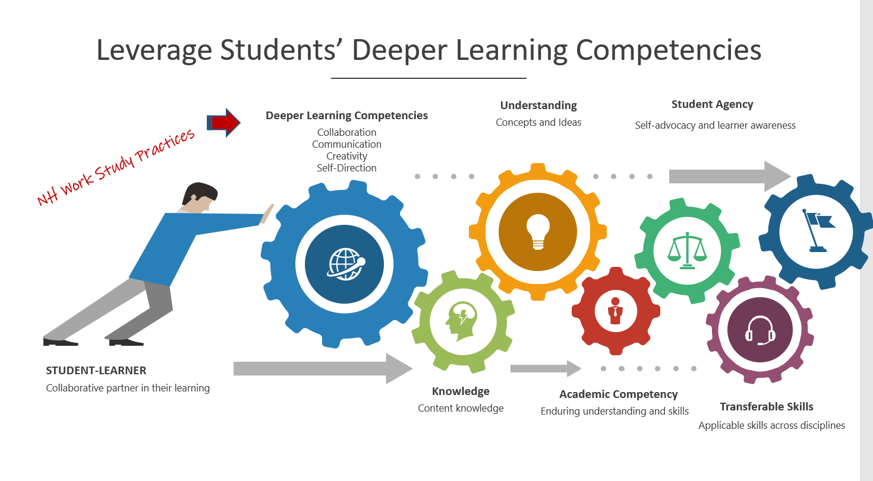

Slide 7

NH PACE
How are WSPs (same as Essential Skills) embedded in tasks?

Slide 8
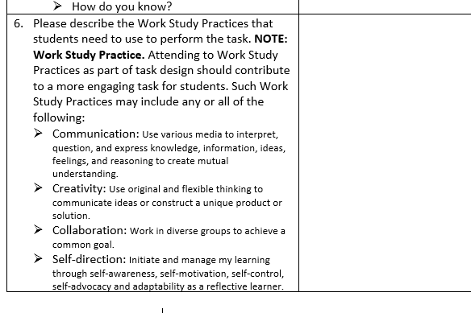
Work Study Practices in PACE Template
Work Study Practices embedded in an assessment
K-12 progression; student goals; clear expectations from teachers; system approach
Connected to a quality product and experience as a result of WSPs
Competency driven; evidence collected to demonstrate progress
WSPs go beyond classroom assessments and activities

Slide 9
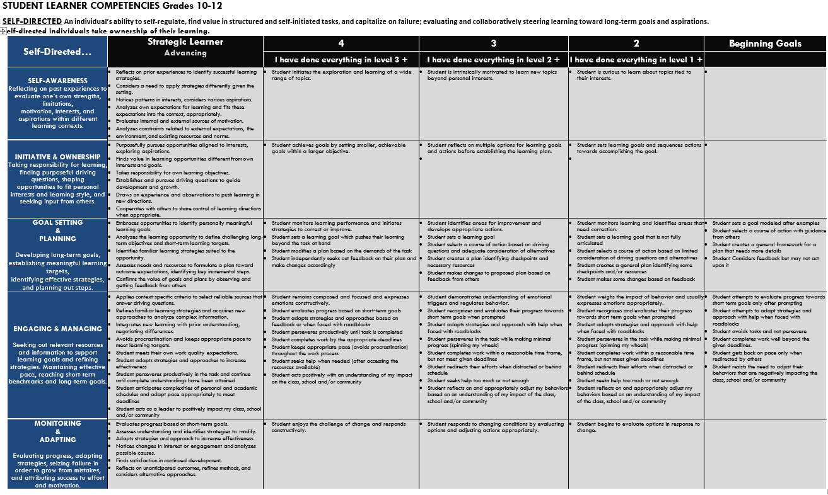

Slide 10
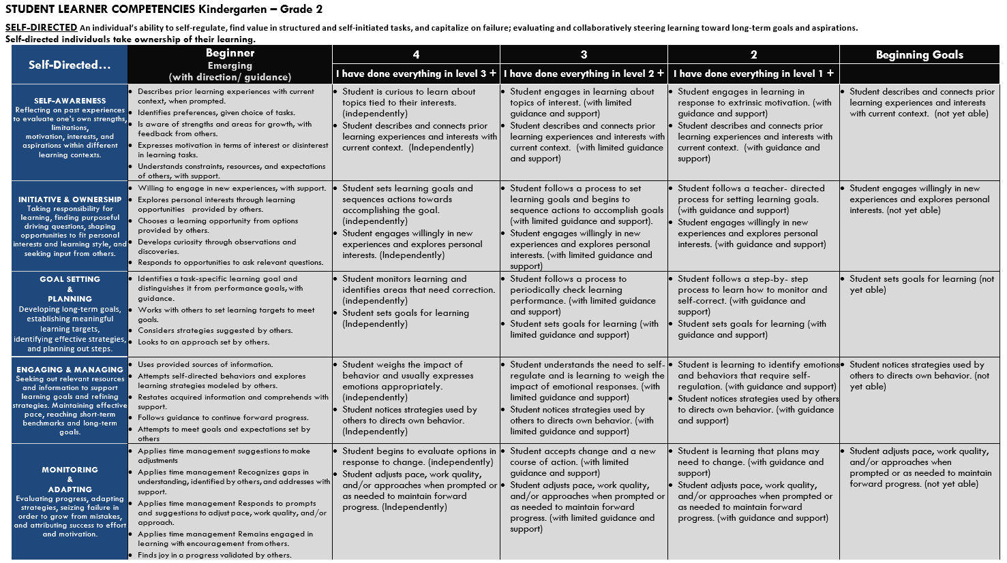
Criteria K-12
Translated into student friendly language
Rubric
Building on positive gains
Developmentally Appropriate
Goals based on child development in grade bands

Slide 11
Mathematics
Grade 5 SPEED STACKING CHALLENGE In this performance task, students will be engaged in speed stacking activities to connect real-world experiences to their math work with decimals. Students will work collaboratively to collect data in the form of decimal fractions and then independently interpret their own, as well as additional given data, to solve real-world problems in the context of speed stacking competitions.
High School Geometry WATER TOWER In this performance task students are asked to calculate and analyze surface area and volume and compare their results between various geometric figures: Your town’s population is predicted to increase over the next 3 years. As one of the town planners, you are asked to address this issue in terms of the town’s water supply. In order to meet the future needs of the town, you need to make a proposal to add a water tower somewhere on town property that will be capable of holding 45,000 ± 2,000 cubic feet of water. The town is looking for a water tower to contain the most amount of water while using the least amount of construction material. Communication Presentation

Slide 12
ELA
Grade 5 SHRUNKEN CHRONICLES In this performance task, students will be asked to write a narrative writing piece in response to the following prompt: “Oh no! Something has gone horribly wrong and you and a friend have suddenly been shrunk to the size of an ant! How are you going to show through first person narrative your adventure with your friend to become life size again by the end of the school day? “ Communicating through another’s point of view.
Grade 9 Students will write a series of a first person narrative journal entries which include a narrator who is dealing with a social issue, using their knowledge from research, a text they have read, and/or personal experiences. Students will create three or more journal entries that tell the story of how their character deals with the issue and their growth over the course of their journals. Interviewing peers

Slide 13
SCIENCE
Grade 8 PENGUIN PAD DESIGN In this performance task, students will be asked to create a solution for the penguin problem.
Penguins are in peril. As the Earth warms, the oceans warm, pack ice melts, and penguins lose habitat. They also lose food sources such as krill, which rely on the protection of pack ice and feed on the algae that grow underneath the ice. South African penguins are actually leaving their nests to cool off in the water, placing their eggs at risk to attacks by gulls. Park rangers at Boulders Beach in Cape Town, South Africa, have created little semi-enclosed “huts” for penguins to nest in, which keep them cooler and protect their eggs from predation. However, these huts are very expensive and the penguins are still getting overheated. The World Penguin Authority has selected you to compete in a penguin house building challenge. Your task is to create a model for a penguin pad that is cost-effective and reduces heat transfer. During this challenge you will need to design three solutions, build and test one solution, and then improve on your chosen design to make it more efficient.” Creativity

Slide 14
SCIENCE
Grade 4 CODE CREATORS In this performance task, students will be asked transfer information to a classmate across the classroom. You cannot go over to them or speak to them directly. Your job is to develop a way to transfer secret information you want to share with your classmate. Collaboration-Communication
Grade 9 Physical Science HIGH ROLLERS In this performance task, students will be asked to apply what you have learned about energy, energy transfers, and science process skills (data collection and data analysis) to design and test a track system with one or more balls that will allow a ball to have the greatest vertical displacement Collaboration

Slide 15
NHLI’s College and Career Pathway Engine
Personalized Learning Pathways for Student Success
Student Success
Personalized Learning Pathway leads to successful career and workforce opportunities.
Career & College Technical
Disciplines and Skills
STEM & Advanced Manufacturing
Industry & Transportation
Life & Health Science
Hospitality & Culinary
Career & College
Disciplines and Skills
Business, Finance, Accounting
Arts, Humanities, Communication
Behavior Sciences
K-12 Competencies
Academic Content and Knowledge
Mathematics, Science, Technology
English Language Arts, Social Studies
World Language Physical Education, Wellness, Art , Music
Career & Work Force Experiences
Disciplines and Skills
Apprenticeships, Externships-Internships
Extended Learning Opportunities (ELOs)
Certification
NH
Learning
Initiative
Habits of Success
Skills and Dispositions
Collaboration, Communication, , Creativity, &
Self-Direction, Leadership, Critical Thinking,
Problem-solving, self-advocacy

